Slide 1
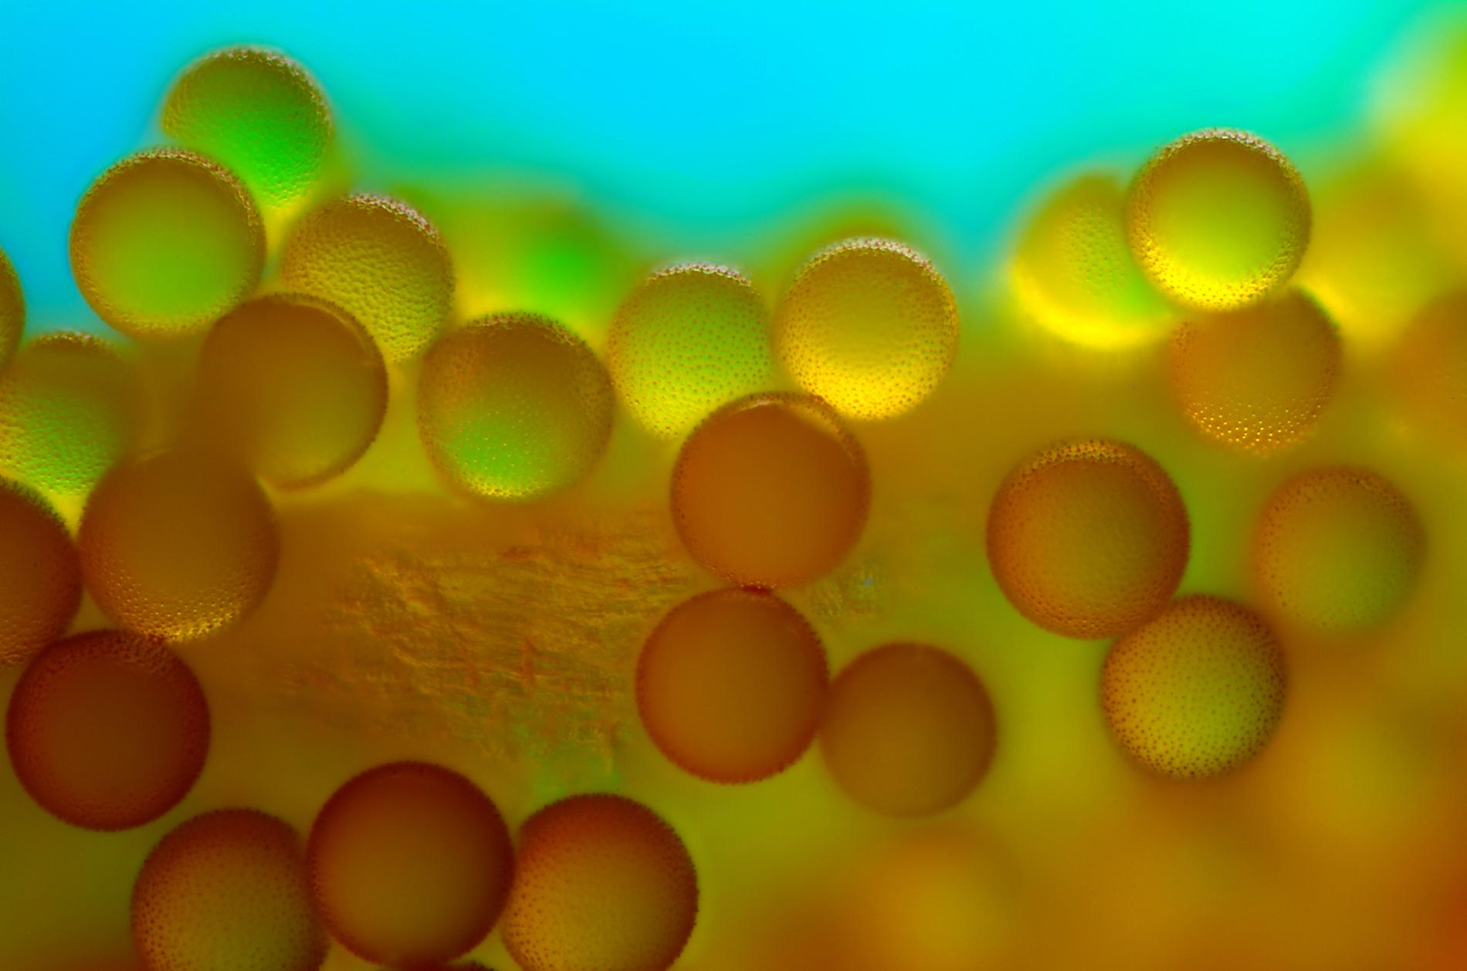
Characteristics of LIFE
Notes:
These dreamlike spheres are pollen grains from the Crocus, a genus of flowering plants in the iris family.

Slide 2
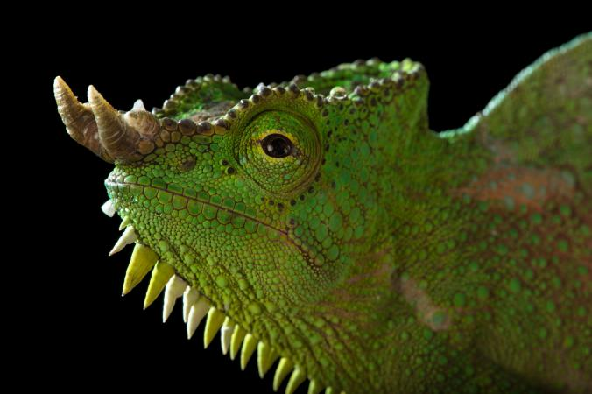
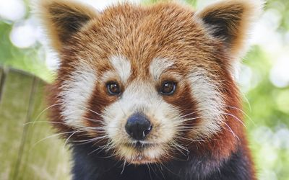
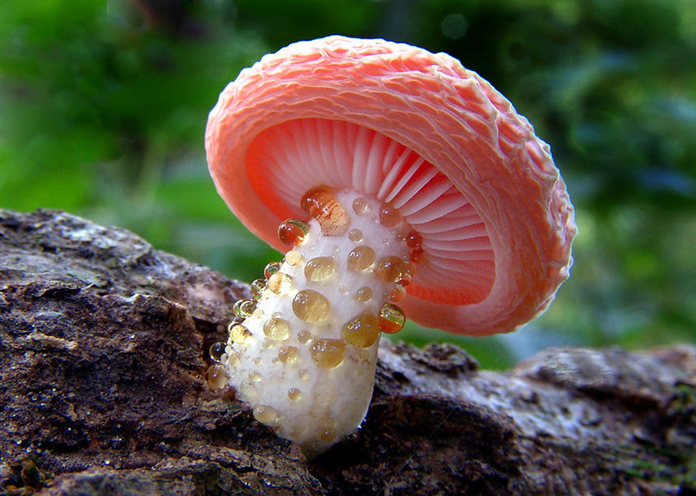
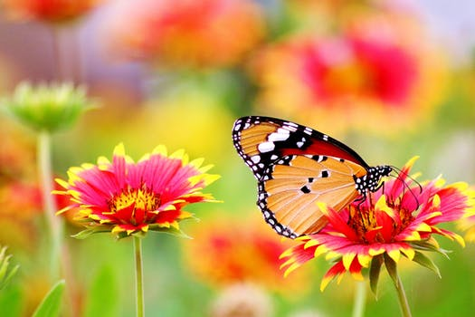
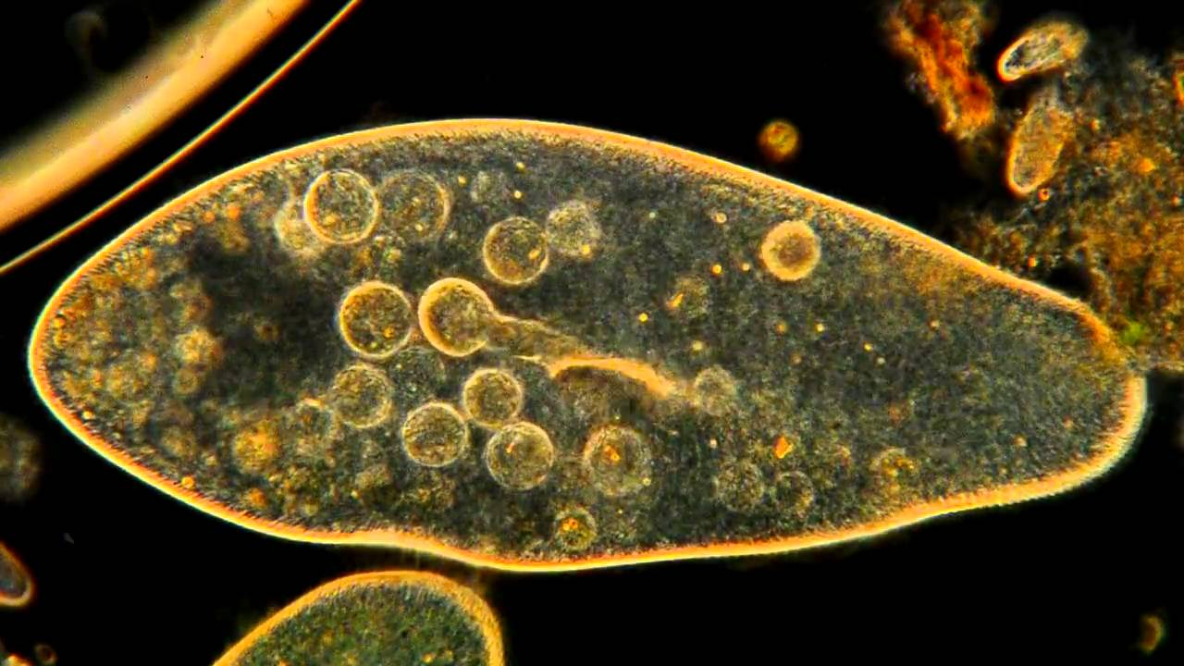
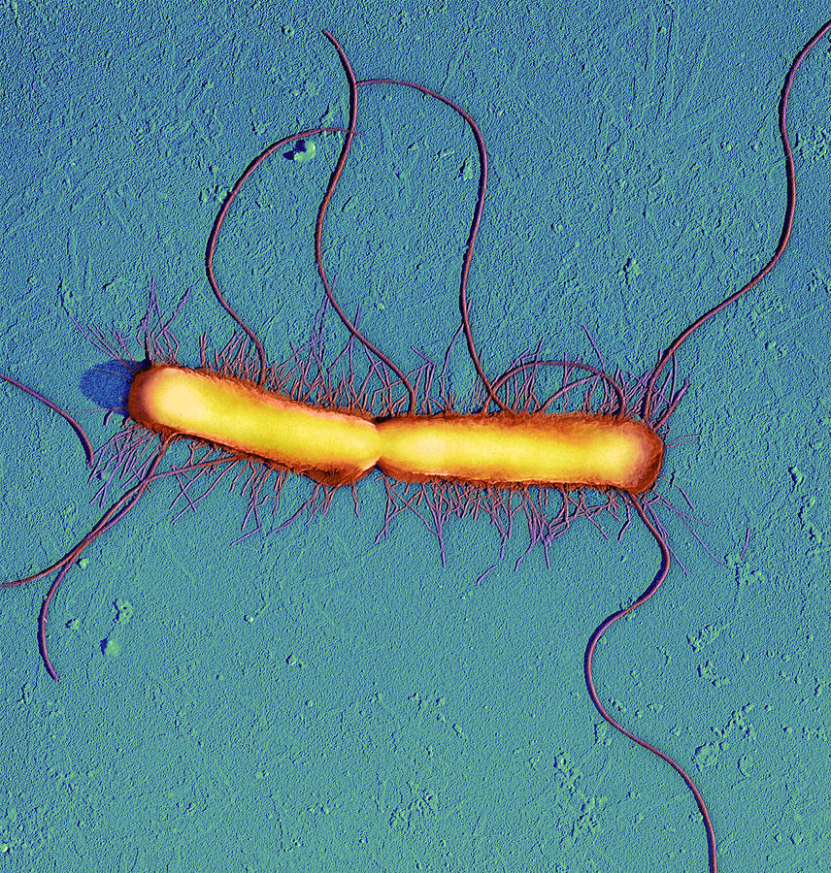
What is Biology?
Bio = Life
-ology = study of
Biology = The Study of Life
Notes:
Both derive from Greek

Slide 3
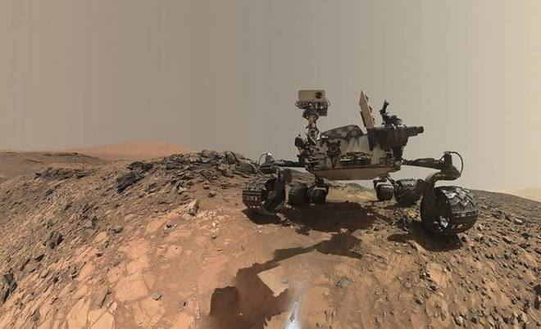
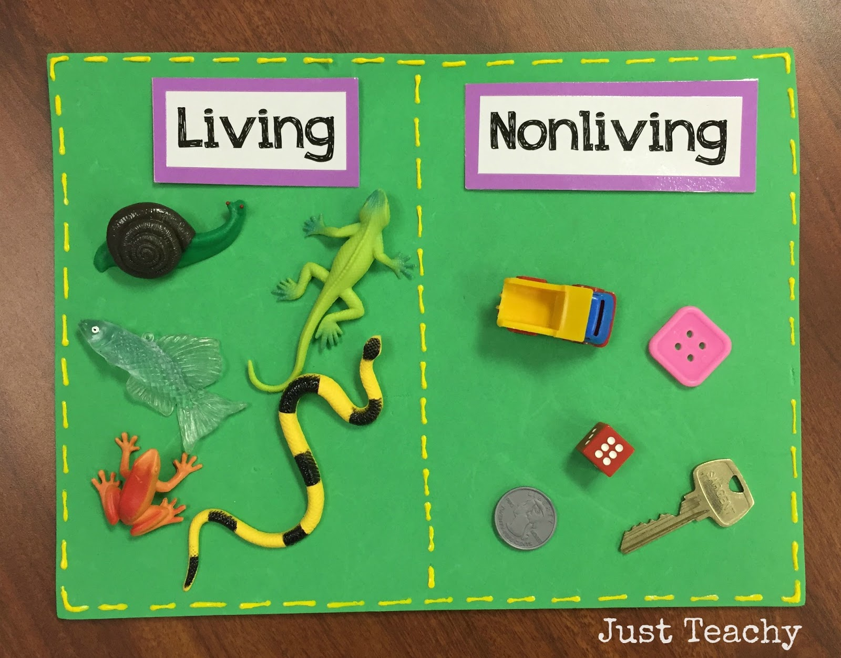
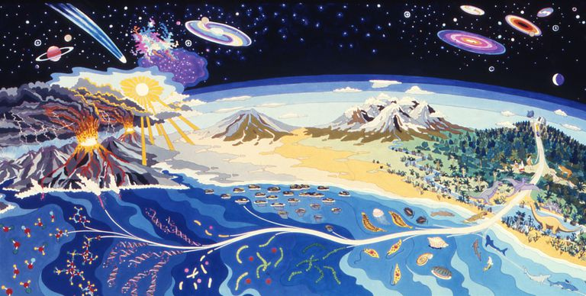
Why Might it be Important for Scientists to Agree on a Definition of Life?
Notes:
See if students can guess what the pictures are representing.
The one on the left is obvious, it helps us sort living from nonliving objects. It also allows us to look for patterns in living things.
Upper right, it could help us in identifying extraterrestrial life.
Lower right, it could help us in understanding the origins of life.
It is important to note, that ironically scientists still can’t agree on a common definition of life. The 8 characteristics we have chosen may be slightly different if you asked another biologist.

Slide 4
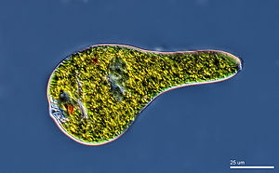
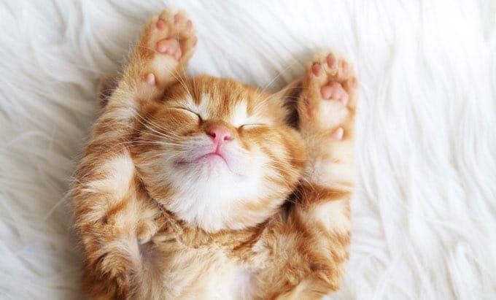
#1: All Living Things are Made of Cells
Cells are the smallest things considered alive.
Living organisms can be made of 1 or more cells.
Unicellular:
Made of 1 cell.
Multicellular:
Made of more than 1 cell.

Slide 5
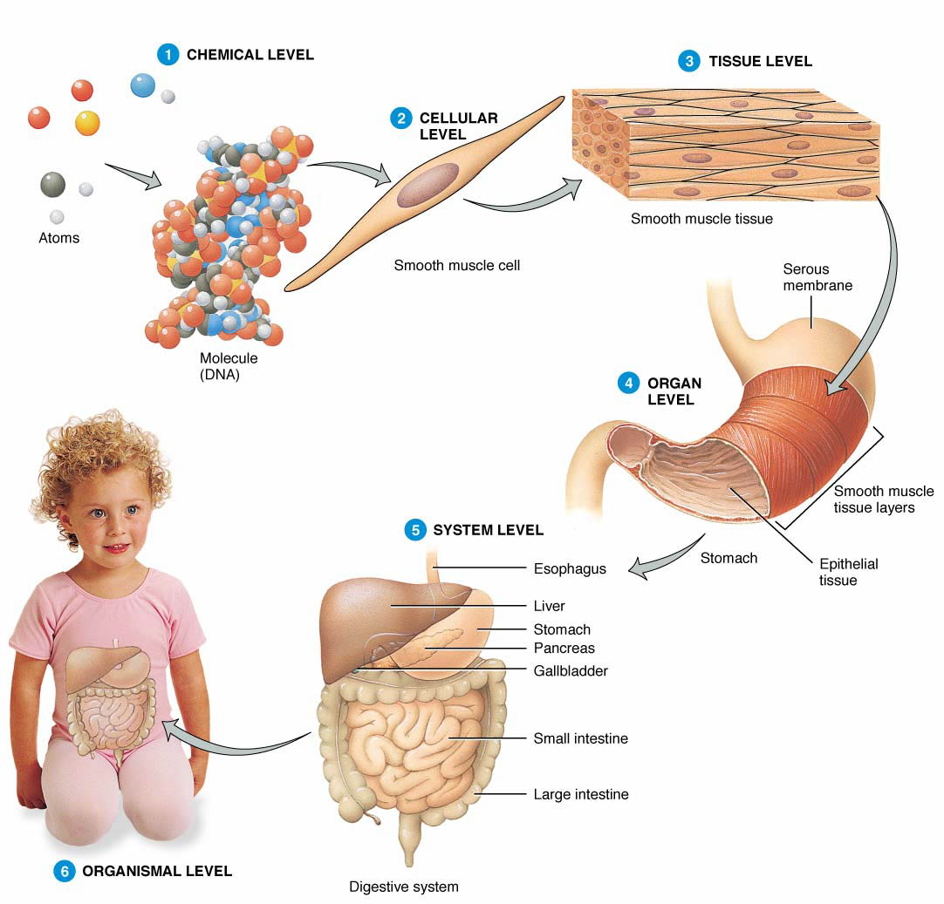
#1: All Living Things are Made of Cells
Cells are NOT the most basic unit in an organism, just the simplest living thing.
Cells are still made up of atoms like all other matter in the universe.
Notes:
Ask students: what makes up cells? What is a molecule?
What do cells make up?

Slide 6
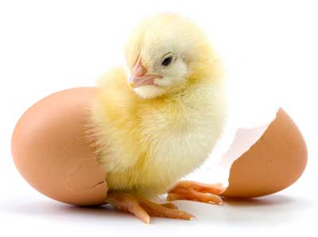
#2: Reproduction
All organisms can produce new organisms through a process called reproduction.
This is the ultimate goal of any living thing.

Slide 7
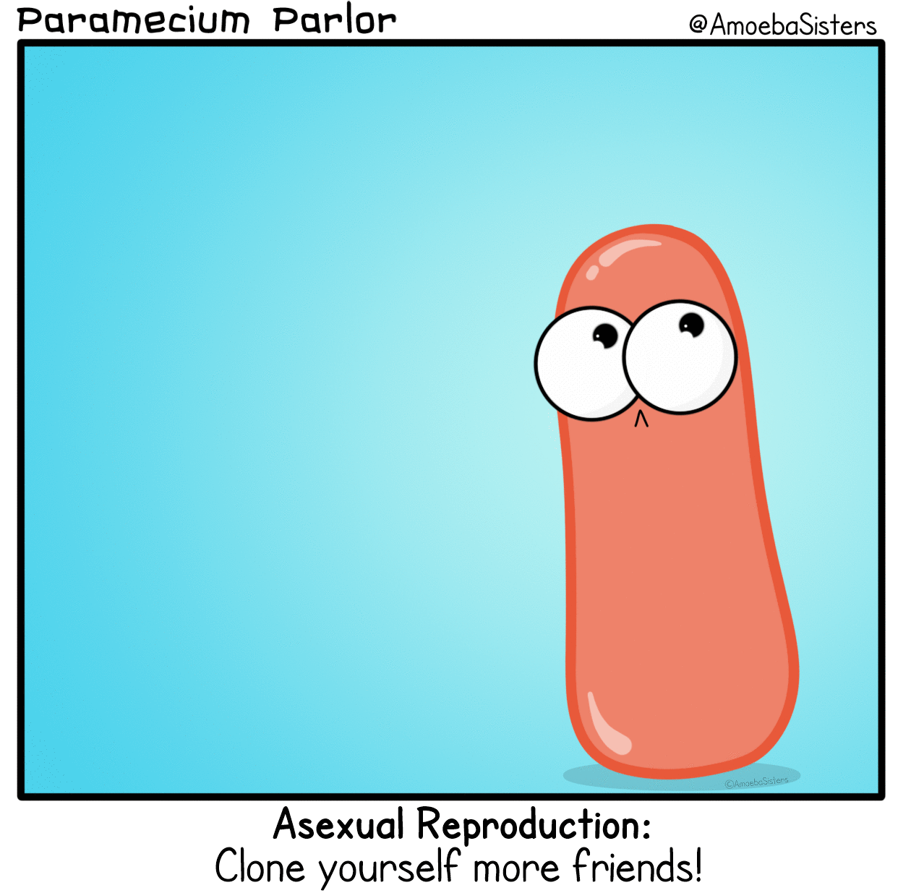
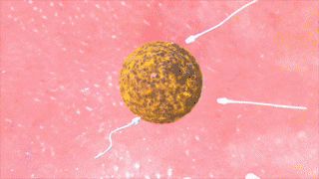
#2: Reproduction
There are two basic kinds of reproduction:
Asexual:
Involves only one parent. The parent produces an identical copy of itself as offspring.
Sexual:
Involves two parents. The offspring has genetic material from both parents.
Notes:
All unicellular creatures do asexual reproduction.
Multicellular creatures do asexual reproduction to repair tissues (mitosis), but most are also capable of sexual reproduction.

Slide 8
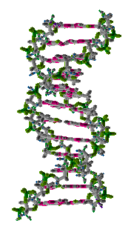
#3: Uses DNA as Genetic Material
Offspring always resemble their parents.
This resemblance is due to genes that are inherited or passed on.
The biological molecule responsible for this inheritance is DNA.

Slide 9
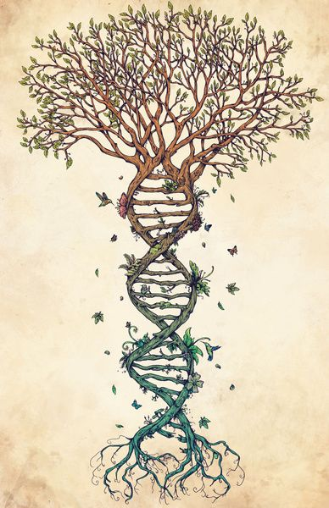
#3: Uses DNA as Genetic Material
All living things have DNA & and use it in the same way.
In fact we can trace the DNA of every organism on Earth back to the first living thing.
Notes:
The oldest fossils found show life existed on Earth nearly 4 bya.

Slide 10
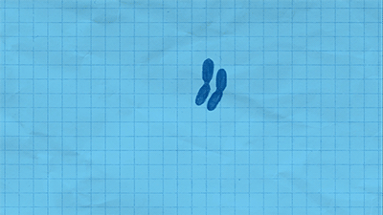
#4: Growth and Development
All living things grow during at least part of their lives.
For unicellular creatures like bacteria, this usually means just an increase in size.

Slide 11
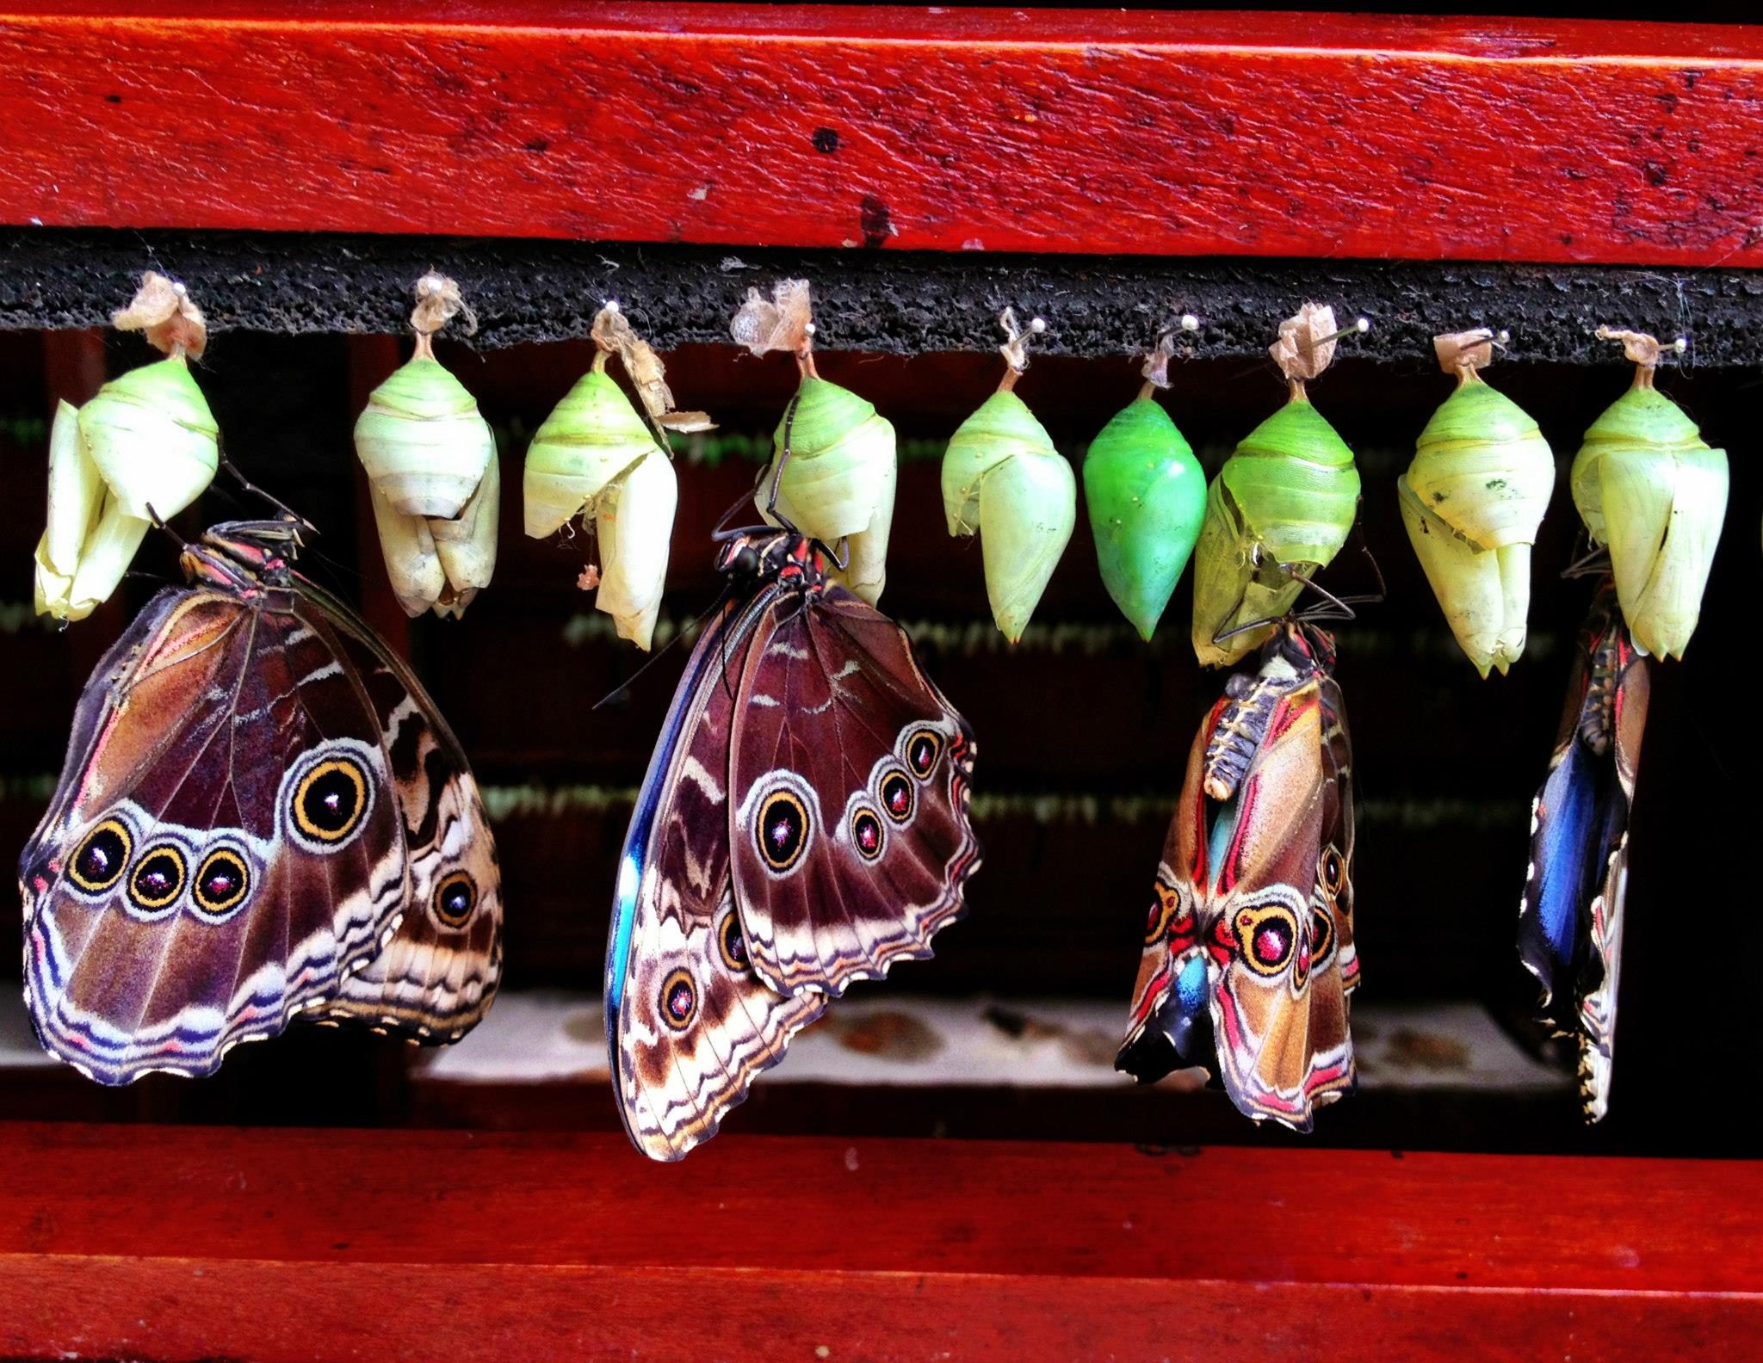
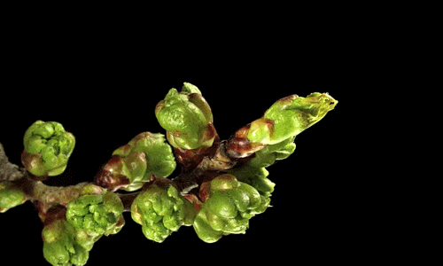
#4: Growth and Development
Multicellular creatures grow through a process called development to produce the many cells of a mature organism.
These cells can have different forms and functions and as they divide they can change in shape and structure.
Notes:
Production of different cells with specific functions is called differentiation.

Slide 12
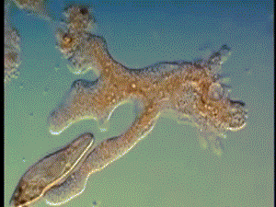
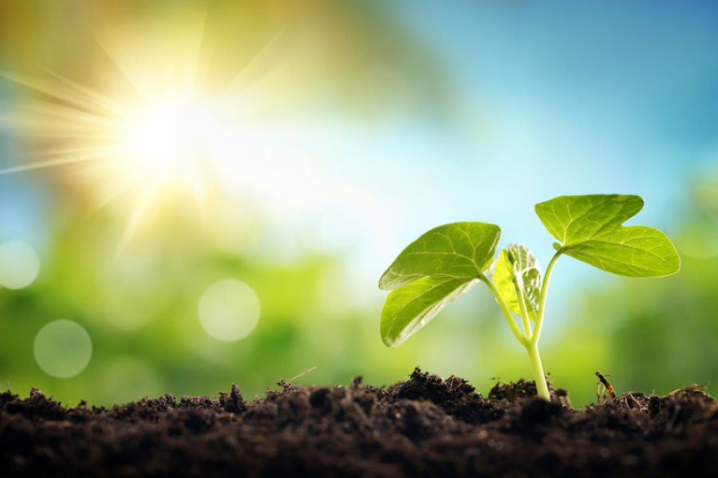
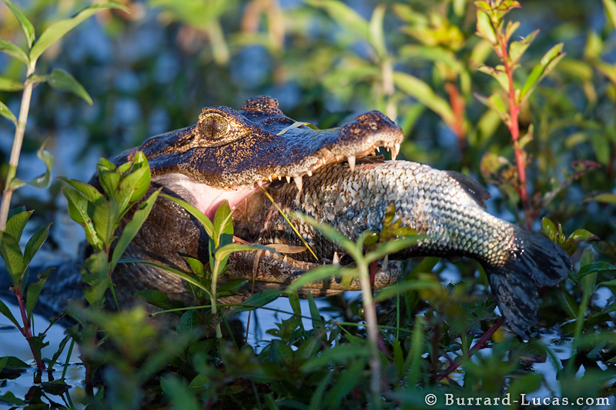
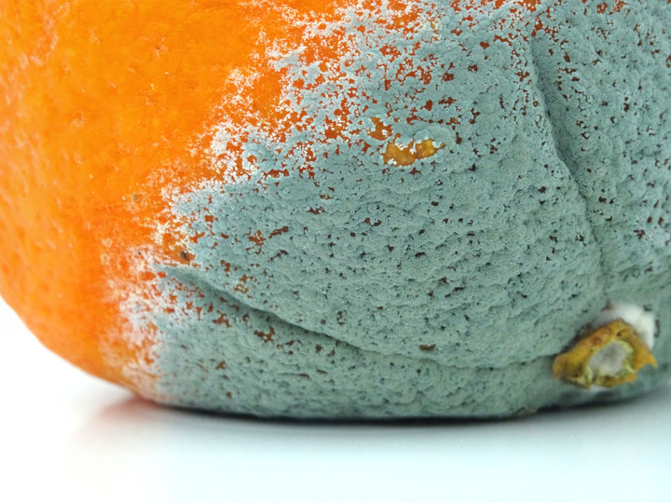
#5: Need for Materials & Energy
As an organism grows and develops it needs raw materials and energy to make new cells and keep existing cells alive.
There are a variety of ways that organisms obtain energy.

Slide 13
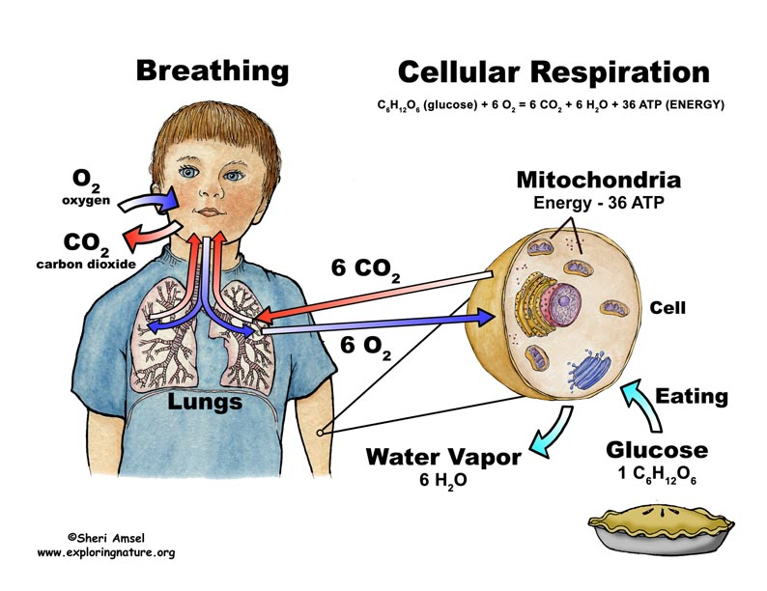
#5: Need for Materials & Energy
All living organisms perform a variety of chemical reactions to keep themselves alive known as metabolism.

Slide 14
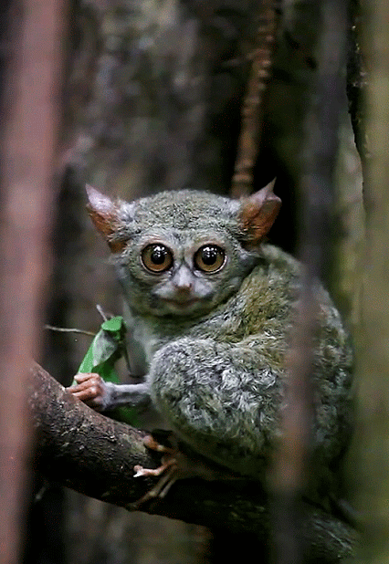
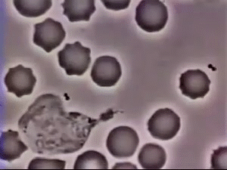
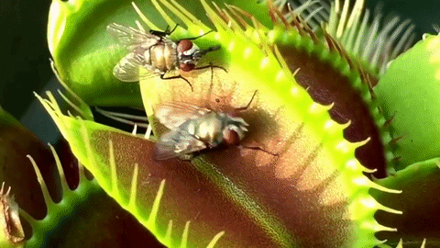
#6: Response to the Environment
All organisms can detect and respond to stimuli (signals) both internally and externally.

Slide 15
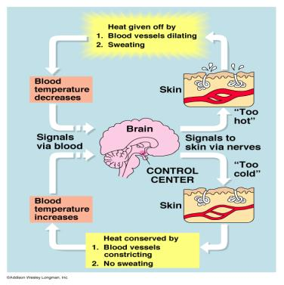
#7: Maintaining an Internal Balance
Even though external conditions may vary widely, most organisms must keep their internal conditions (body temperature, water content) fairly constant.
Think about when it gets hot outside… How does your body respond to keep your core body temperature constant?

Slide 16
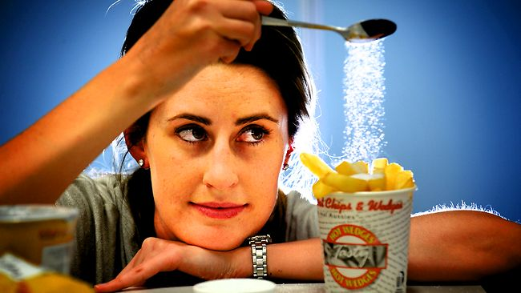
#7: Maintaining an Internal Balance
Maintaining constant internal conditions is known as homeostasis.
How might homeostasis help you maintain a stable, internal water balance if you were to eat something really salty?
What if you drank way too much water?

Slide 17
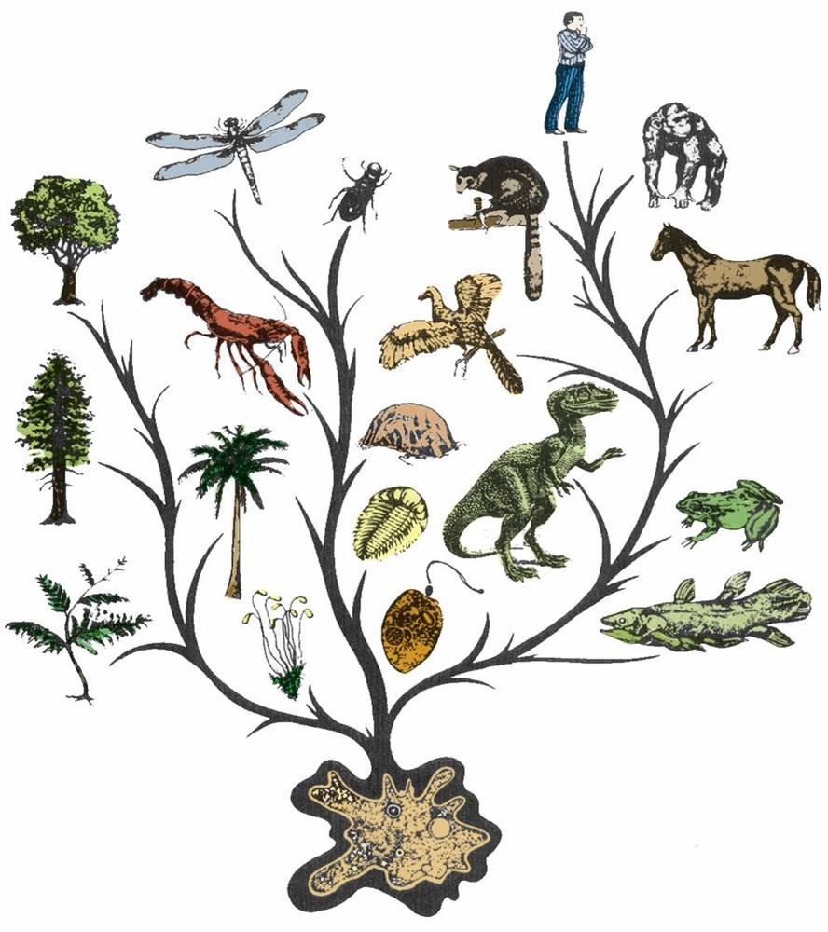
#8: Evolution
Evolution is just change over time.
In the case of biological evolution, this explains how populations of species change over time to become new species.
Though individuals cannot evolve, groups of individuals of the same species can.

Slide 18
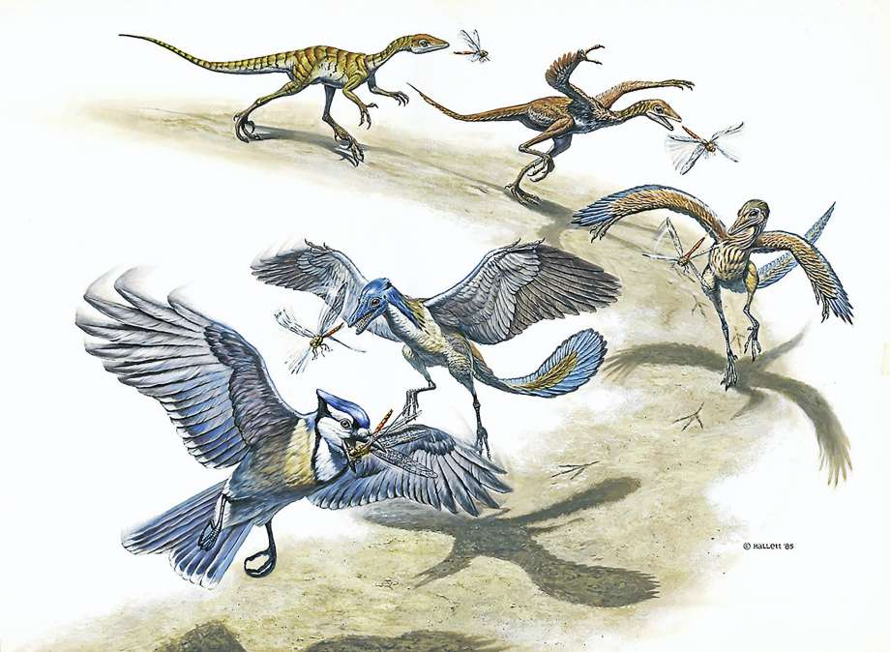
#8: Evolution
Species are therefore able to evolve and adapt to changing environments.
If they cannot, these species go extinct.

Slide 19
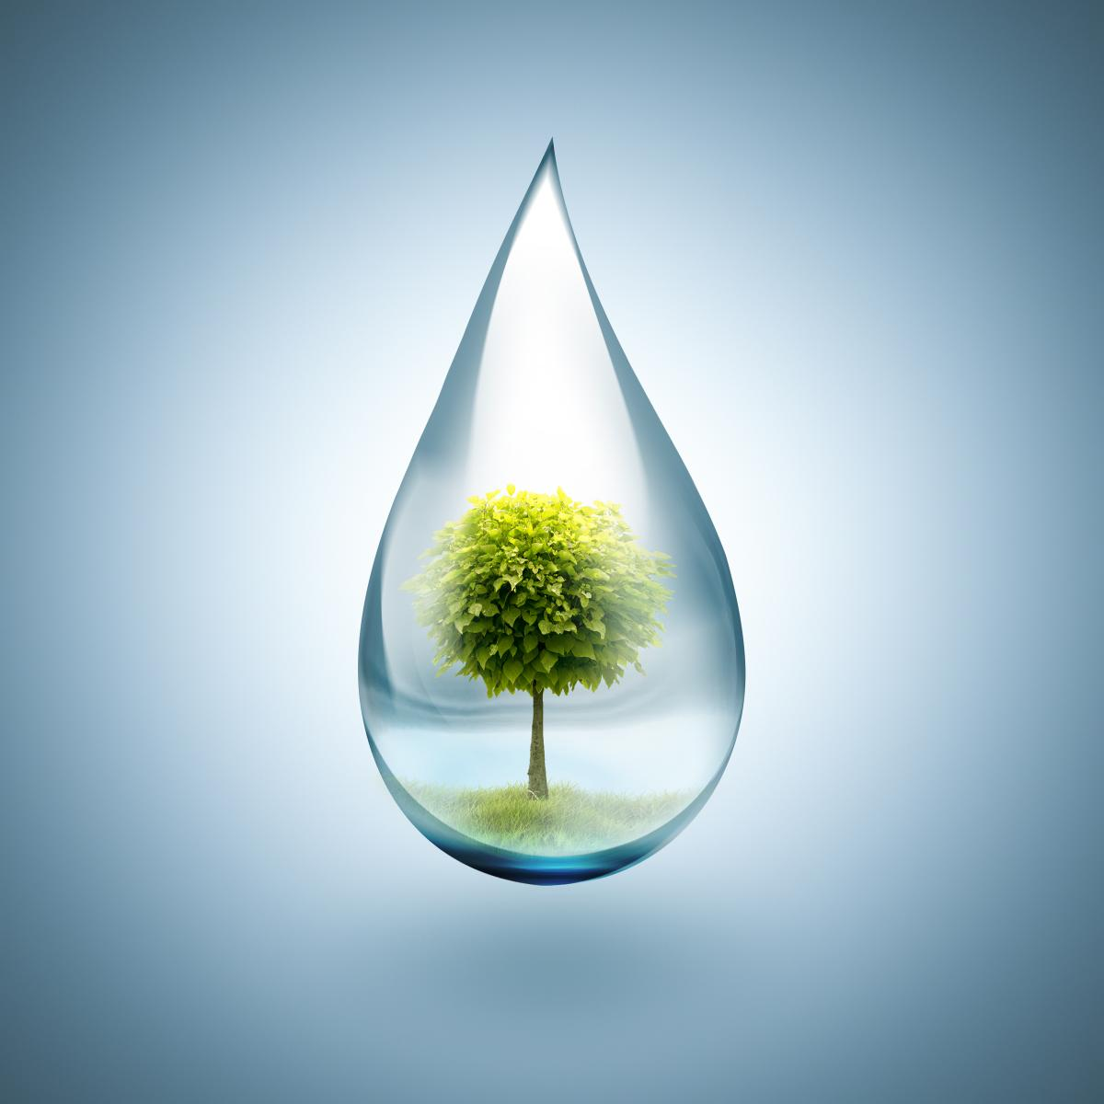
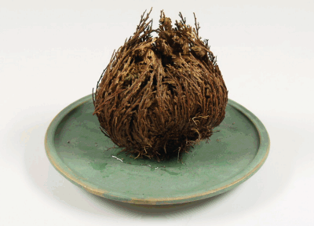
Exceptions
Don’t all living things need water?
Life is too complicated and diverse to be black and white.
Here are some exceptions to the 8 characteristics:
Notes:
Though all living things on Earth require water, many scientists agree that extraterrestrial life might use some other polar molecule as a solvent. That being said, water could be considered a characteristic of terrestrial life and can be included on this list.

Slide 20
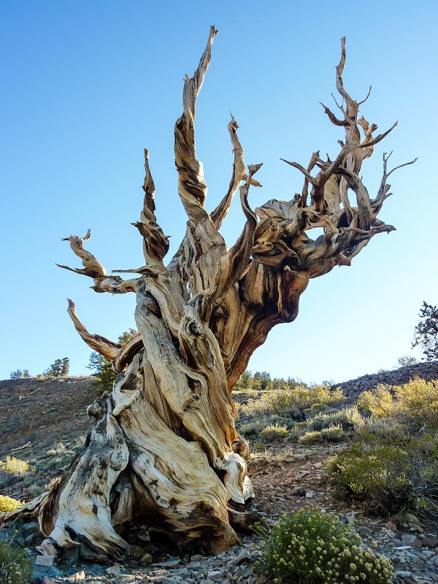
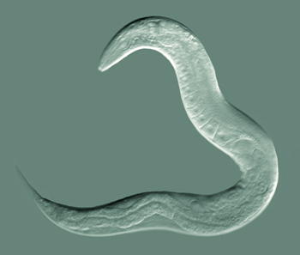
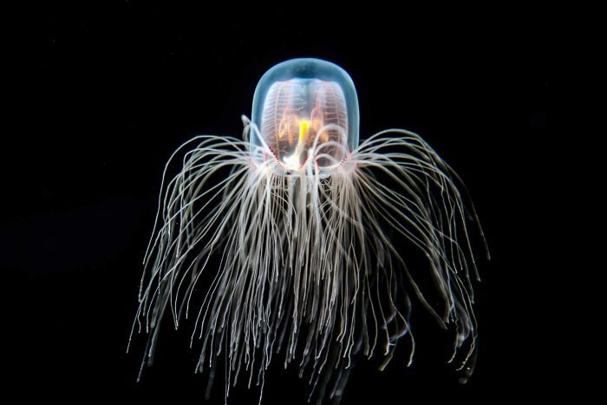
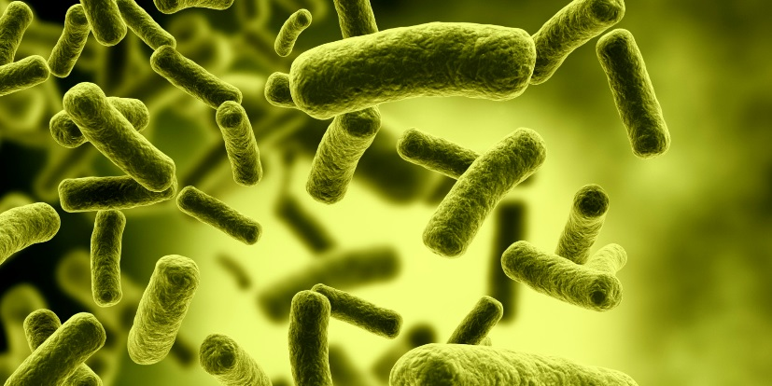
Exceptions
If Something is Alive, must it also Die?
Immortal Jellyfish
Notes:
Death is an inevitable part of life, but some organisms seem to be able to stave it off (at least indefinitely).
Bristlecone pines are the oldest (continuously) living eukaryotic organism on Earth, with one 5,067 years old (not the one pictured).
In July, 2018 two out of three hundred nematode words found frozen in Arctic permafrost were coaxed back to life. These worms began to move and feed after being thawed. One was estimated at 32,000 years old while the other was 41,700- the oldest multicellular life on Earth.
There have been numerous claims of thawing frozen bacterial spores, that then grow and resume a normal metabolism. Some of these are as old as 240 million years, the longest living organisms known.
Turritopsis dohrnii aka the Immortal Jellyfish, is one of a few hydrozoan species that can revert back to an immature, juvenile state when stressed (for instance when it can’t find food). Theoretically it could do this repeatedly, meaning it is one of the few known species that doesn’t have a lifespan. It could still die of disease, starvation, or be eaten- so it isn’t technically immortal in that sense. (Click the link to watch a short video).
https://en.wikipedia.org/wiki/List_of_longest-living_organisms

Slide 21
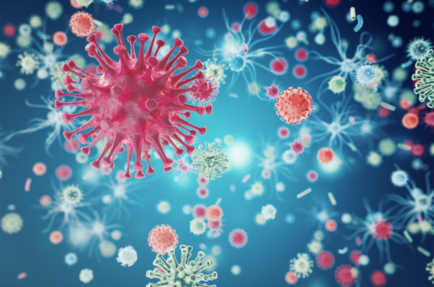
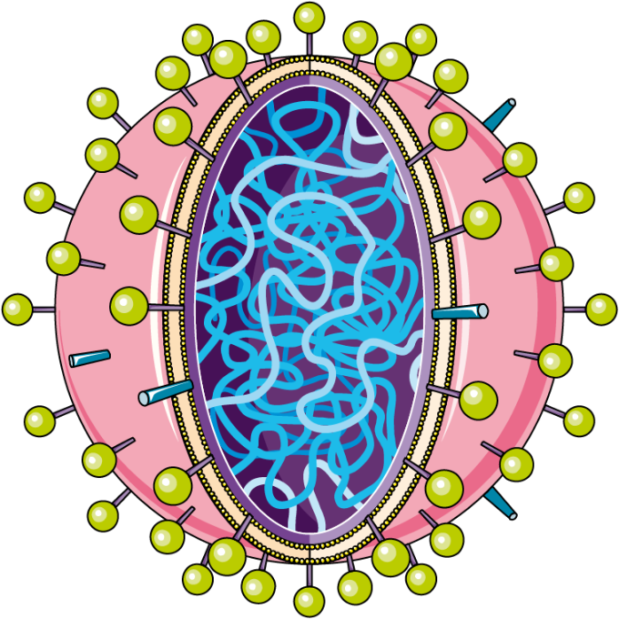
Exceptions
What About Viruses?
Notes:
Viruses are essentially a strand of DNA or RNA surrounded by a protein capsule. This DNA or RNA is infectious, meaning that it has genes that help code for making receptors on the protein coat that allow it to enter a cell and hijack its DNA. Viruses need to infect other cells so they can use their protein making machinery (ribosomes), to make their own proteins.
Some scientists consider viruses a primitive form of life. Others see them as a gray area between living and non-living.
Because viruses cannot make their own proteins they cannot reproduce on their own. Some scientists (as well as our book) consider that justification to not consider viruses as alive.

