Slide 1
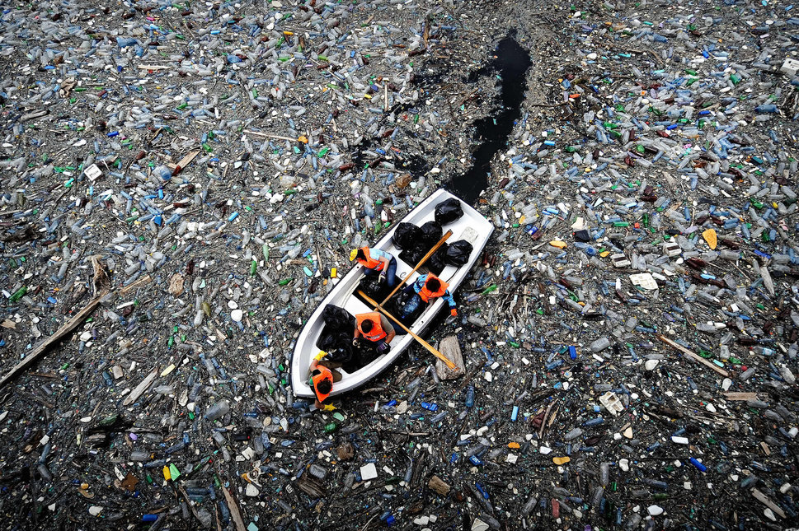
Human Impact on Air & Water

Slide 2
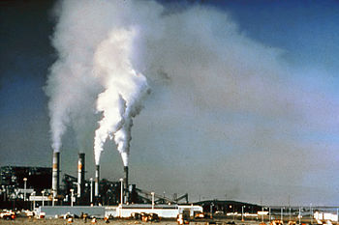
Air Quality
Burning fossil fuels releases compounds that pollute the biosphere.
Forms of Air Pollution:
Smog
Ozone
Acid Rain

Slide 3
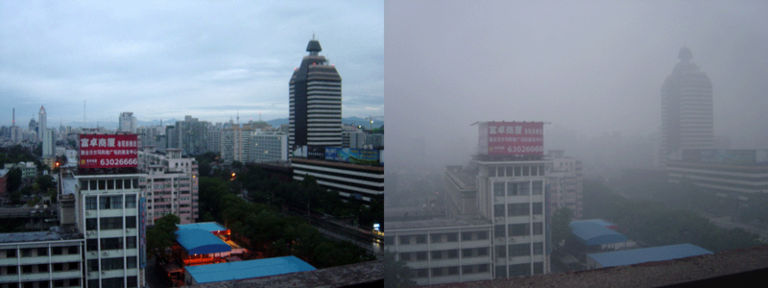
Smog
A type of air pollution caused by the interaction of sunlight with pollutants produced by fossil fuel emissions.
Full of particulates, which are microscopic bits of dust, metal, and unburned fuel (1-10 microns in size).
These can be inhaled and cause many health problems.
Bejing: After a day of rain After a day of Sun

Slide 4
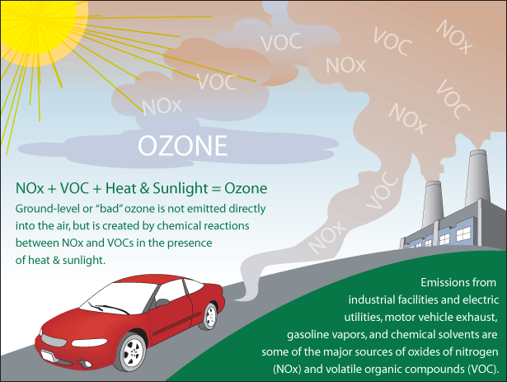
Ozone
NO2 produced in fossil-fuel combustion reacts with O2 to create O3 (Ozone). Ground level ozone is very dangerous to living things.
Can cause asthma, emphysema, and is very harmful to plants

Slide 5
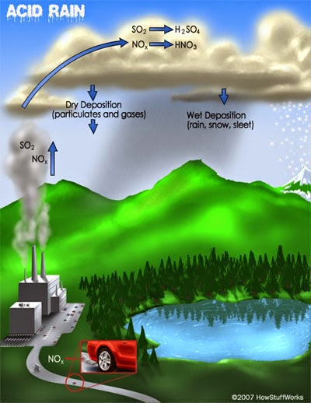
Acid Rain
Type of precipitation (water formation) produced when pollutants in the water cycle cause rain pH to drop below normal levels.
pH: amount of H+ ions in a solution.
Lots of H+ = Low pH
pH scale: 1-14
Neutral pH= 7
Normal Rain slightly acidic (5.6)
Acid Rain any pH less than this.
Threatens water supplies and plant life. Can result in growth rate declines. Makes plants more vulnerable to disease and weather.

Slide 6
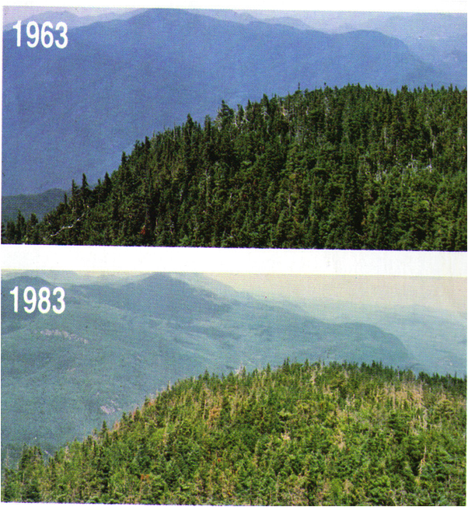
Acid Rain

Slide 7
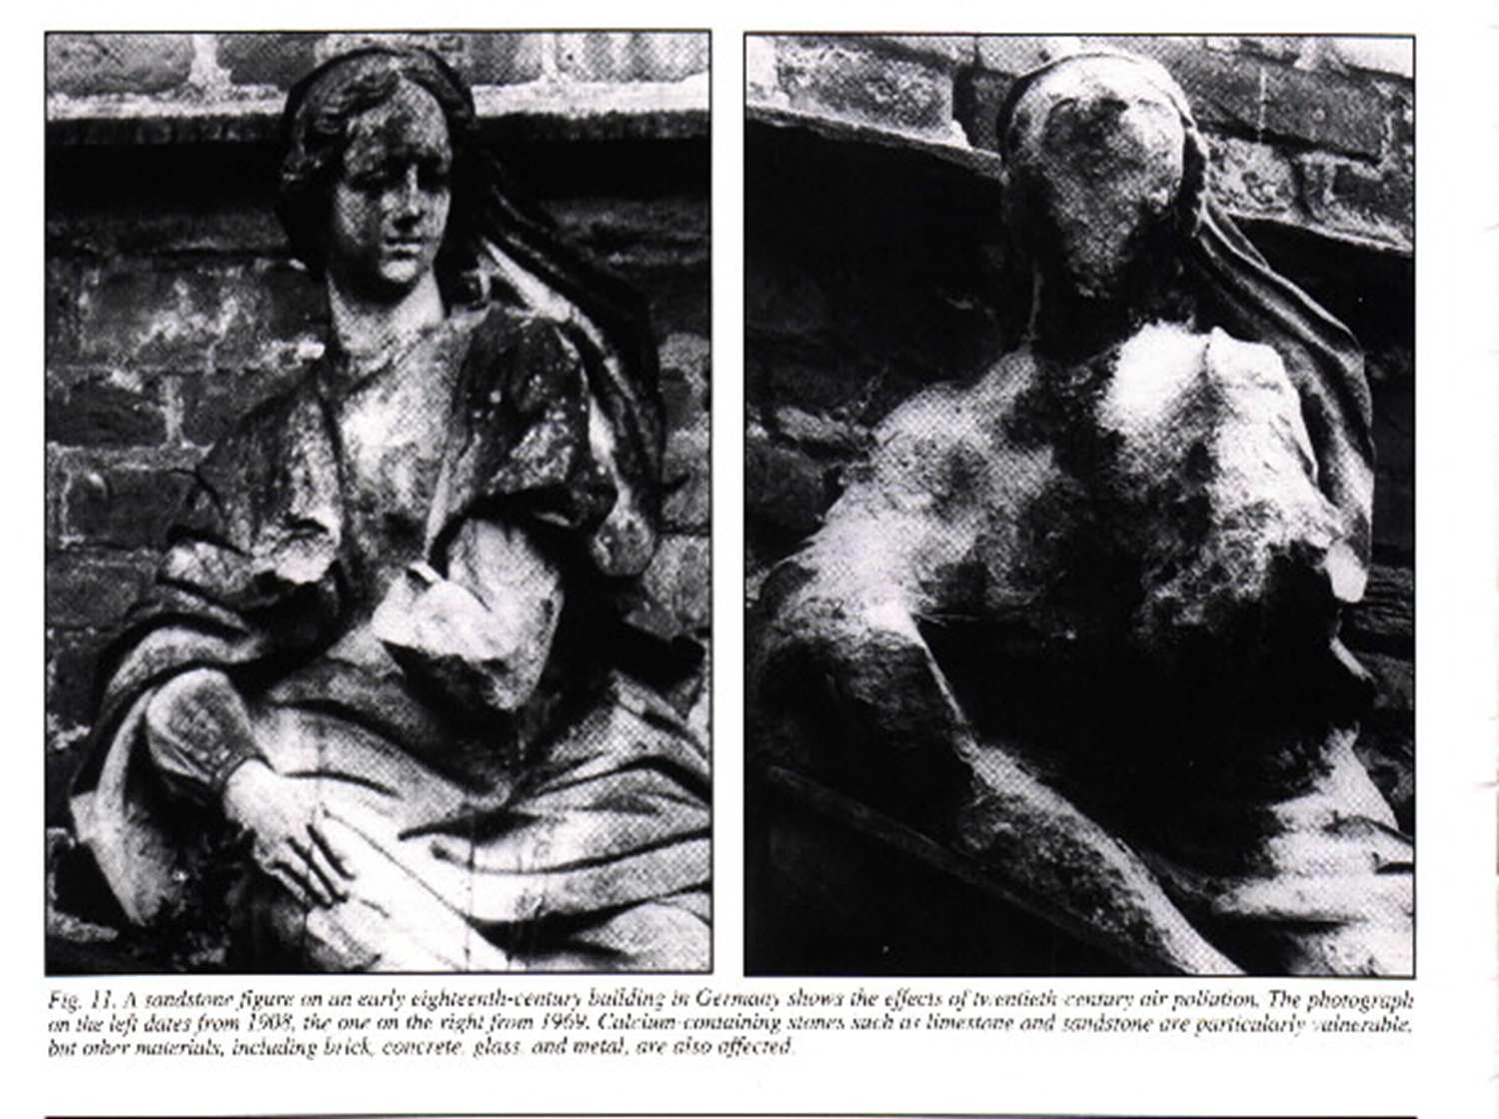

Slide 8
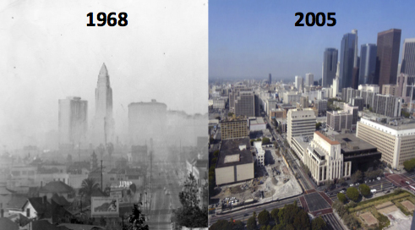
LA Pollution then and now

Slide 9
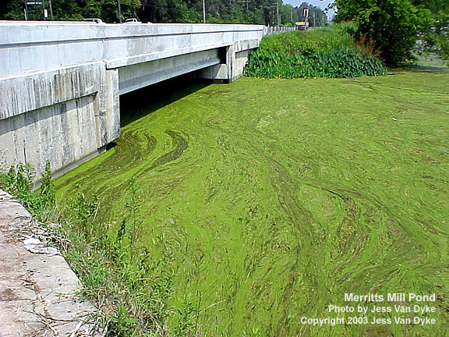
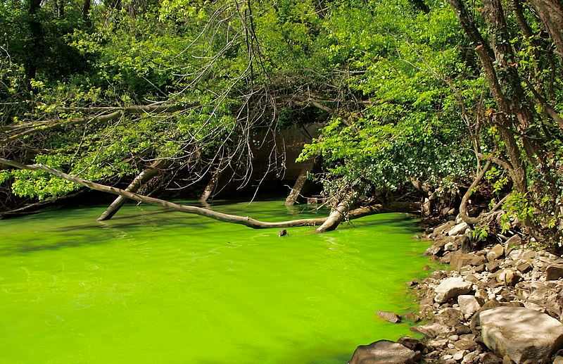
Water Quality
Pollution can also have major impacts on water ecosystems.
Effect #1:
Detergents and fertilizers can stimulate plant and algae overgrowth in lakes.

Slide 10
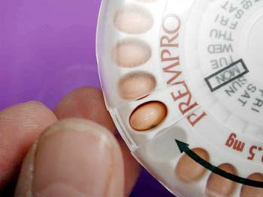
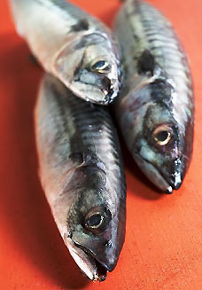
Water Quality
Effect #2:
Medical waste can expose fish to hormones that can cause them to change gender.

Slide 11
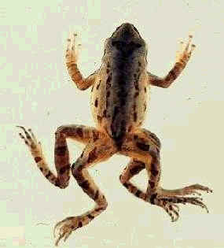
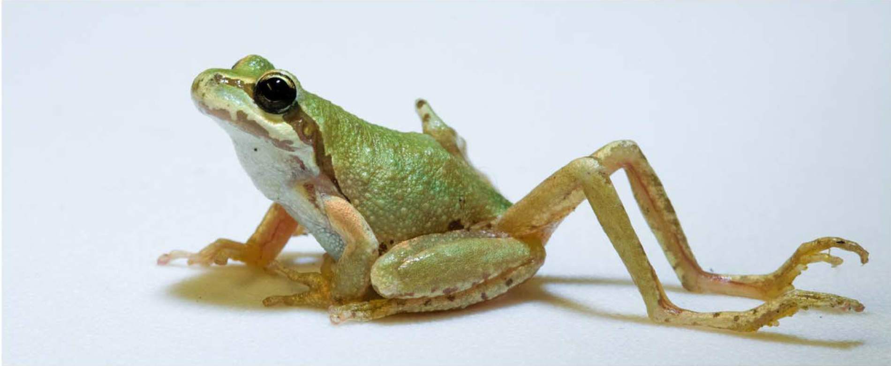
Water Quality
Effect #3:
Amphibians with water permeable skin come into direct contact with pollutants, that can cause deformities like extra arms and legs.

Slide 12
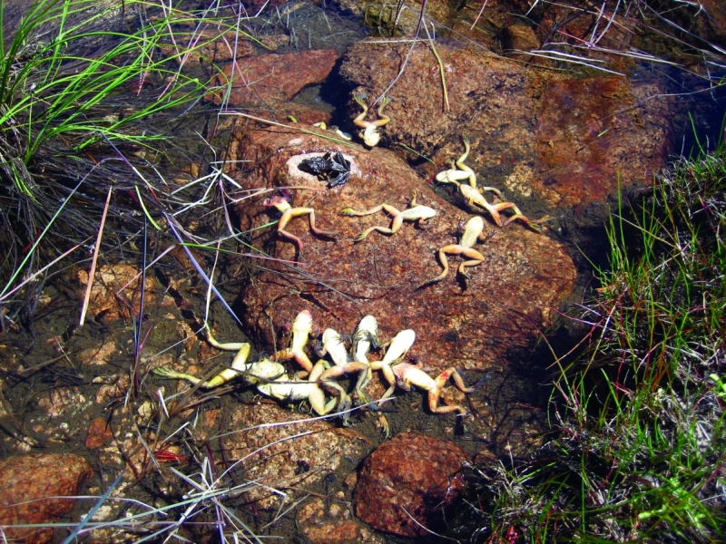
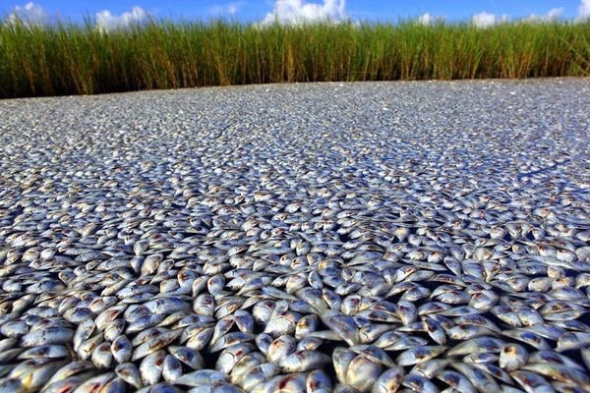
Indicator Species
These previous organisms are all examples of indicator species, a species that provides a sign, or indication of the quality of the ecosystem’s environmental conditions.

Slide 13
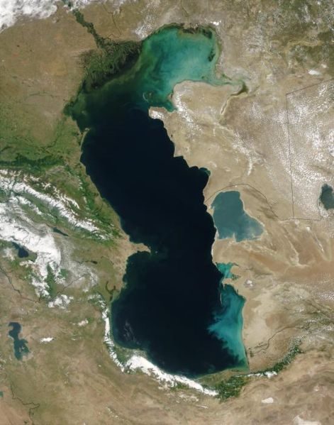
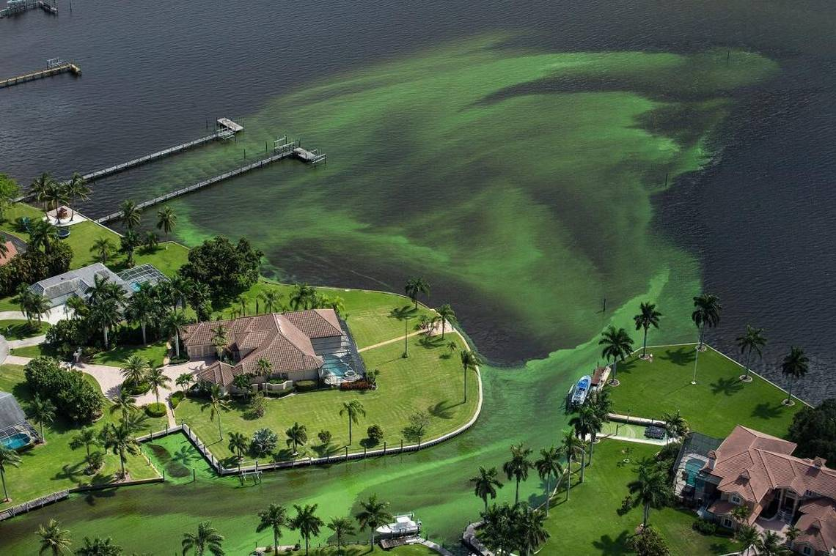
Indicator Species
Algal blooms are indications of negative effects on the ecosystem.
Detergents and fertilizers provide nutrients for large algal populations that then suck all the oxygen out of the area, killing anything living there.
This keeps detritivores from breaking down waste materials, and the lake or pond will eventually fill up, which is called eutrophication.
Caspian Sea
Algal Bloom in Florida, 2018

Slide 14
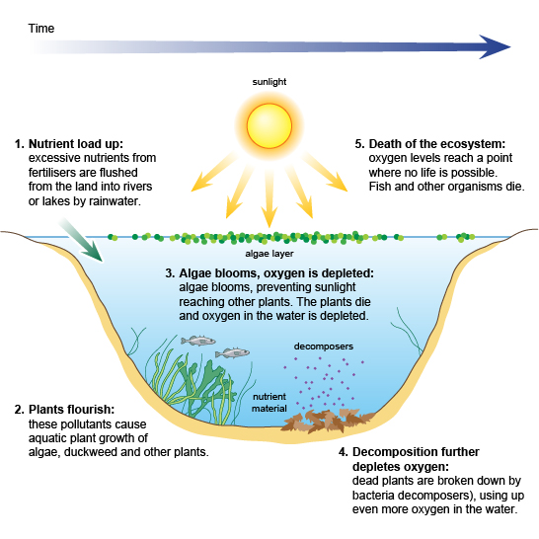
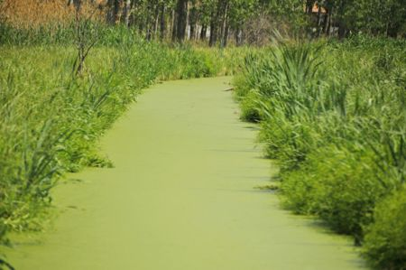
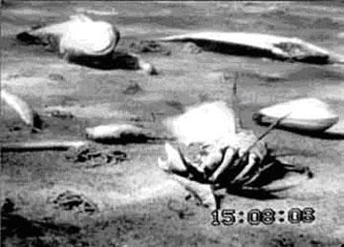
Eutrophication

Slide 15
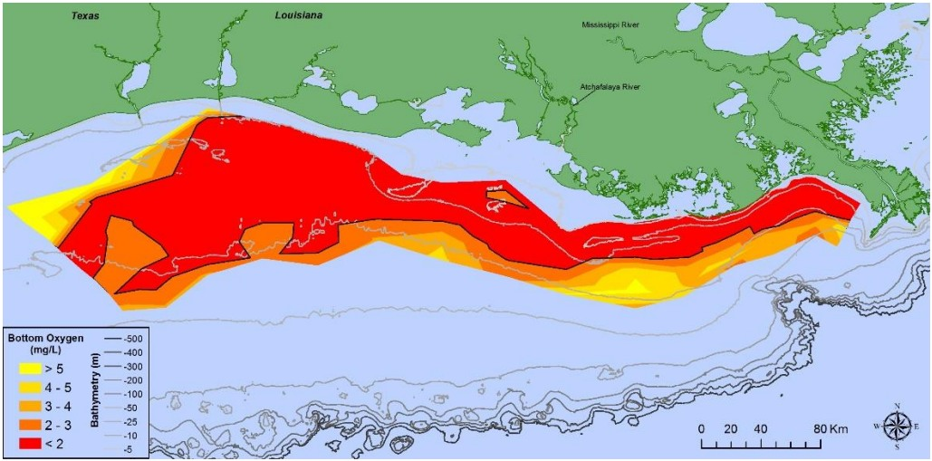
Eutrophication
Eutrophication can create dead zones, areas in the body water devoid of oxygen.
Notes:
The Gulf of Mexico dead zone is the largest on Earth. This is caused from all the agricultural runoff that comes out of the Mississippi.

Slide 16
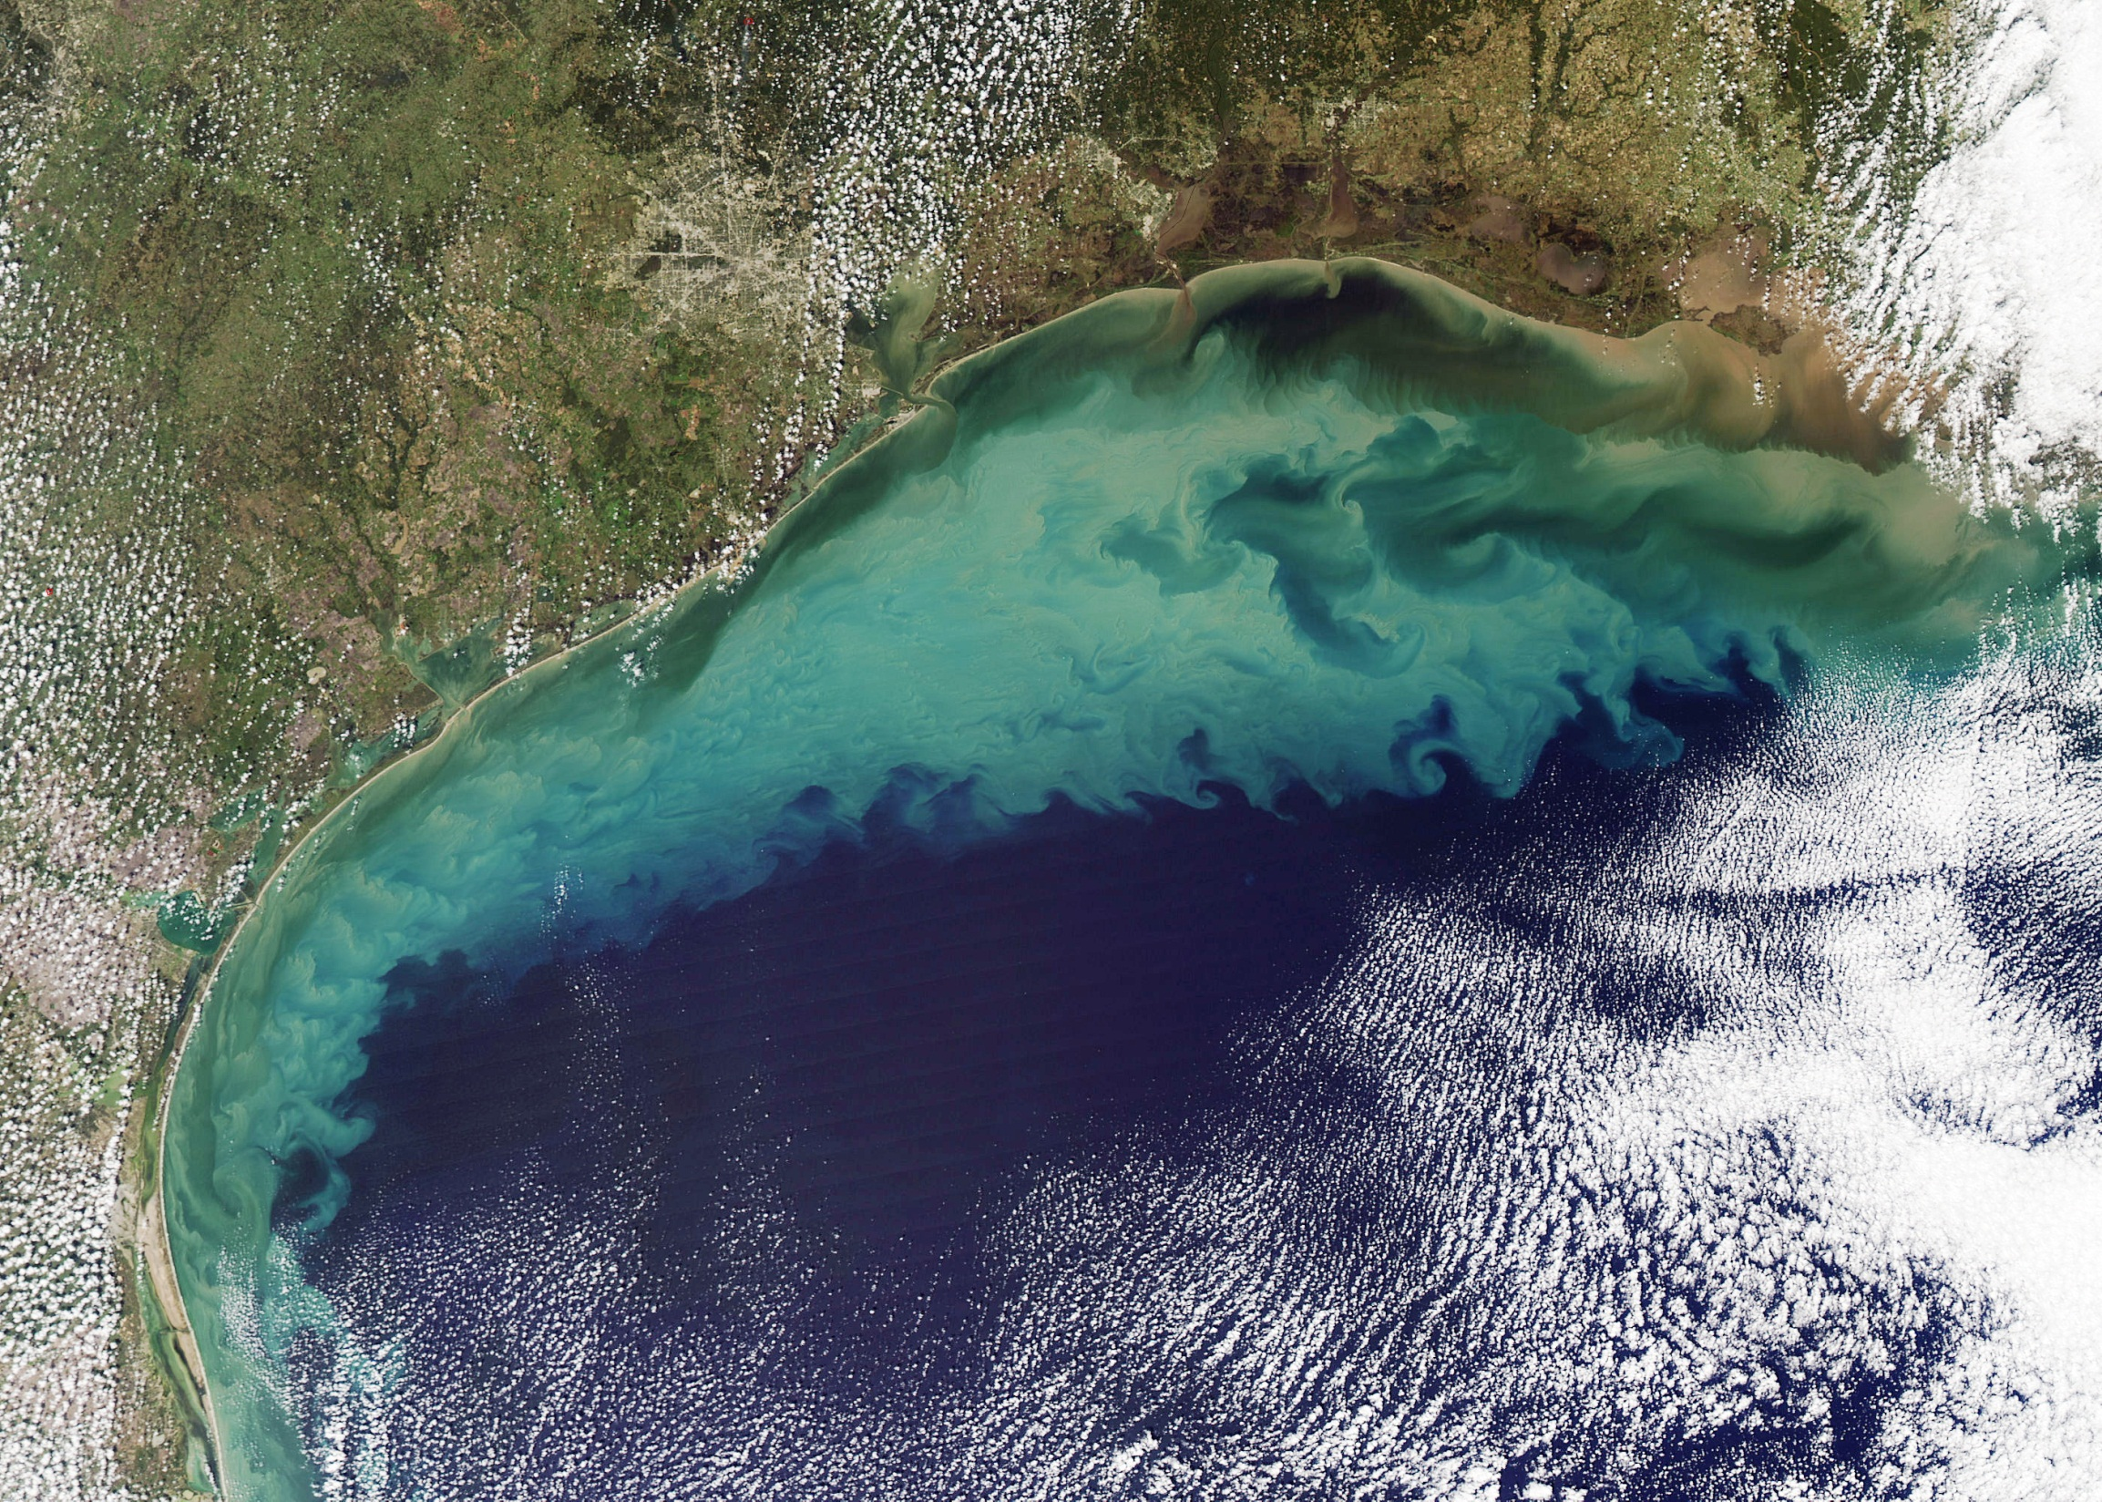

Slide 17
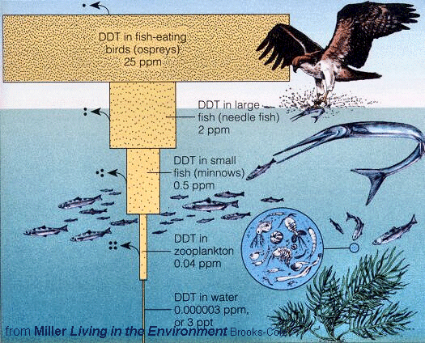
Biomagnification
Pollutants can move from one organism to another through a process called biomagnification. This occurs when a pollutant moves up the food chain as predators eat prey, and ends up accumulating in higher concentrations in the bodies of predators.
Scientists measure pollutants this way in parts per million (ppm).

Slide 18
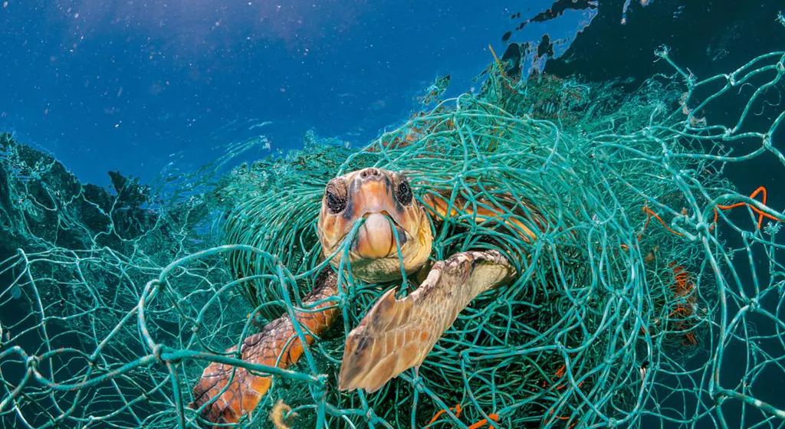
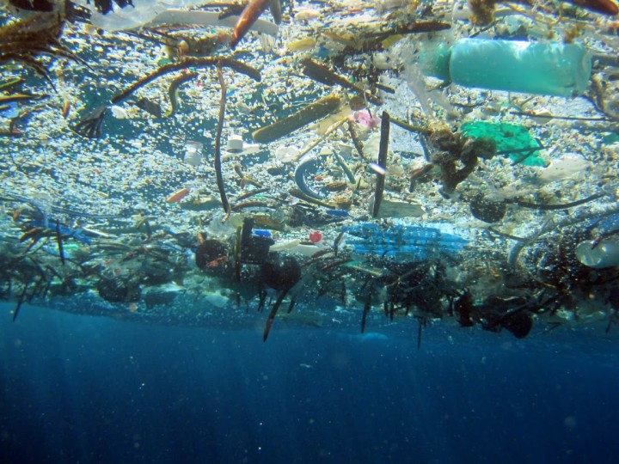
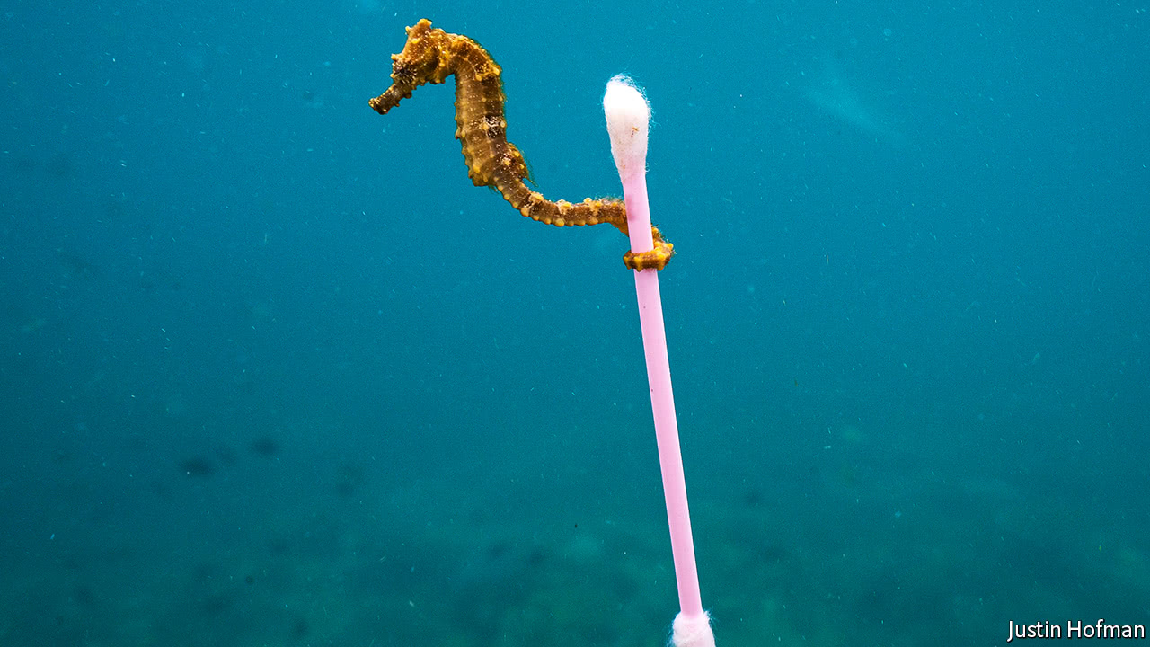
Plastic in our Oceans
So much plastic is in the ocean, that soon we will end up with a pound of plastic for every 3 pounds of fish in the sea.
Notes:
8 million metric tons of plastic pollution enter the oceans each year from the world’s 192 coastal countries based on 2010 data.
That is enough to place the equivalent of 5 grocery bags full of plastic trash on every foot of every nation’s coastline around the globe (from Scientific American, Feb. 12, 2018)

Slide 19
Plastic in our Oceans
Plastics can affect up to 96% of biodiversity in the oceans.
Plastic does not decompose or break down, it just gets smaller (microplastics) that can be taken up by all types of life.
Seabirds, whales and turtles are most vulnerable to plastic pollution.

Slide 20
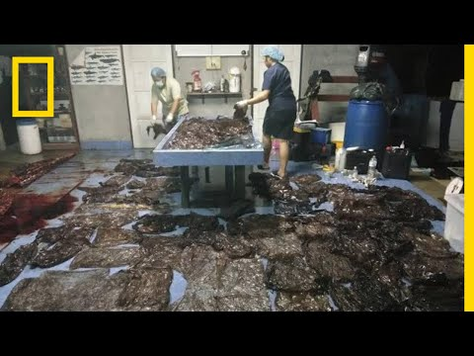
Plastic in our Oceans

Slide 21
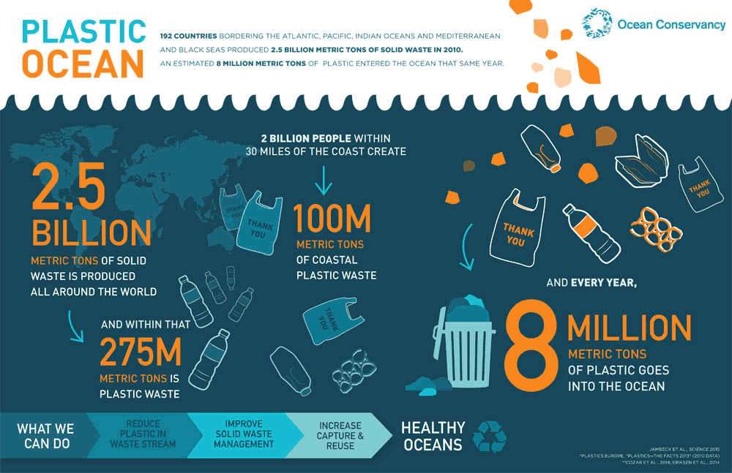
Plastic in our Oceans

Slide 22
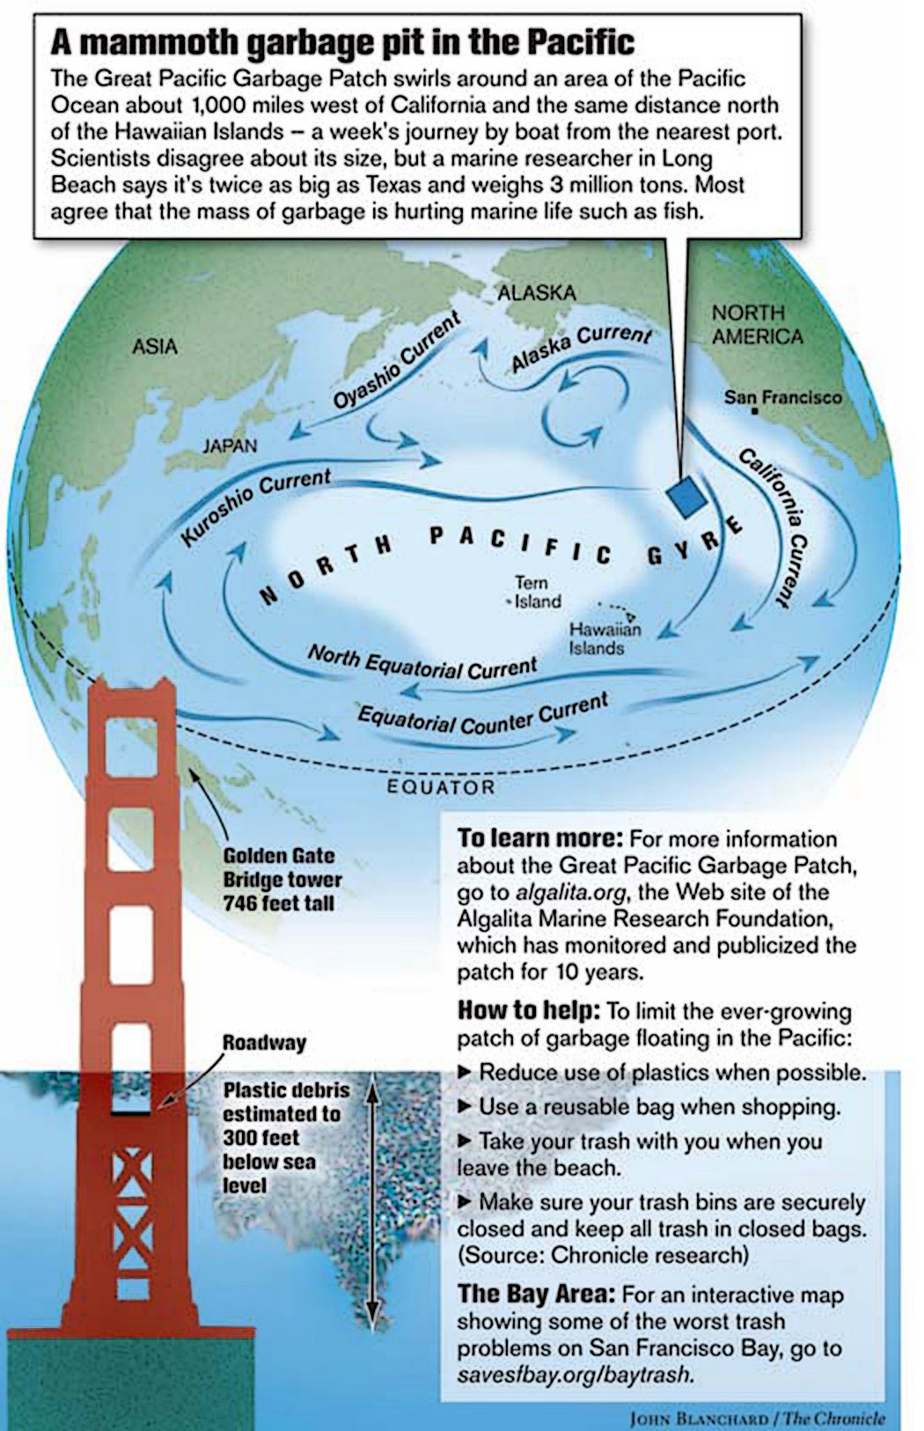
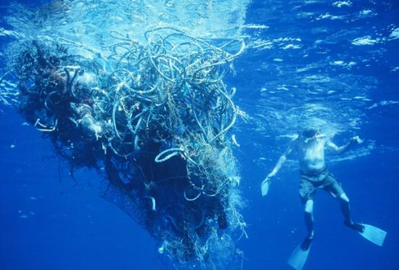
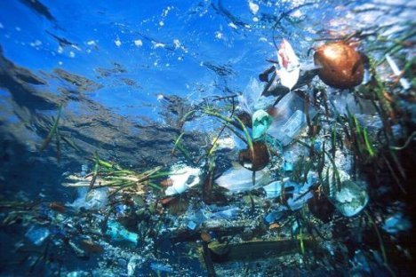
The Great Pacific Garbage Patch

Slide 23
Plastic in our Oceans
Ways that you can make a difference:
Stop buying single use plastics
Stop using plastic bags
Buy things locally instead of having them shipped from places like Amazon that have lots plastic packaging
Recycle appropriate plastics
Don’t buy products that have plastic microbeads

Slide 24
Vocabulary
Smog
Ozone
Acid Rain
Indicator Species
Eutrophication
Dead Zone
Biomagnification

