Slide 1
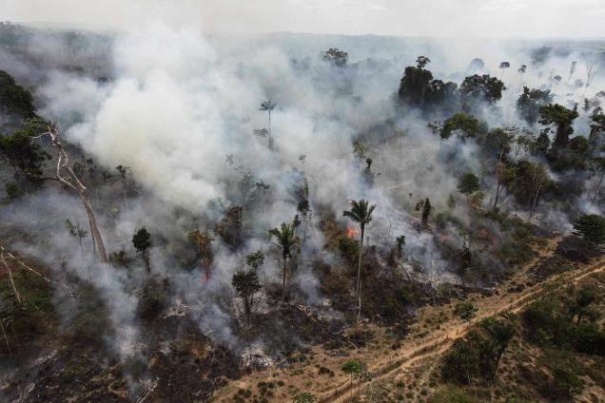
Threats to Biodiversity/Sustainability

Slide 2
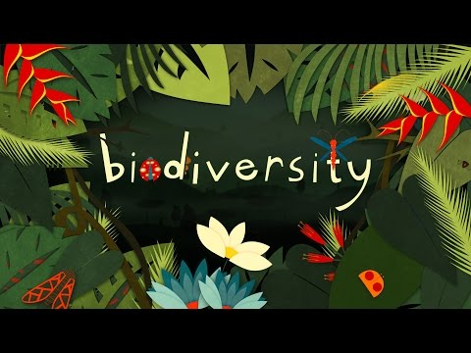
What is

Slide 3
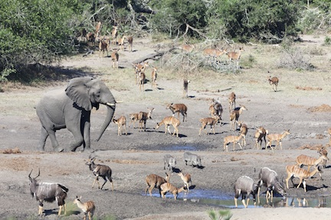
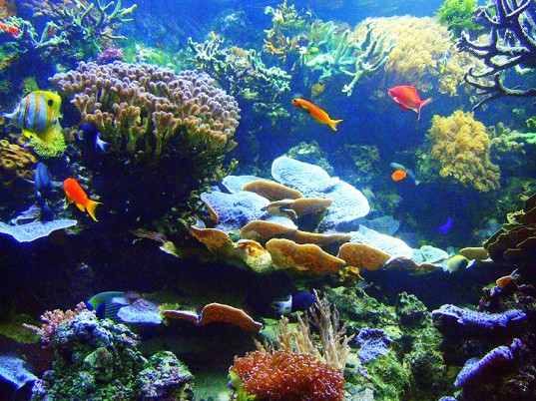
Biodiversity measures the variety of life in an ecosystem.
The more biodiversity there is, the higher the number of unique species in the ecosystem.

Slide 4
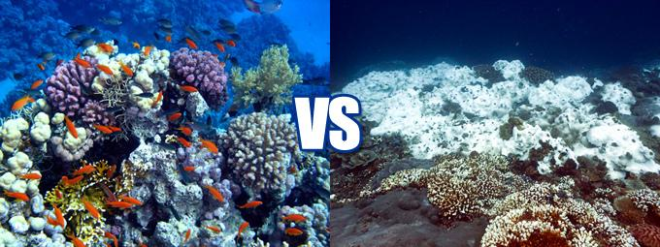
An ecosystem’s health is typically measured by how much biodiversity it has.
The loss of even a single species can threaten the overall stability of an ecosystem.

Slide 5
Earth has had moments of massive biodiversity loss in the past.

Slide 6
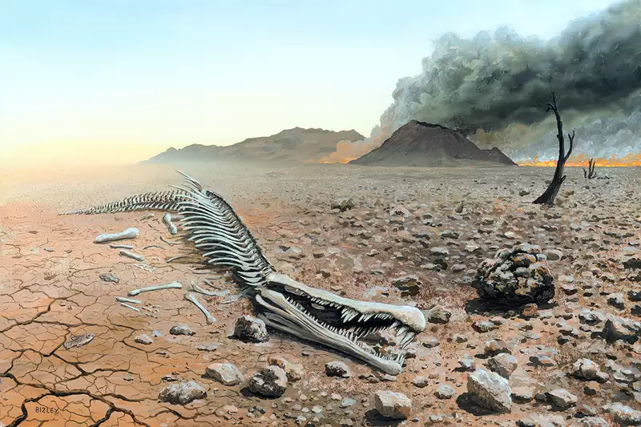
These events are called
Mass Extinctions

Slide 7
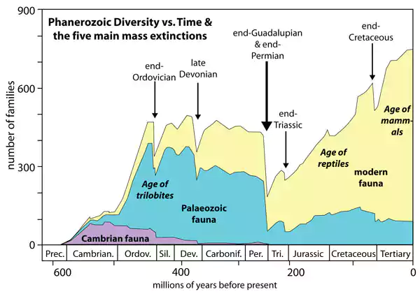
Previous Mass Extinctions
Notes:
Most people are aware of the K-T mass extinction (Cretaceous-Tertiary; K in this case stands for Kreide, meaning chalk in German- describing the chalky layer from that period of time). That extinction was caused by an asteroid that hit the Earth 66 million years ago, killing off the non-avian dinosaurs and ushering in the age of mammals. This extinction event is dwarfed by the Permian-Triassic extinction, that occurred 252 million years ago that wiped out up to 96% of all marine life and 70% of all terrestrial vertebrate species. It was the closest to all life ending on Earth as we’ve ever come. Suggested mechanisms for the latter include one or more large meteor impact events, massive volcanism such as that of the Siberian Traps, and the ensuing coal or gas fires and explosions,^{[16]} and a runaway greenhouse effect triggered by sudden release of methane from the sea floor due to methane clathrate dissociation according to the clathrate gun hypothesis or methane-producing microbes known as methanogens.^{[17]} Possible contributing gradual changes include sea-level change, increasing anoxia, increasing aridity, and a shift in ocean circulation driven by climate change.

Slide 8
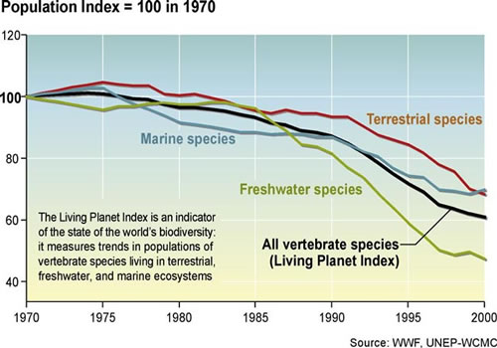
Notes:
Humanity has wiped out 60% of animal populations since 1970

Slide 9
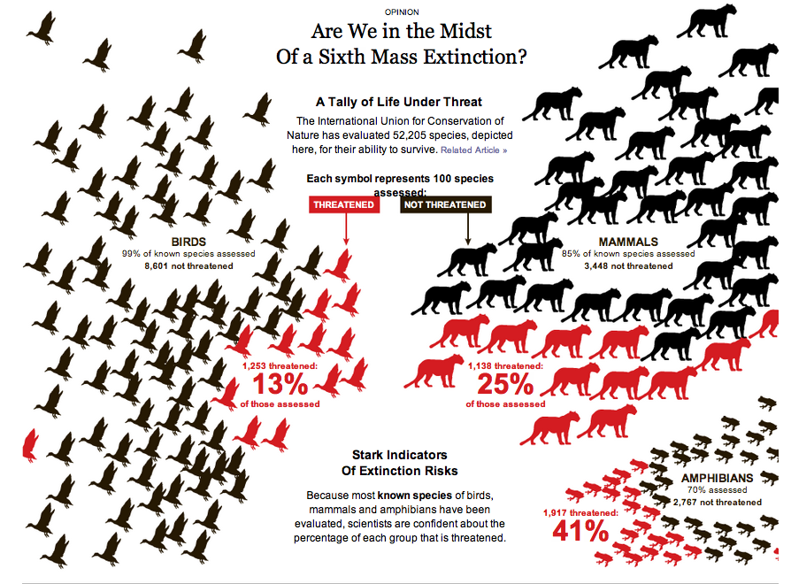

Slide 10
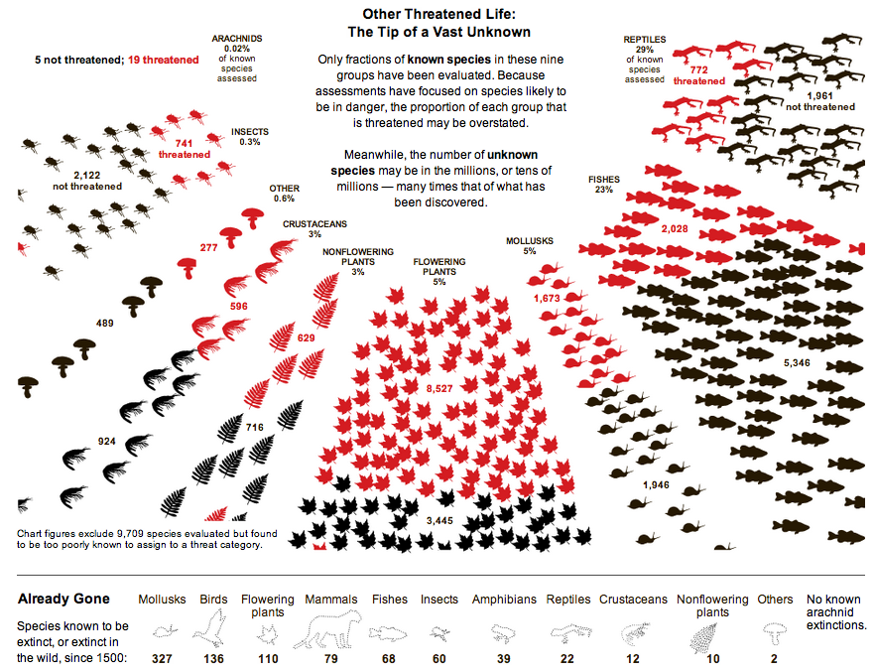

Slide 11
What decreases Biodiversity?
The three big ones are:
Habitat Loss
Introduction of new species
Poaching

Slide 12
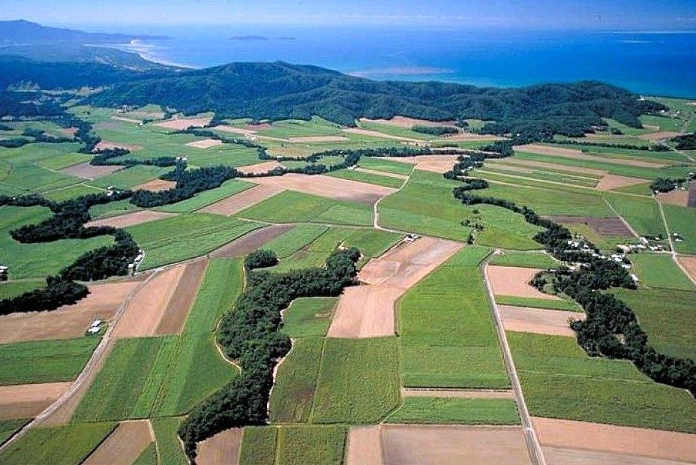
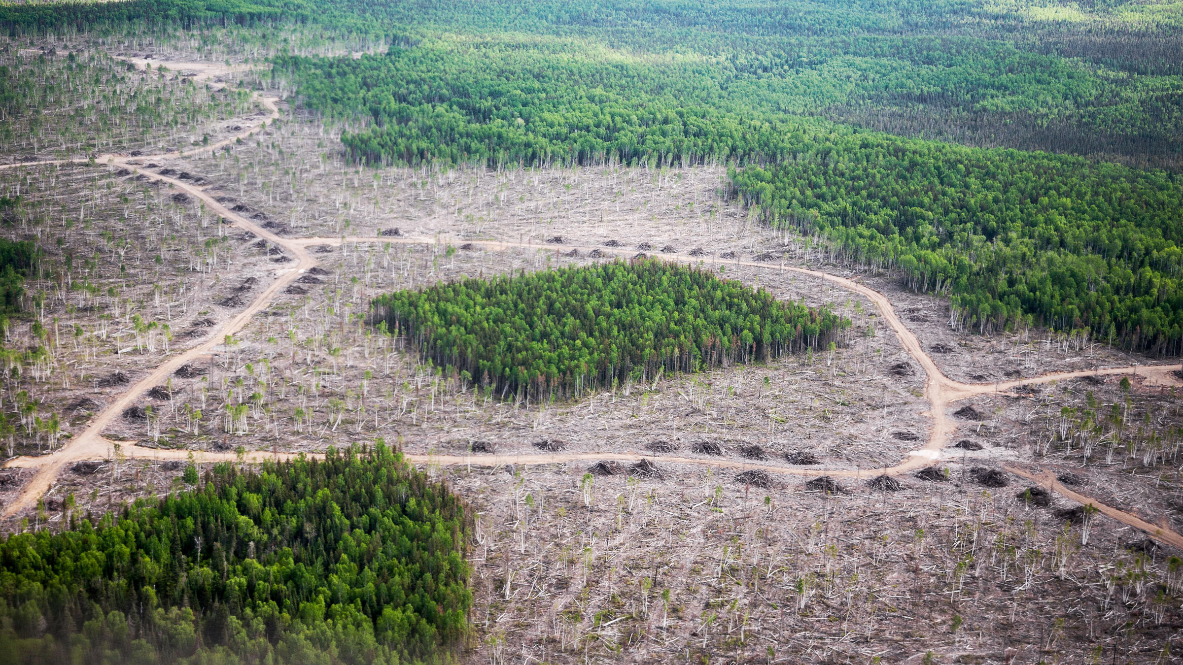
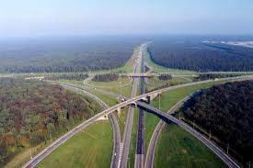
Habitat Loss
As humans take up more and more land, there is less wilderness available for organisms and many risk going extinct.
Habitat fragmentation occurs when a barrier forms that prevents an organism from accessing its home range.

Slide 13
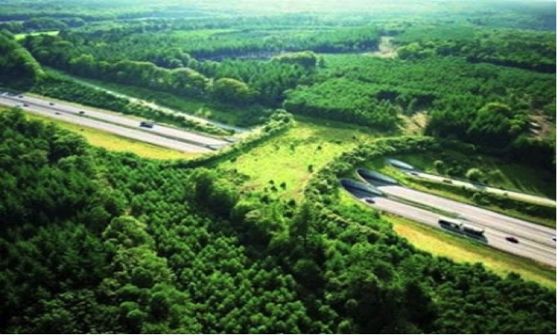
Habitat Loss
We can reduce this by increasing the size of fragments, and protecting land containing the most vulnerable of species.
Wildlife crossings can also be used to help animals access their home ranges across roads.
Wildlife crossing to prevent fragmentation.
You can also stop buying products like palm oil that contribute to habitat destruction.

Slide 14
The Problem with Palm Oil

Slide 15
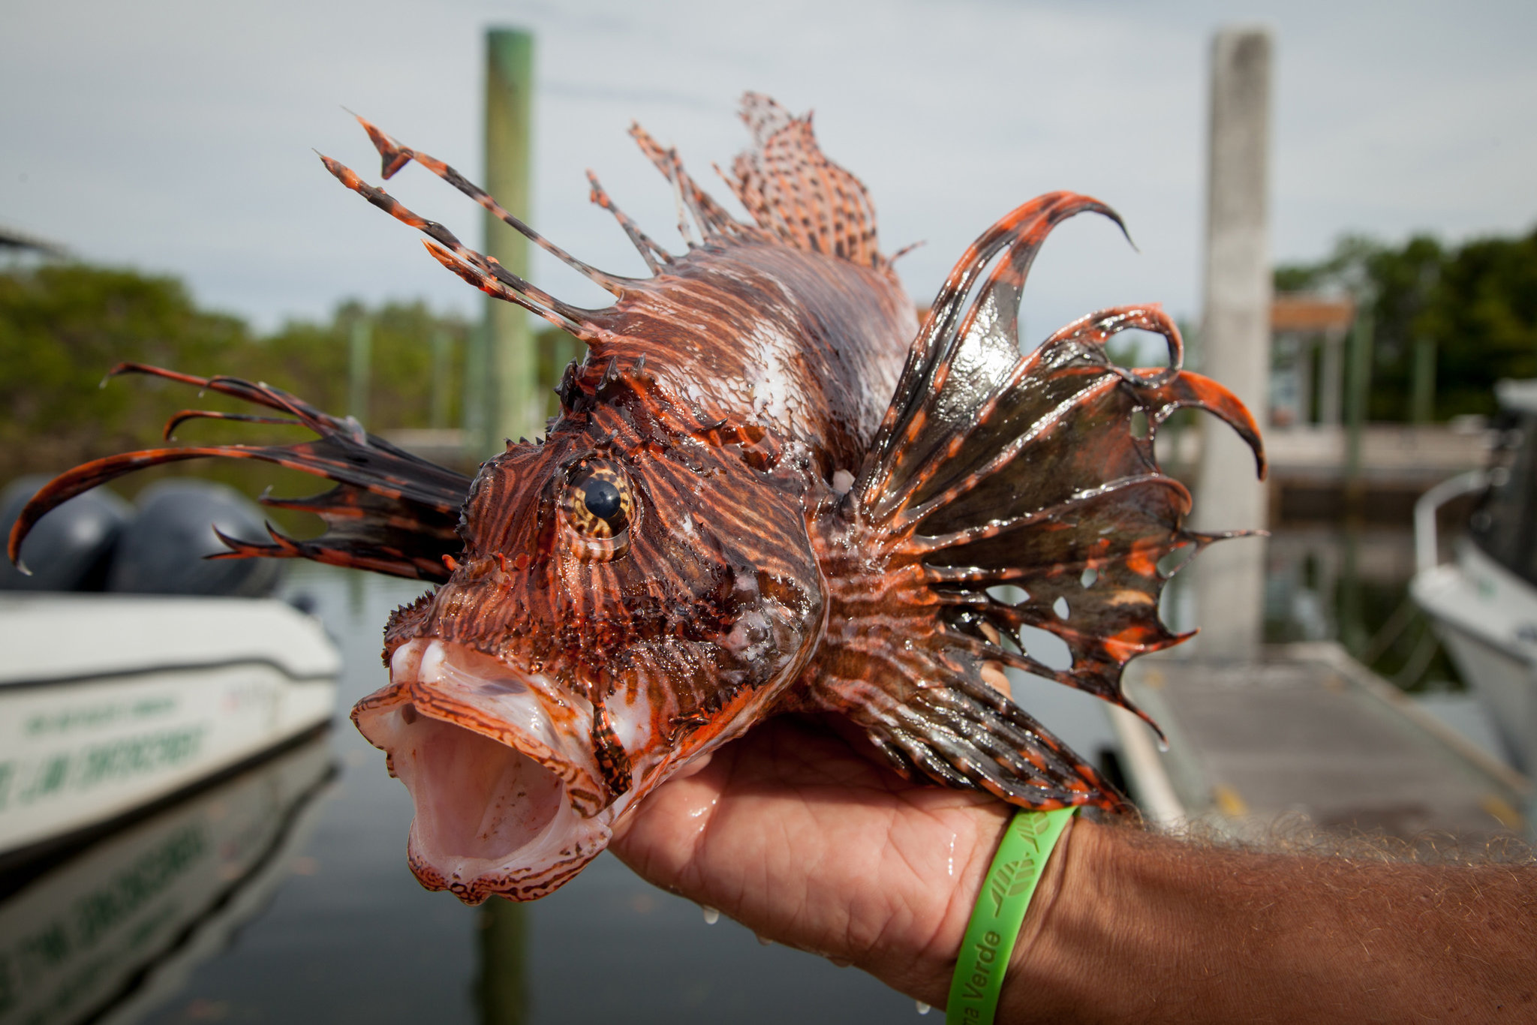
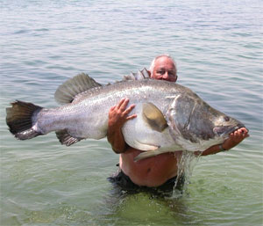
Invasive Species
Invasive Species are organisms released to a habitat they did not originate in, either intentionally or unintentionally by humans.
Since these organisms did not evolve in this habitat they typically have no natural predators and grow out of control, devastating the biodiversity in the area.
Lionfish in Florida
Nile Perch

Slide 16
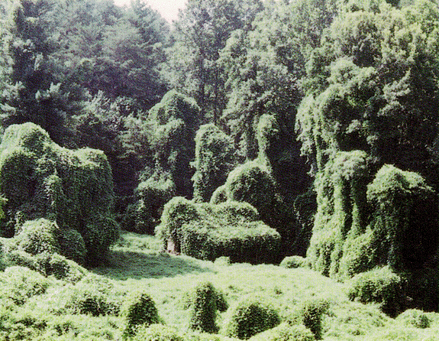
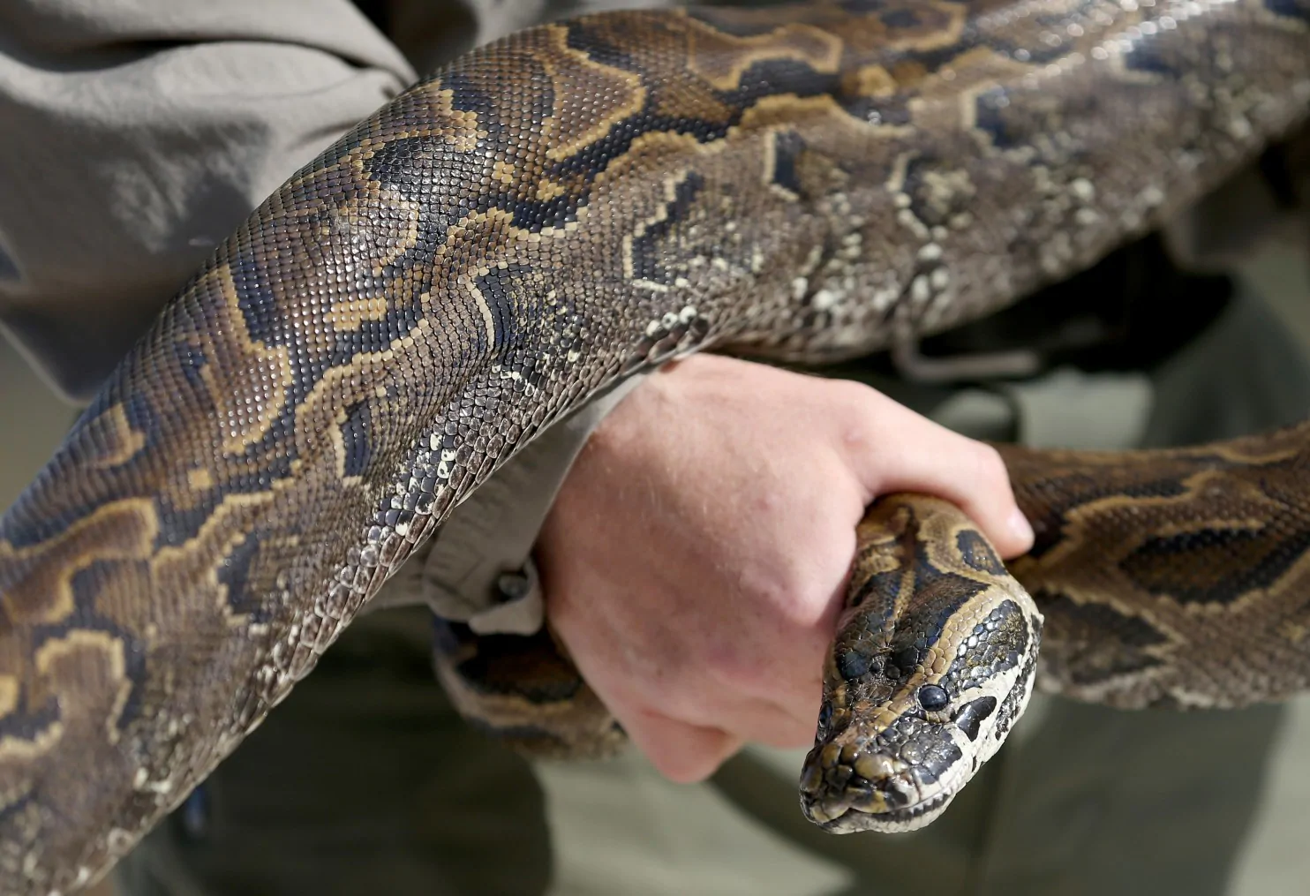
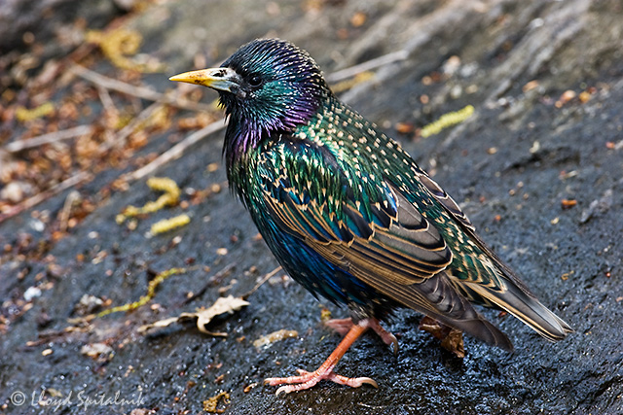
Invasive Species
There are a number of characteristics all invasives have in common:
Non-native
Have no natural predators in the area
Reproduce often
Have a wide range of food available
Are highly adaptive to different environments
Decrease biodiversity in the area
Kudzu
Burmese Python
European Starling
Notes:
There are over 200 million starlings in North America. n March 6, 1890, a New York pharmaceutical manufacturer name Eugene Schieffelin brought natural disaster into the heart of completely without meaning to. Through the morning snow, which congealed at times to sleet, sixty starlings, imported at great expense from Europe, accompanied Schieffelin on the ride from his country house into Central Park—the noisy, dirty fulfillment of his plan to introduce every bird mentioned by Shakespeare into North America. Schieffelin loved Shakespeare and he loved birds….The American Acclimatization Society, to which he belonged, had released other avian species found in Shakespeare—the nightingales and skylarks more commonly mentioned in his plays and poems—but none had survived. There was no reason to believe that starlings would fare any better. Schieffelin opened the cages and released the birds into the new world, without the smallest notion of what he was unleashing.
Follow us: @SmithsonianMag on Twitter

Slide 17
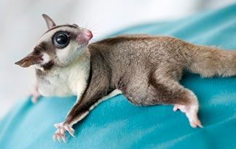
Invasive Species
We can help, by not supporting the exotic pet trade.
There are also invasive species roundups in your local area.
Lake Sammamish Park has volunteer opportunities where you can help remove invasives and replace them with local trees and plants. https://www.lakesammamishfriends.org/volunteer-opportunities/
King County also has a number of volunteer opportunities around Seattle to help remove invasives:
https://www.kingcounty.gov/services/environment/animals-and-plants/noxious-weeds/volunteer-information.aspx
Notes:
The Sugar Glider is one of the more popular exotic pets on the market.

Slide 18
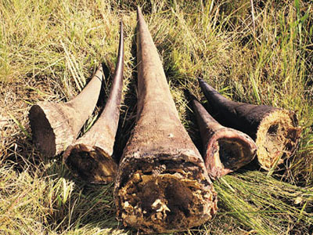
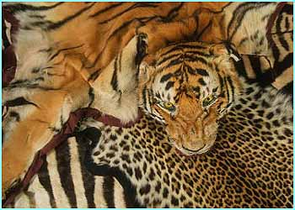
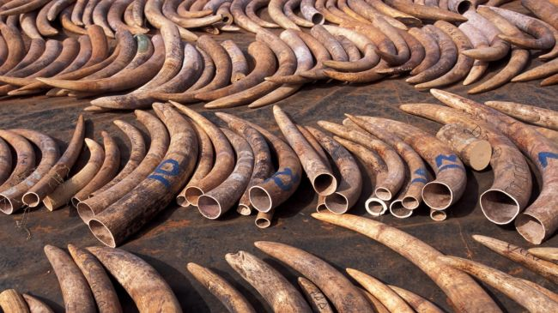
Poaching
Poaching is the illegal hunting, capturing or killing of wild animals.
People may poach for:
Food
To sell products from the animal on the international market
The animal may be considered dangerous or a pest
Traditional medicines or ceremonies

Slide 19
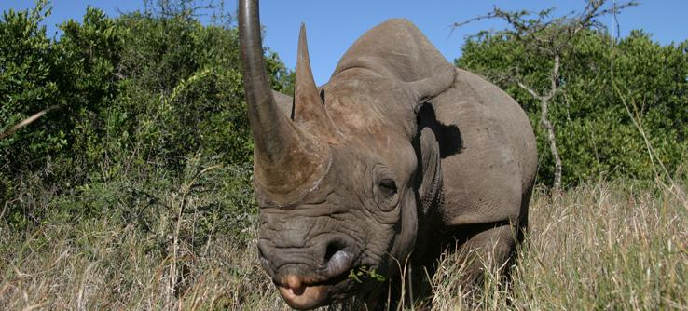
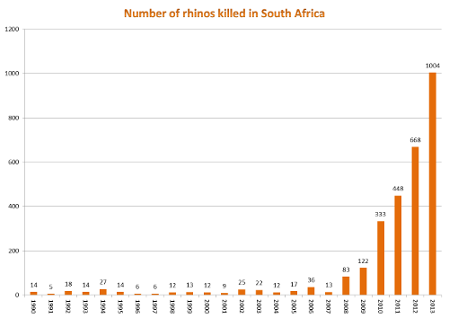
Poaching
The black rhino in Africa, is good example of a population that has declined dramatically do to poaching.
Current numbers are at 5,055

Slide 20
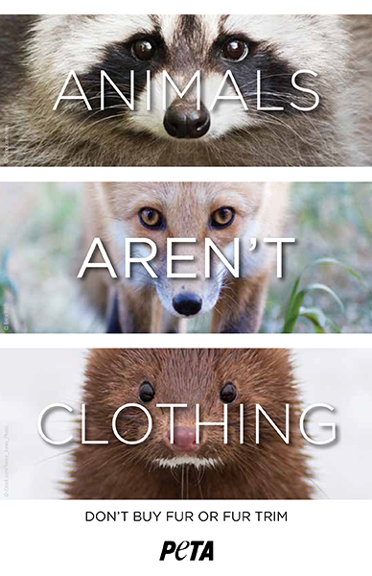
Poaching
You can help by not purchasing exotic furs or items like ivory from the black market.
-You can also donate to non-profit companies like the WWF that help set aside protected habitats for these animals.

Slide 21
Sustainability and Conservation
Sustainable development is a practice in which natural resources are used and managed in a way that meets current needs without harming future generations.
Example of sustainable development: Global Fisheries:
Overfishing has depleted fish populations worldwide. Fish stocks are not as hardy as they once were. One reason for this is that the fish that are caught represent the healthy, reproducing age groups of the fish population.

Slide 22
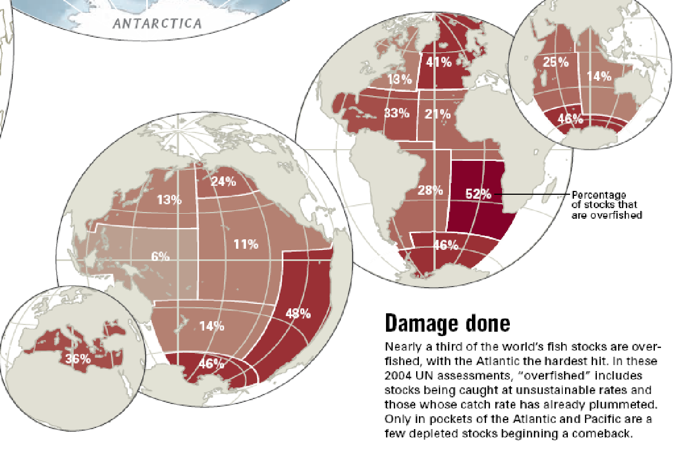

Slide 23
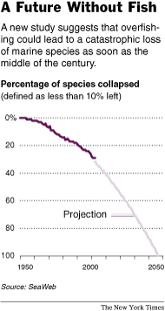
Researchers found that 29 percent of species had been fished so heavily or were so affected by pollution or habitat loss that they were down to 10 percent of previous levels, their definition of “collapse.”
To continue fishing at our current rate, the year we see a collapse in 100% of species is quite surprisingly within our lifetimes: 2048

Slide 24
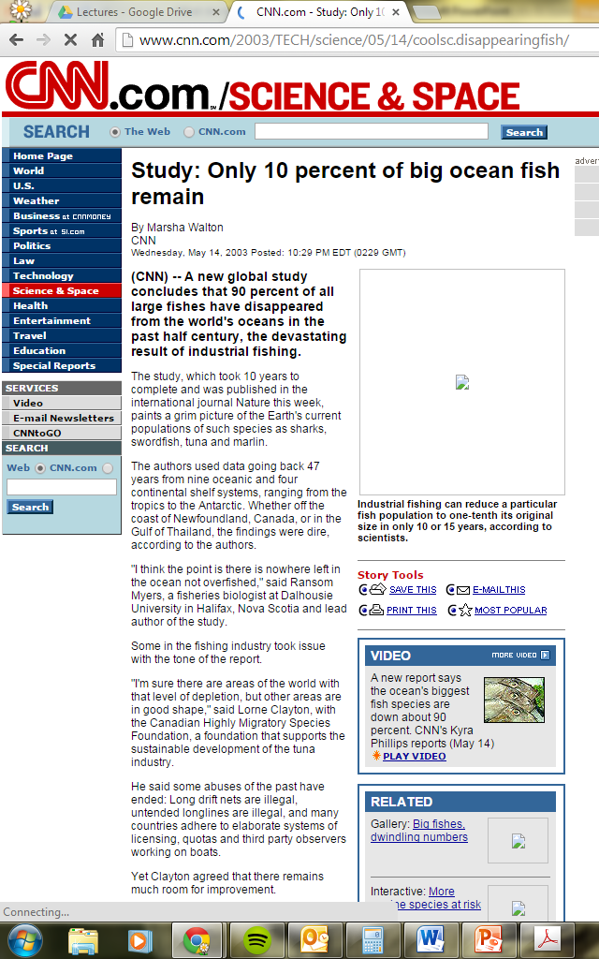
In fact 90% of large ocean fish are already gone according to a recent study.

Slide 25
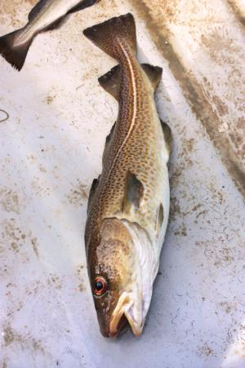
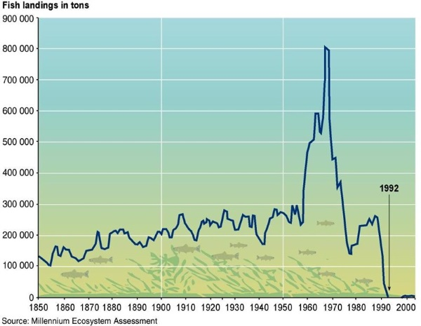
The Atlantic cod has, for many centuries, sustained major fisheries on both sides of the Atlantic. However, the North American fisheries have now largely collapsed.

Slide 26
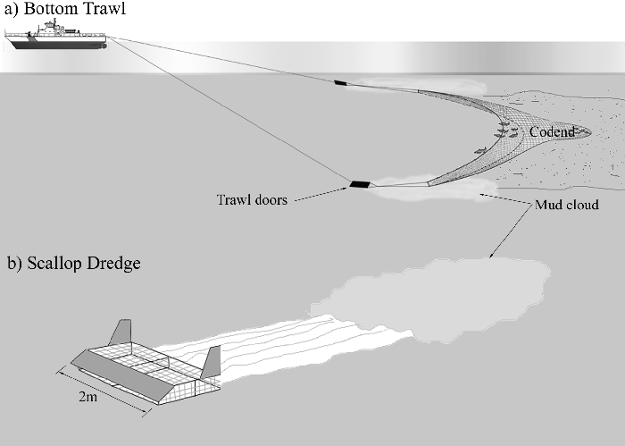
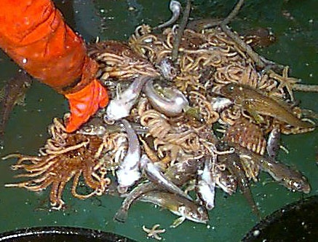
Making Fisheries Sustainable
Bottom-Trawling
Rotation: rotating catches between different species gives the “off” species time to recover their numbers.
Fishing Gear Review: choosing gear that doesn’t hurt the seafloor or unintentionally catch other species.
Harvest Reduction: Slowing the harvests of deep-water species that grow very slowly allows more time for them to recover.
Fishing Bans: Creating and enforcing bans in certain areas and on certain species helps to replenish numerous populations in the area.
Bottom-Trawling catch

Slide 27
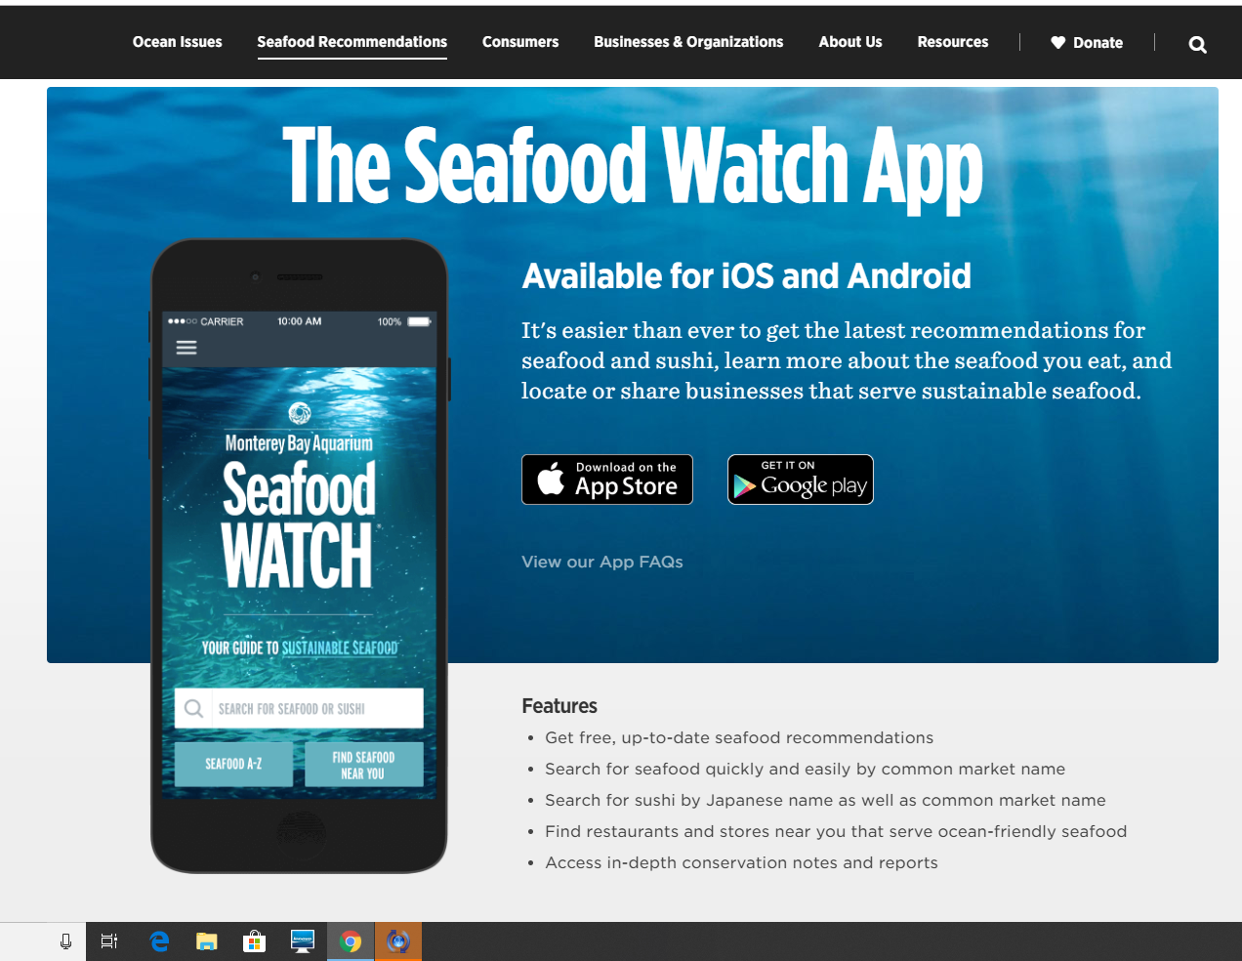
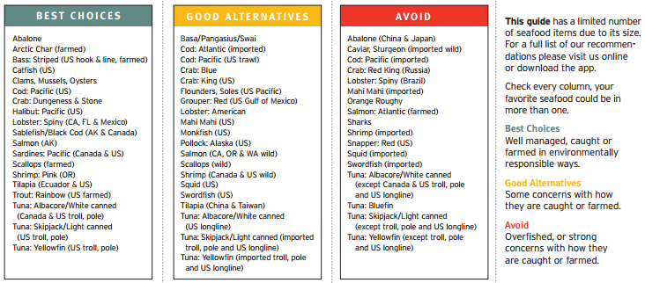
How You Can Help Make Fisheries Sustainable
Look for the Marine Stewardship Council’s checkmark when you buy seafood.
2) Get the Monterey Bay Seafood Watch App.
This tells you when ordering seafood what is considered both safe and sustainable.
3) Know where your seafood comes from!
You should be able to ask your waiter at a restaurant or the person behind the seafood counter where the fish they sell comes from. If they can’t answer, that’s a big red flag.
Notes:
The Marine Stewardship Council is a nonprofit, independent organization based out of the UK that sets a standard for sustainable fishing.

Slide 28
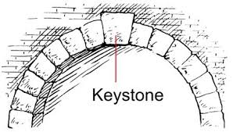
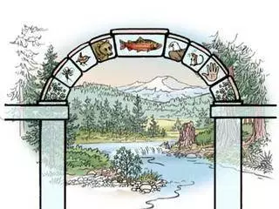
Which species do we save?
Some species are so clearly critical to the functioning of an ecosystem that they are called keystone species.
This term comes from the keystone on an arch, that locks all the other stones into place. Without it the arch falls apart.

Slide 29
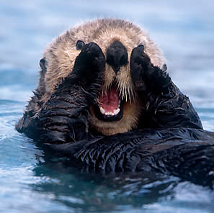
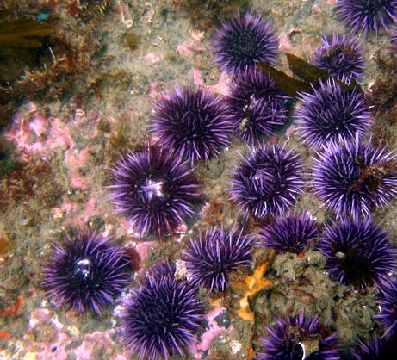
Which species do we save?
In the 1800’s, sea otters were hunted for their fur. They disappeared from the Pacific coast of the U.S.
Sea Urchins, with no more predators, multiplied and ate all of the kelp. The kelp beds began to disappear from the area.
In 1937, a small group of surviving otters was discovered. With protection and scientific efforts, the otter population grew.
The otters once again preyed on the sea urchins. The kelp beds regenerated.

Slide 30
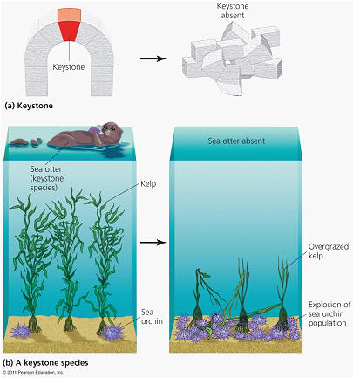

Slide 31
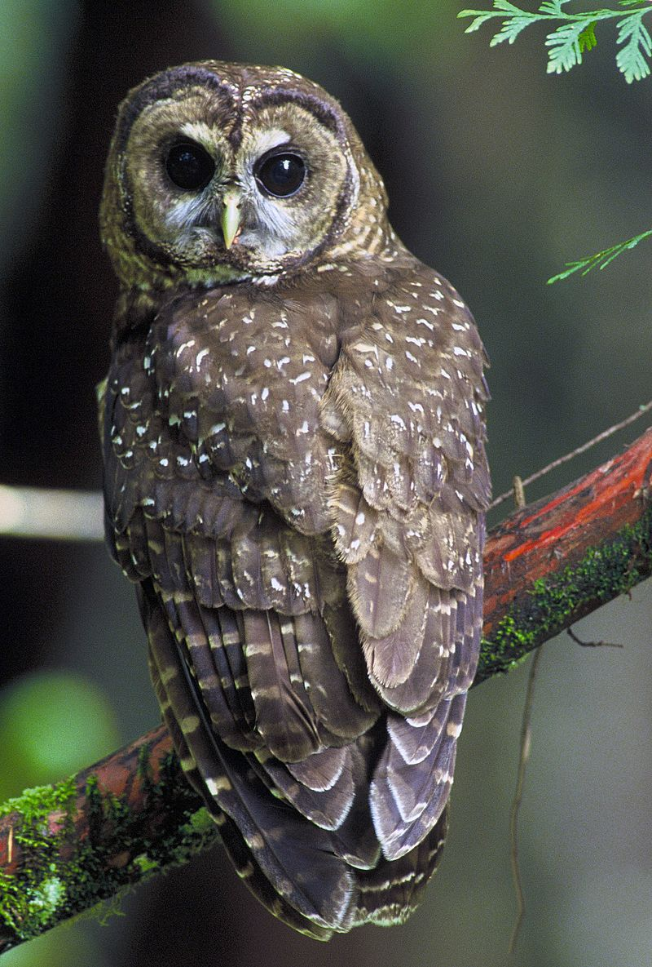
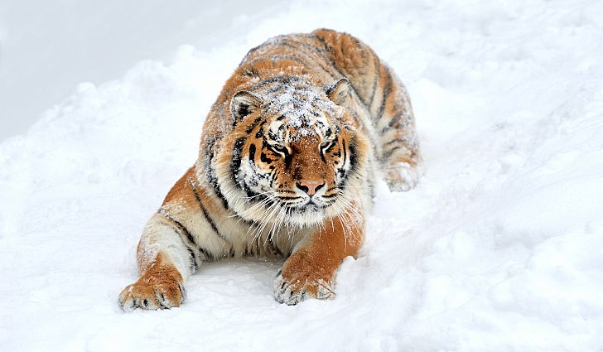
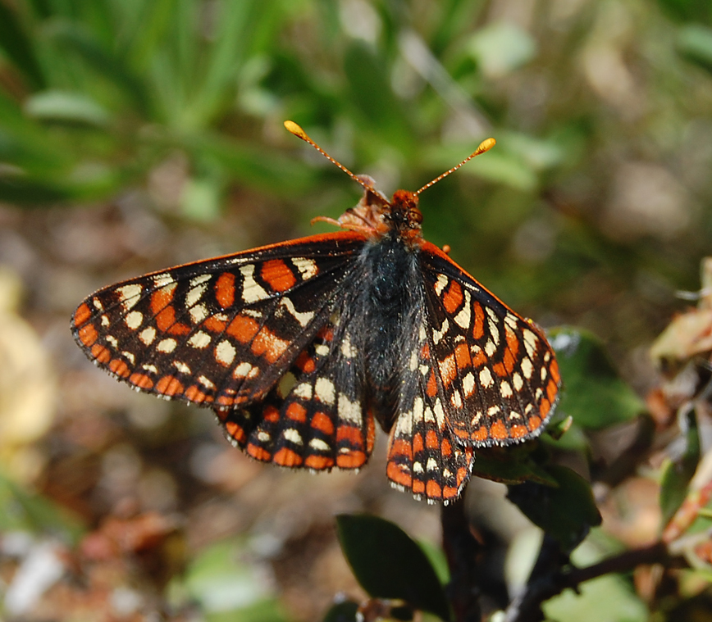
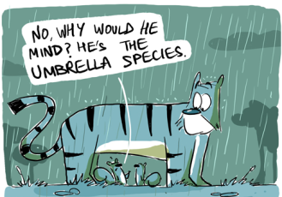
Which species do we save?
Conservationists try to focus efforts on umbrella species, which are species whose being protected leads to the preservation of its habitat and all the other organisms in its community.
Northern Spotted Owl
Bay Checkerspot Butterfly
Amur Tiger
Notes:
By protecting the Northern Spotted Owl, you protect the old growth forests it inhabits.
The Bay Checkerspot Butterfly has been on the Endangered Species list since 1987. By protecting it, we also protect the native grasslands it inhabits.
The Amur Tiger is critically endangered. By protecting it, we protect the habitat of several other species.
The

