Slide 1
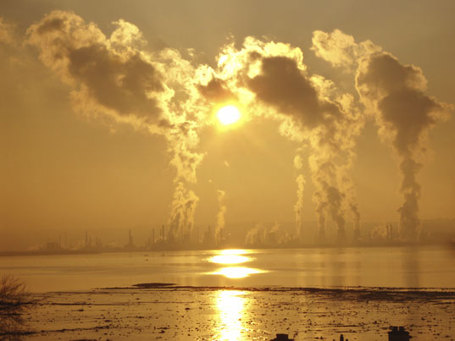
Greenhouse Effect & Climate Change

Slide 2
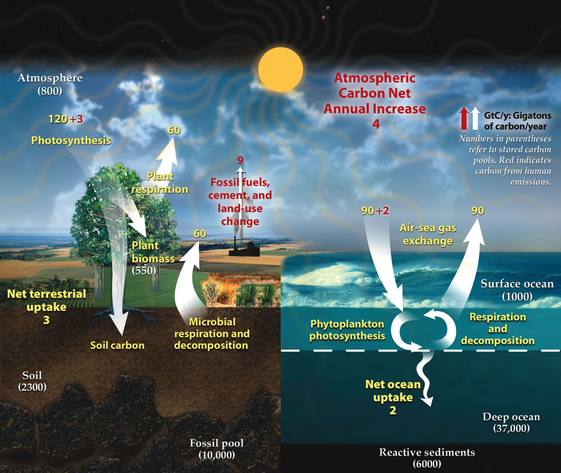
Notes:
This shows in red how we are throwing the carbon cycle out of whack by burning fossil fuels, making cement and land-use change.

Slide 3
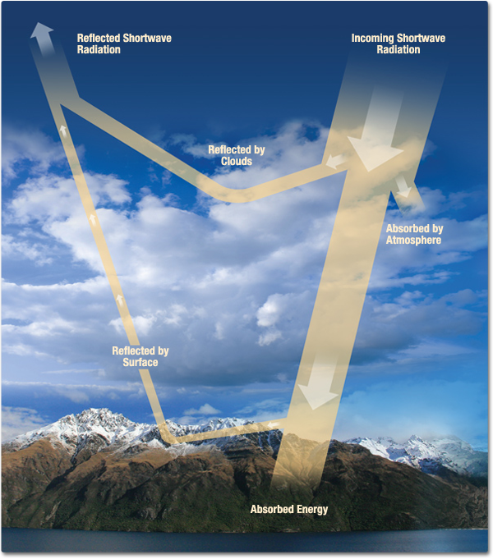
Greenhouse Effect
Light energy from the sun (solar radiation) is either reflected or absorbed by the Earth.

Slide 4
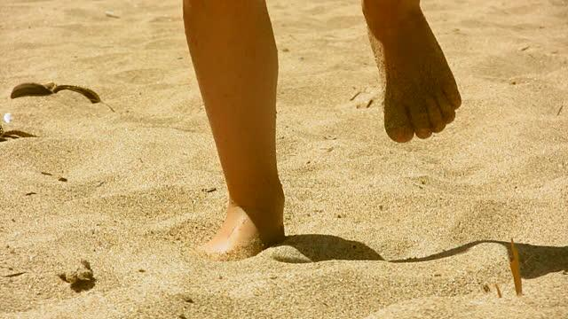
Greenhouse Effect
When it is absorbed by the Earth (or something on the Earth), light is converted into heat energy (infrared radiation).

Slide 5
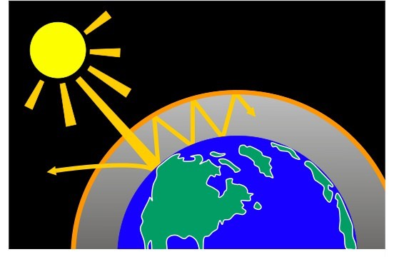
Greenhouse Effect
That heat energy either escapes the Earth through the atmosphere, or gets absorbed by greenhouse gases and reflected back down.

Slide 6
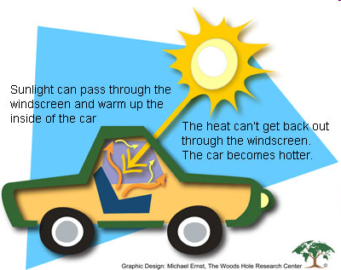
Greenhouse Effect
This is how heat is trapped by the atmosphere and how the Earth stays warm.
Notes:
A car is a good analogy for the Earth/Atmosphere system. The glass windshield is like the atmosphere: it lets sunlight in but traps heat.
The upholstery of the car acts like the Earth. It absorbs sunlight and turns it into heat.

Slide 7
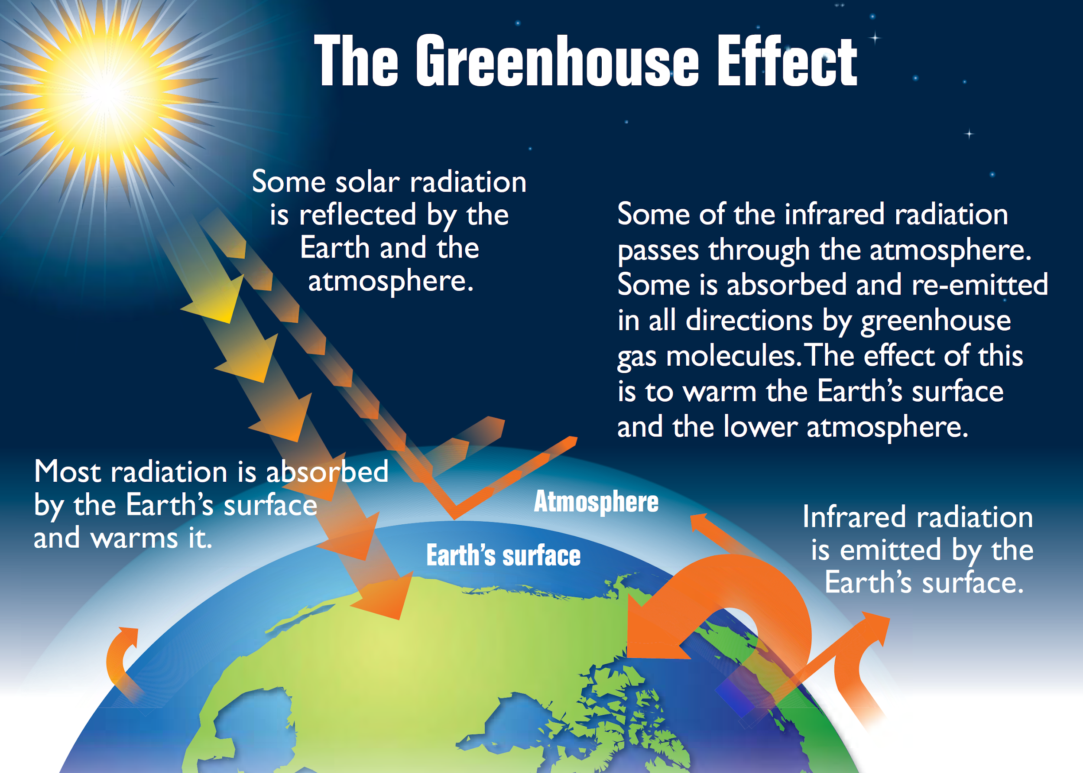

Slide 8
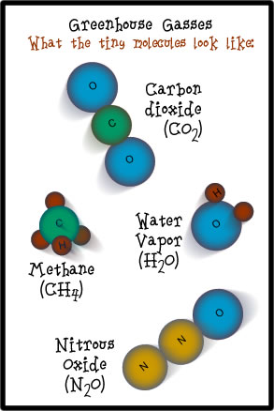
Greenhouse Effect
Greenhouse gases reflect heat & include:
Water (H2O)
Methane (CH4)
Carbon Dioxide (CO2)
Nitrous Oxide (N2O)
The first 3 are very natural, and in
fact are necessary to keep the Earth
warm.

Slide 9
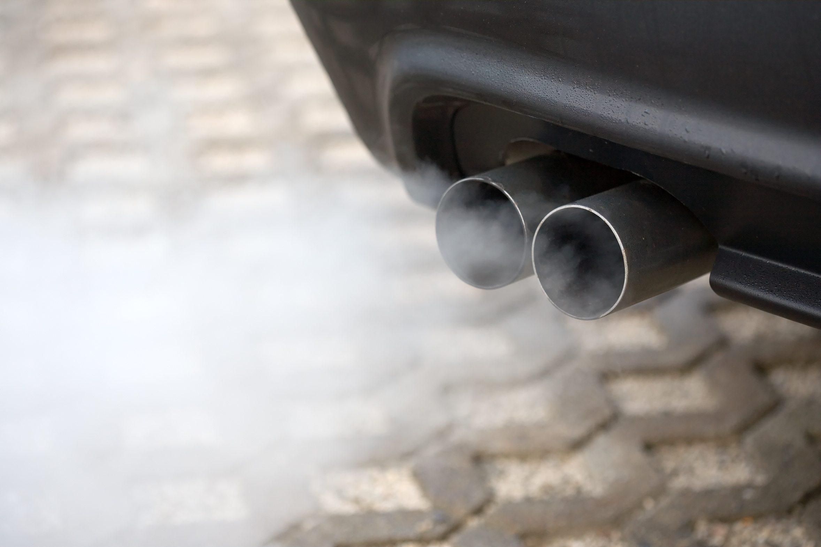
Greenhouse Effect
Nitrous Oxides are formed from combustion of fossil fuels.

Slide 10
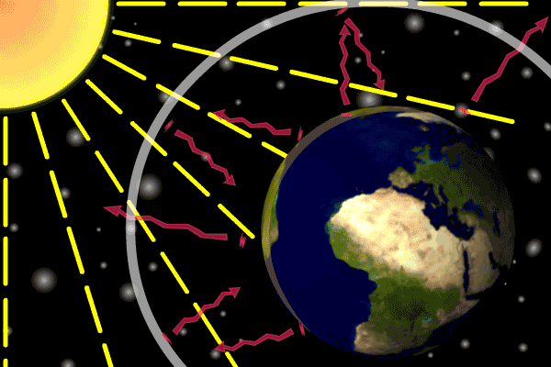
Greenhouse Effect
The greenhouse effect is natural and necessary for most life here on Earth.
Without greenhouse gases, the Earth would be too cold for most life.

Slide 11
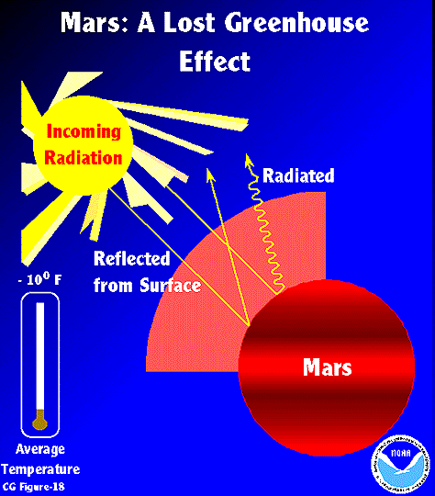
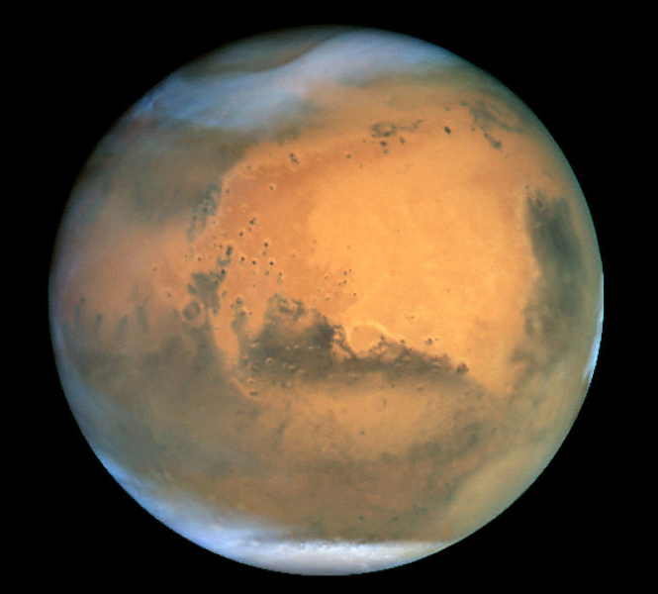
Greenhouse Effect
Without the greenhouses gases in our atmosphere the Earth’s average temperature would be -16⁰C ! This happened to Mars which lost its atmosphere.

Slide 12
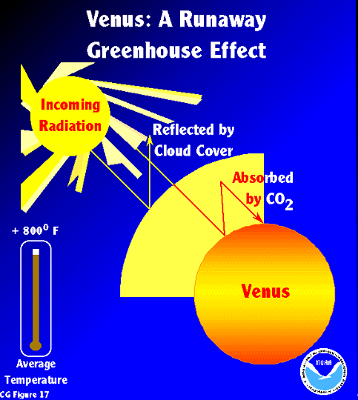
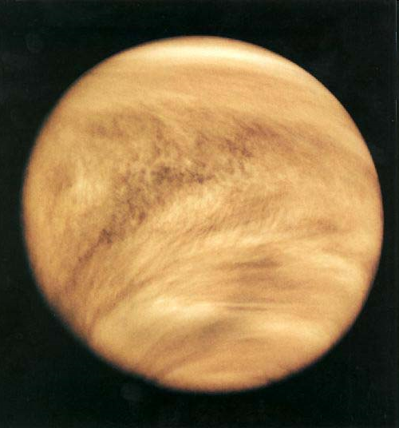
Greenhouse Effect
If a planet has extremely high concentrations of greenhouse gases in its atmosphere however it can have a runaway greenhouse effect.
This is the case with Venus, whose high concentrations of carbon dioxide give it an average surface temperature of 425⁰C!!!

Slide 13
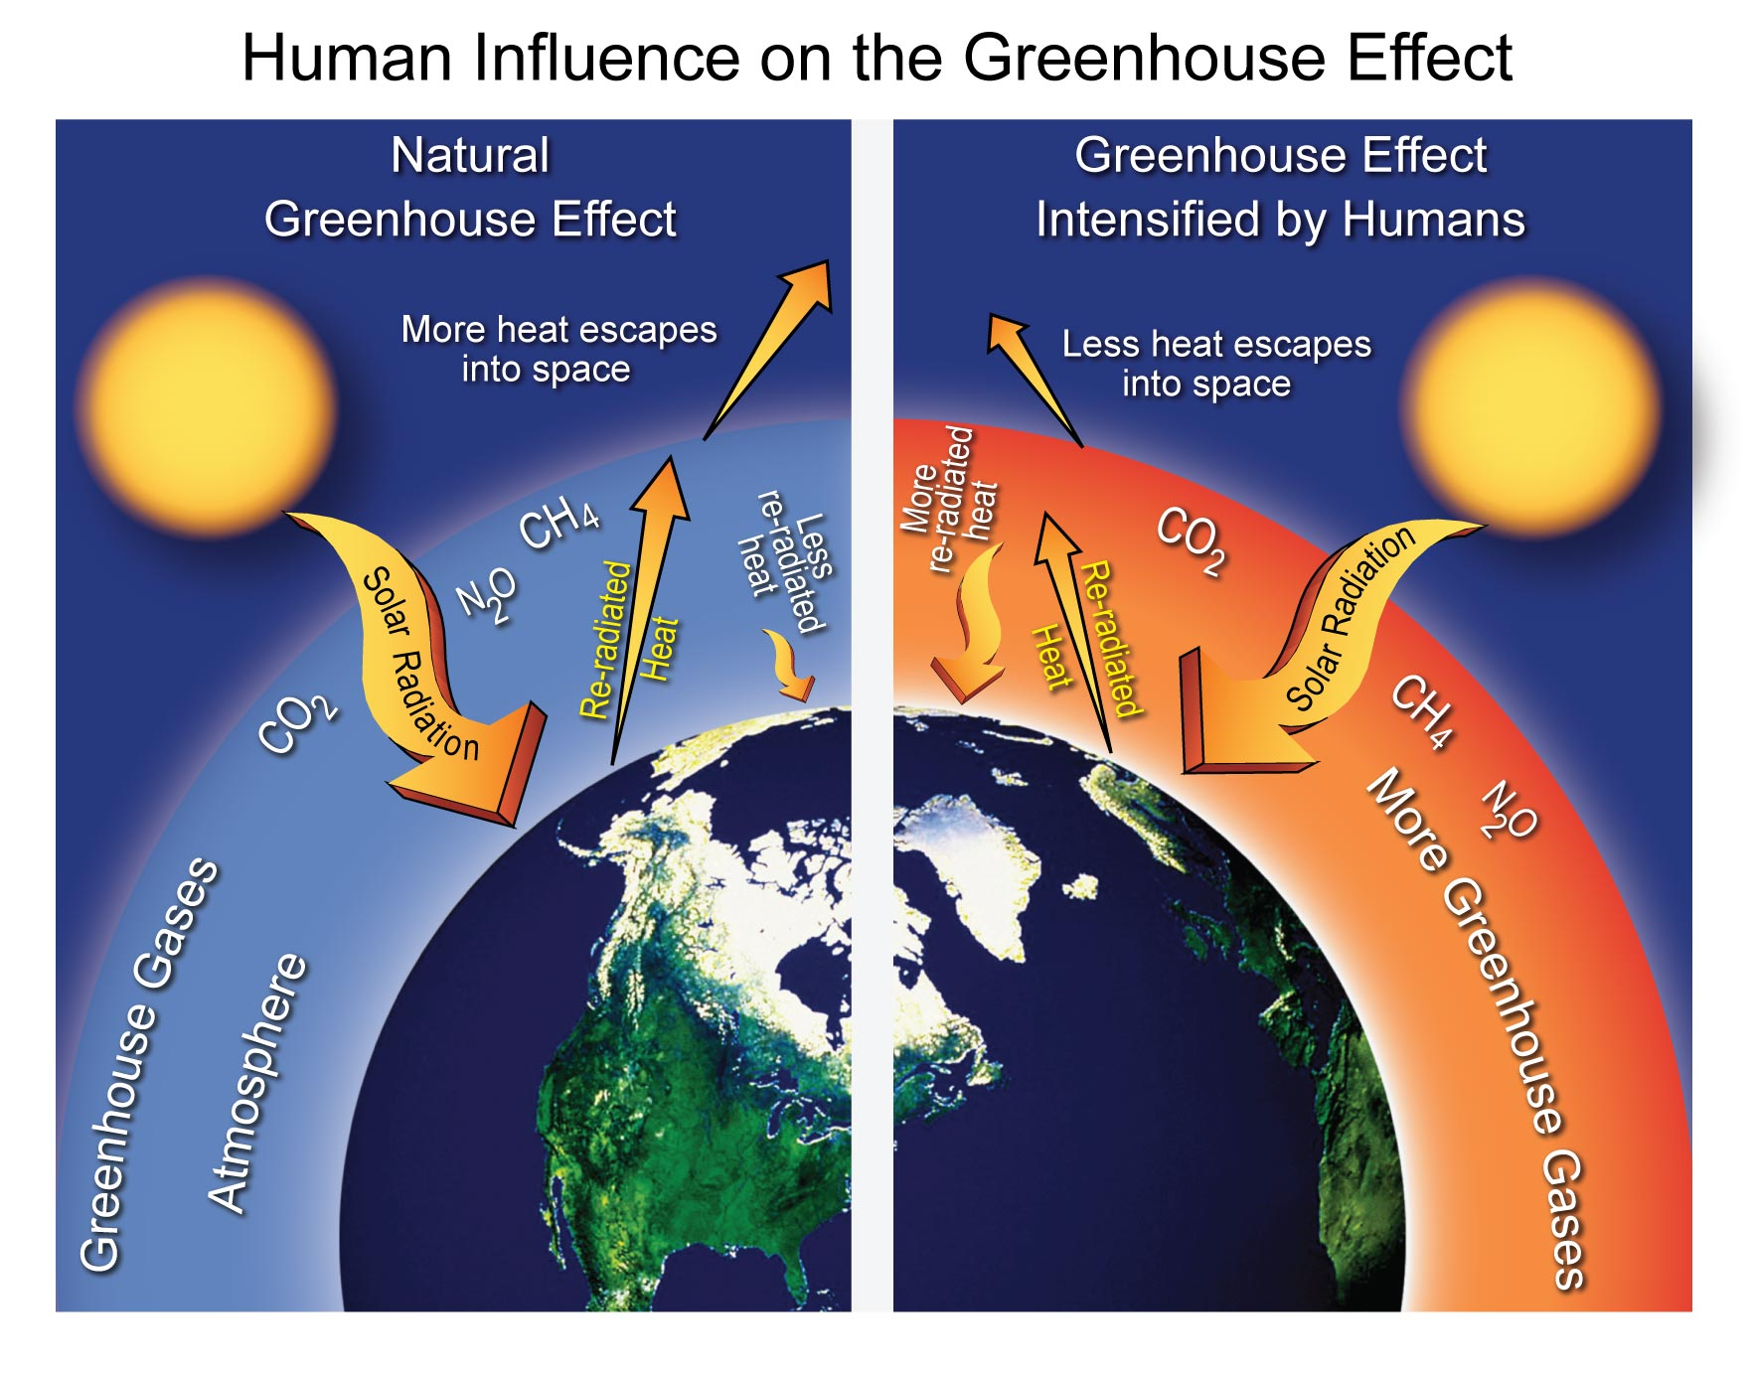
Causes of Climate Change
As more CO2 is added to the atmosphere, it traps more heat reflected from the Earth and raises the average global temperature.

Slide 14
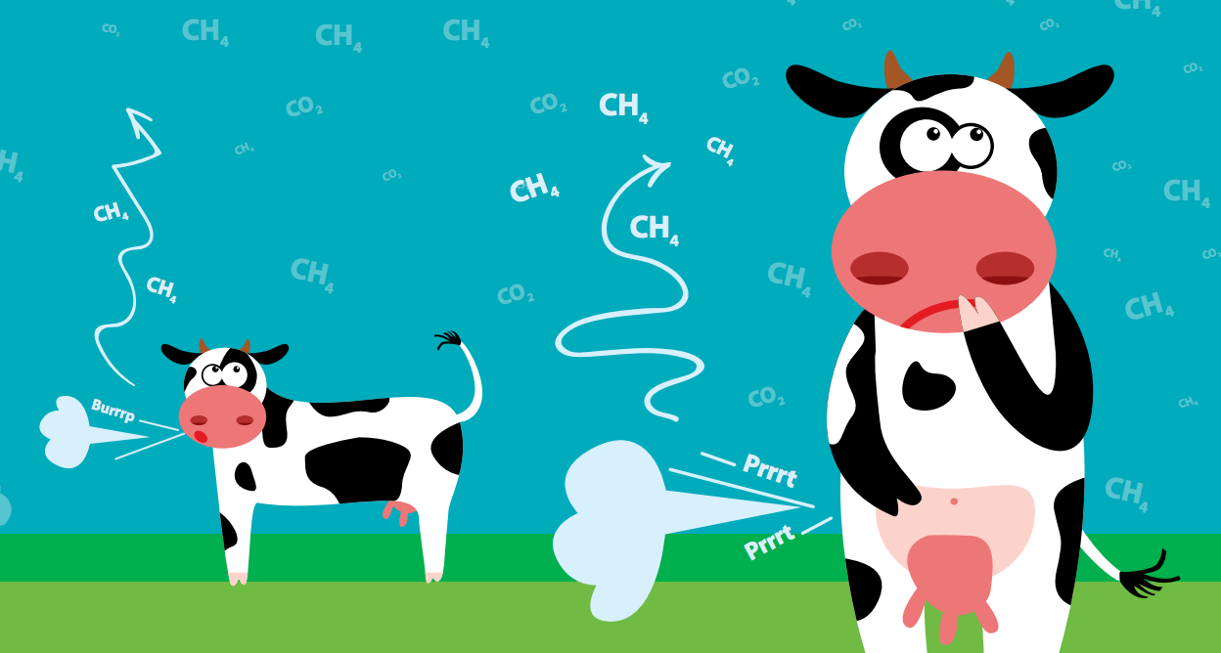
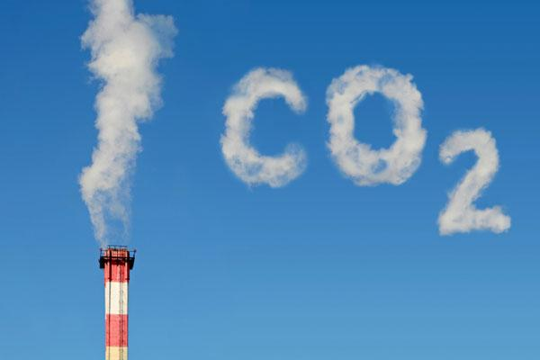
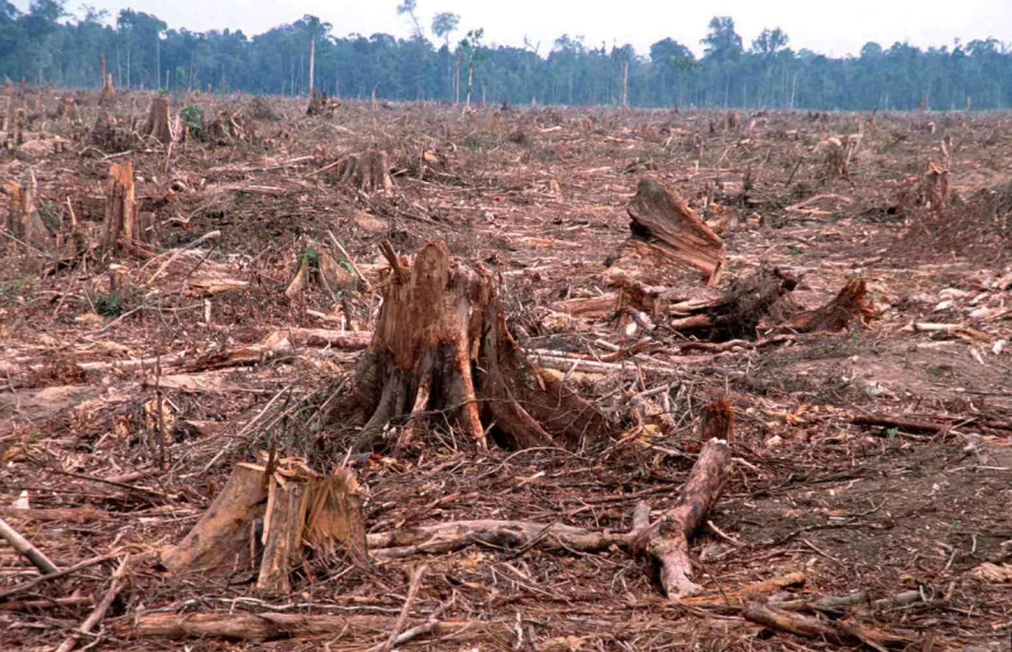
Causes of Climate Change
Humans have steadily been adding more CO2 to the atmosphere since the Industrial Revolution by burning fossil fuels, and cutting or burning trees down on massive scales.
Oh and Cows.

Slide 15
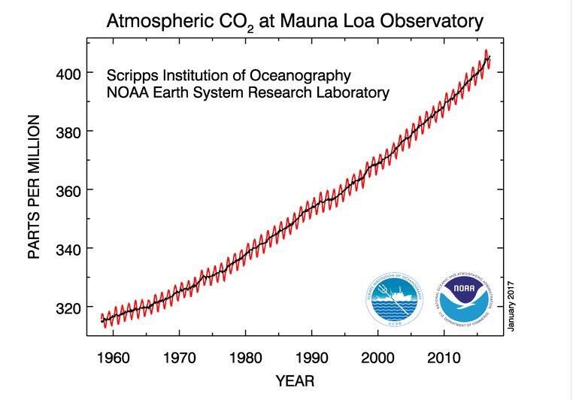
Evidence of Climate Change
CO2 levels in the atmosphere have been recorded since 1958.
We have seen a steady increase of almost 100 parts per million since then.

Slide 16
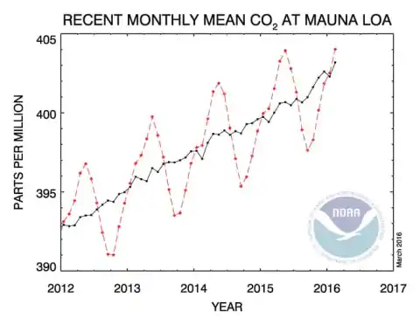
Evidence of Climate Change
CO2 levels in the atmosphere cycle annually, but we still see a steady increase upward.
Notes:
You can explain the annual fluctuations in CO2. The Northern hemisphere of the Earth has many more trees than the Southern hemisphere (which is mostly ocean). When it is spring and summer in the northern hemisphere, it is fall and winter in the southern. As trees and plants grow in the spring they act as carbon sinks taking carbon out of the air. When these trees and plants die or lose their leaves in the fall, they act as carbon sources. The decomposing leaves/plants will release the carbon back into the atmosphere. The Earth then has what some have described as a “breathing” cycle.

Slide 17
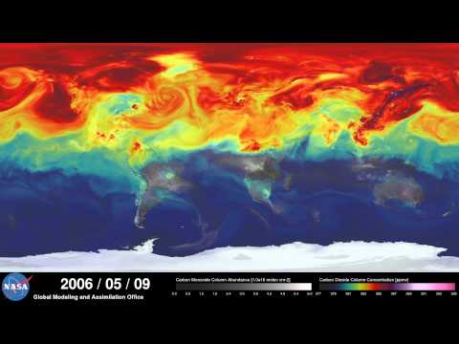
Evidence of Climate Change

Slide 18
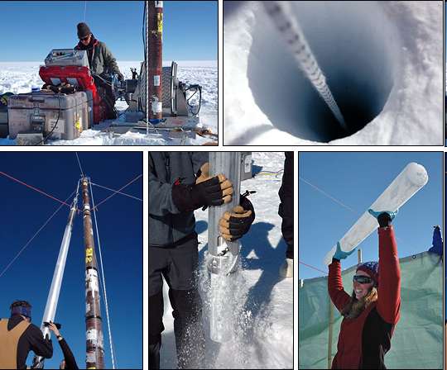
Evidence of Climate Change
What about the fact that atmospheric CO₂ levels have cycled every 100 million years or so?
We can tell what the levels of CO₂ were in the atmosphere thousands of years ago by analyzing ice cores drilled from ice sheets.

Slide 19
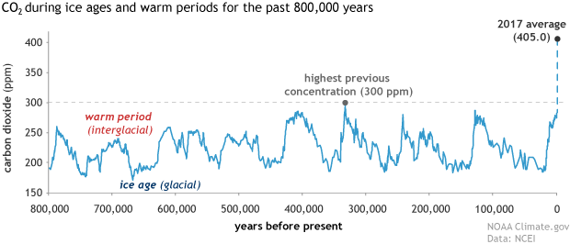
Evidence of Climate Change
These cores show that CO₂ levels did cycle in the past, but never went over 300 parts per million (ppm) or increased at the rate we see currently. Today we are at 400 ppm.
That’s higher than CO₂ levels have been for at least the last 3,000,000 years.

Slide 20
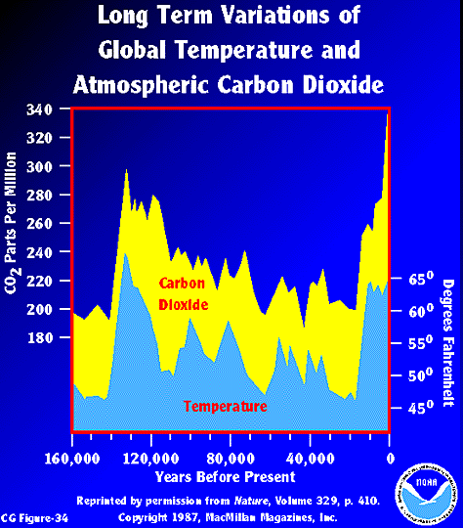
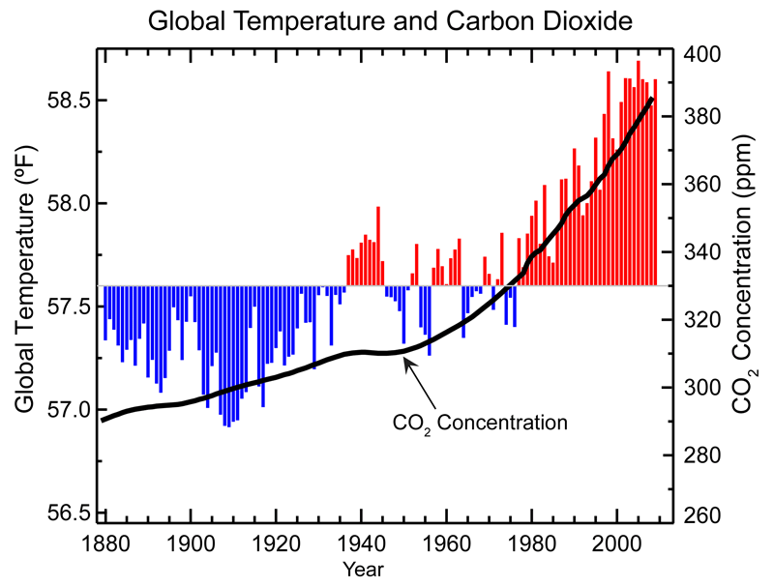
Evidence of Climate Change
Scientists have concluded there is a direct link between the amount of CO2 pumped into the air and the increase in average temperature the Earth has experienced recently.

Slide 21
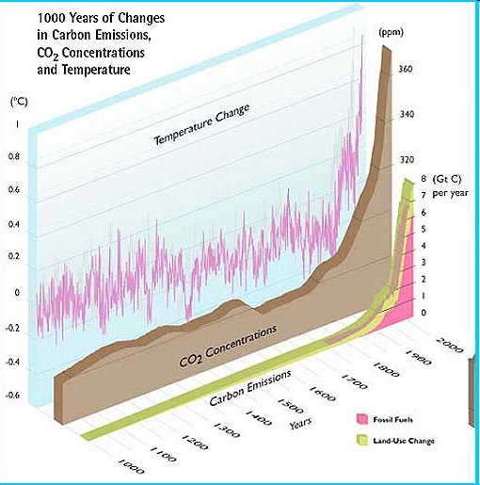
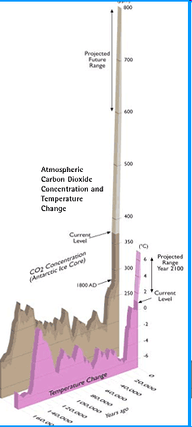

Slide 22
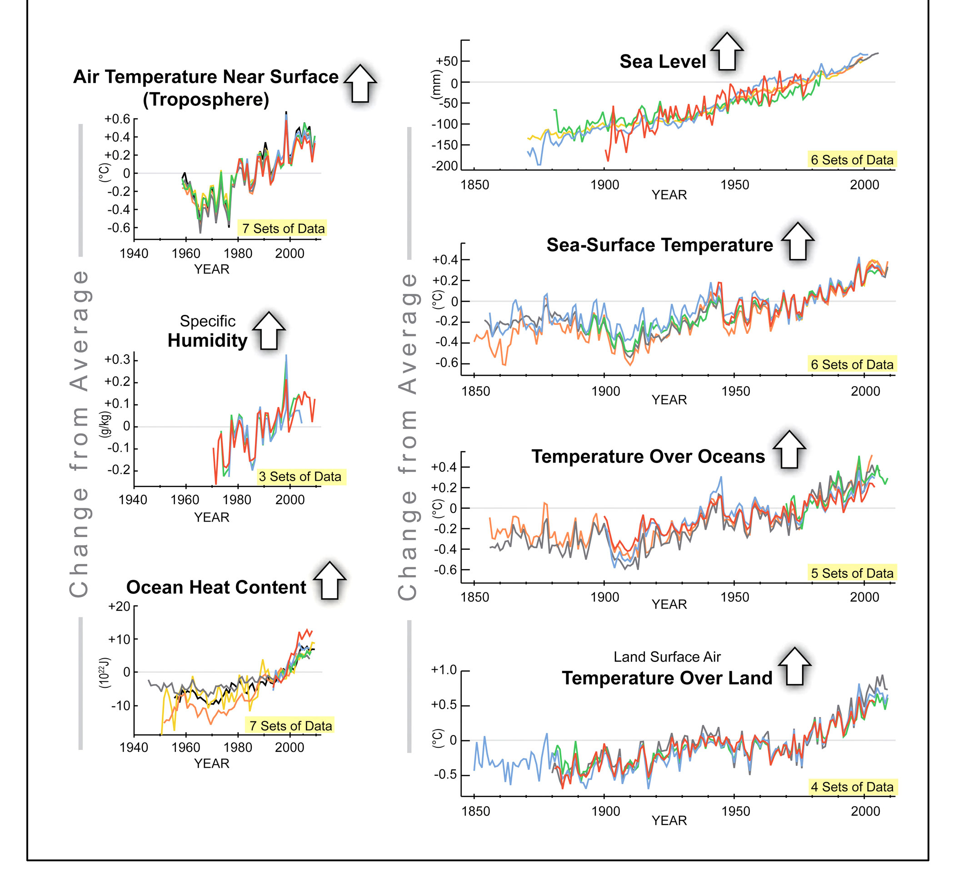
Evidence of Climate Change
We would expect all of the following to increase in a warming world, and that is what we are seeing.
Notes:
Point out that all of these studies have multiple sets of data to suppot them.

Slide 23
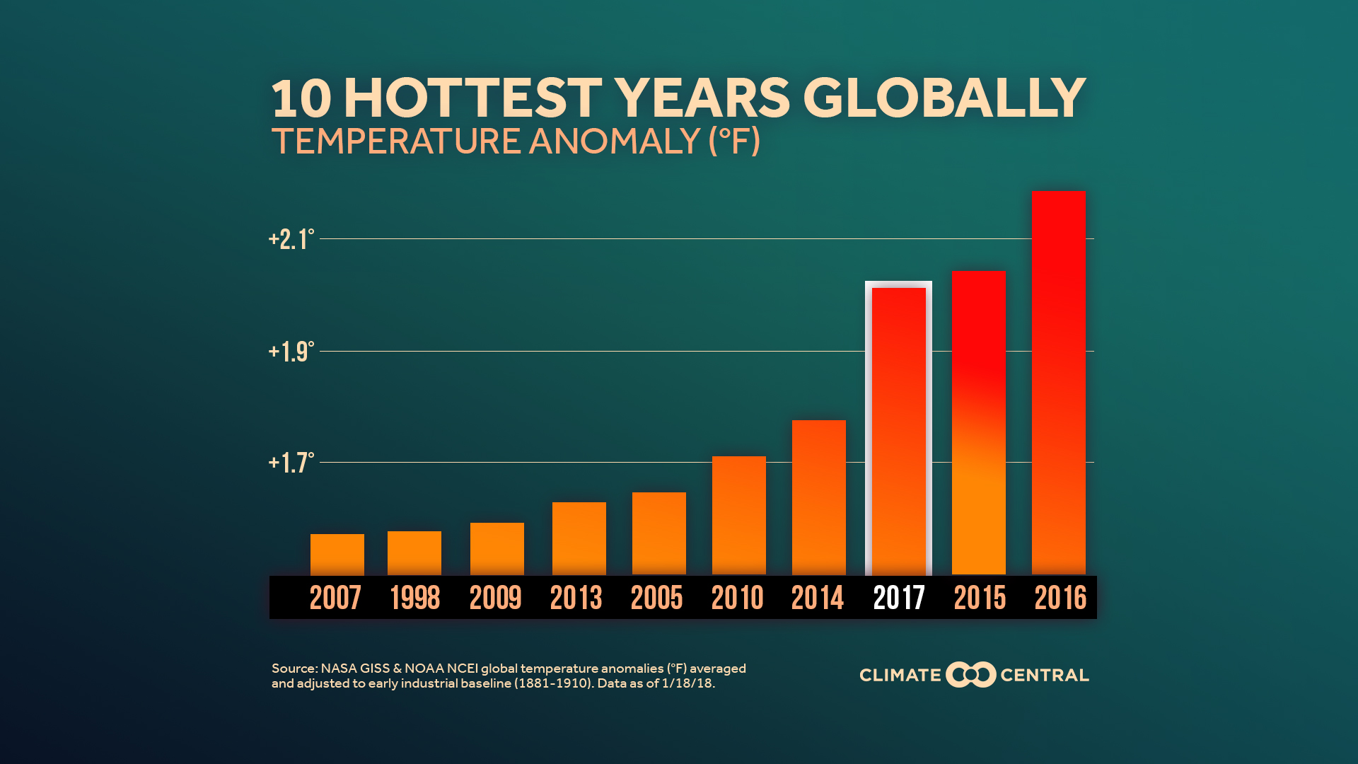
Effects of Climate Change
High Global Temperatures

Slide 24
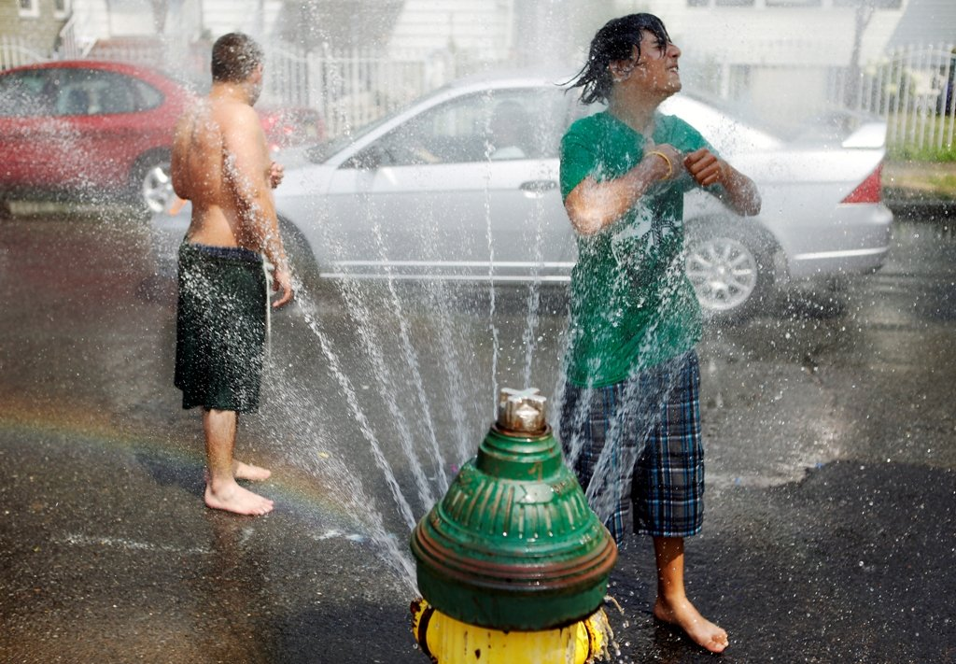
Effects of Climate Change
High Global Temperatures
cause more frequent Heat Waves.

Slide 25
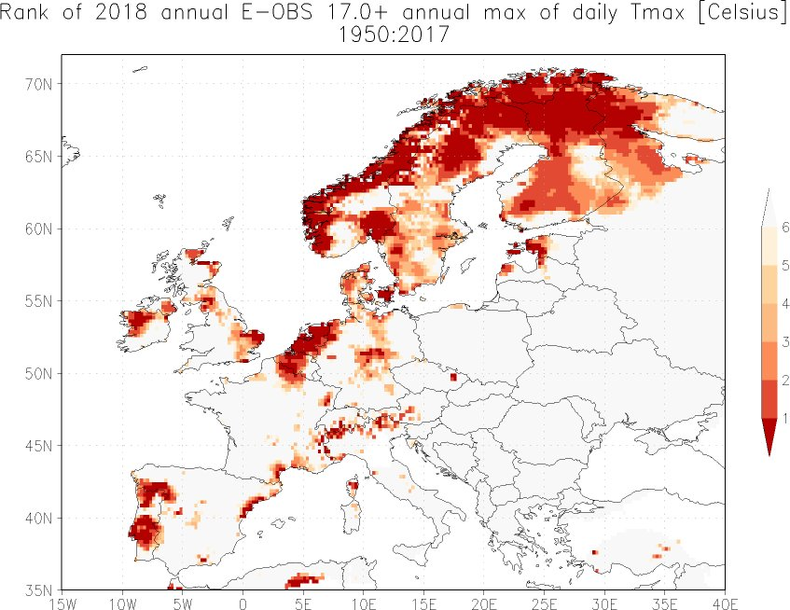
Effects of Climate Change
Europe had a massive heat wave in the summer of 2018.
Notes:
Dark red means record high since 1950, lighter red is second place, etc...

Slide 26
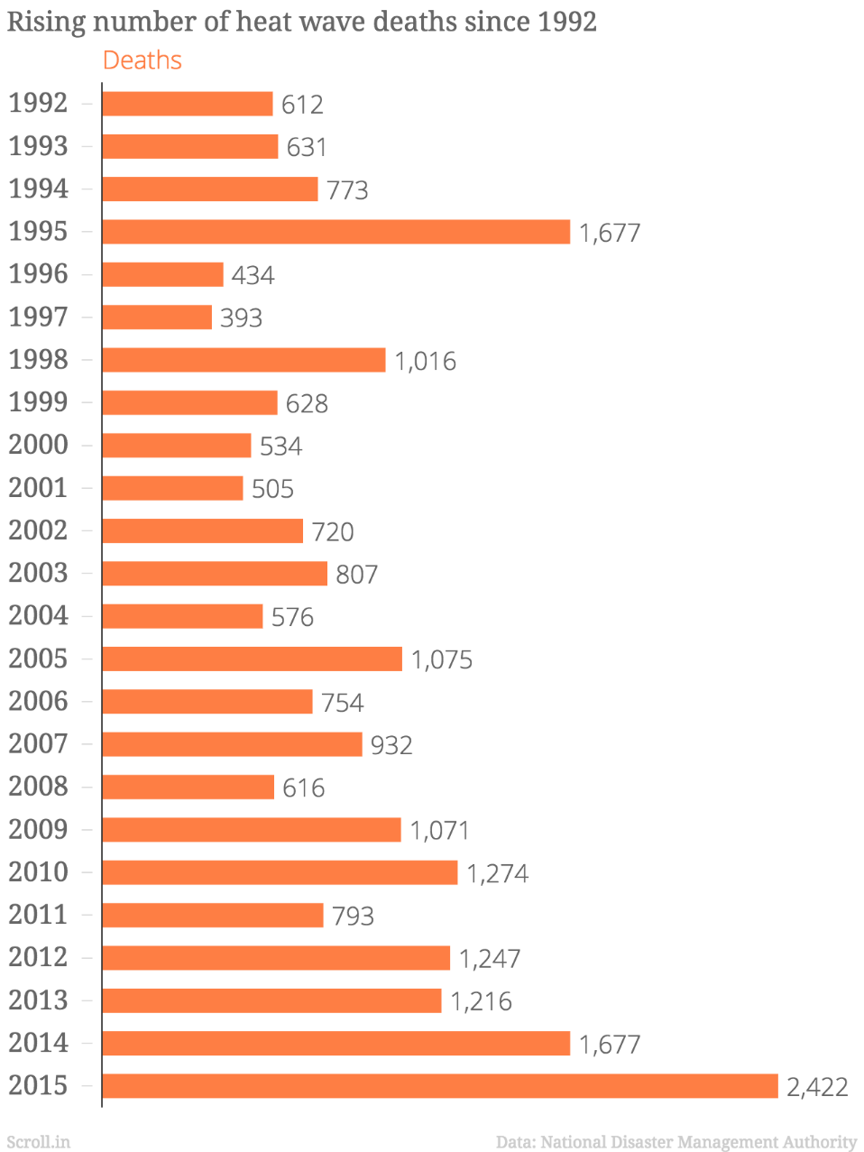
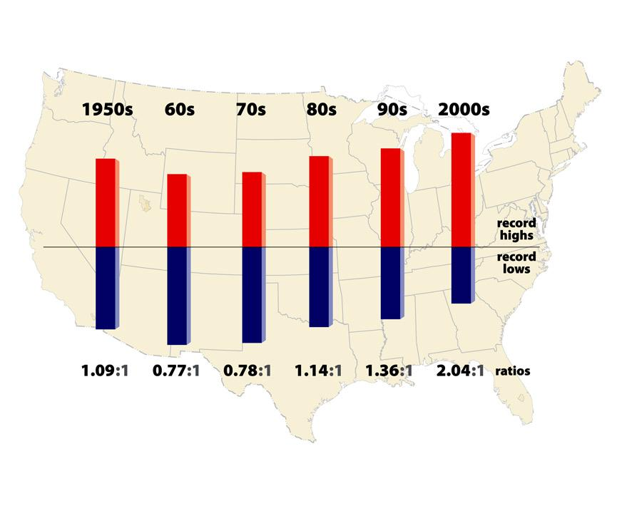
Effects of Climate Change
Heat Waves

Slide 27
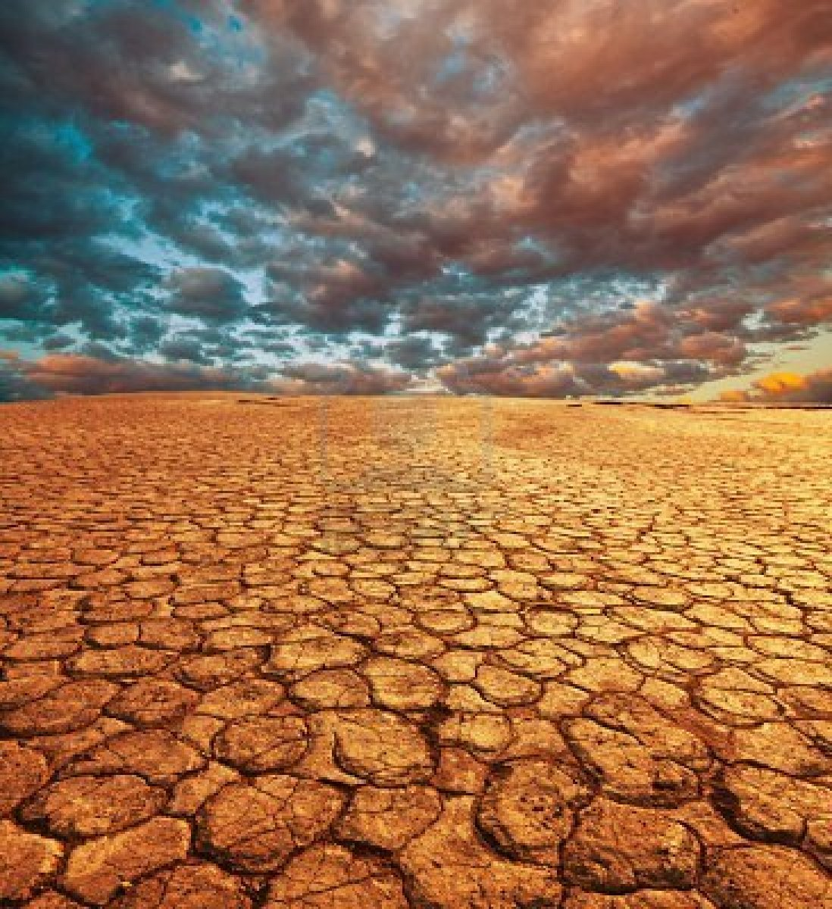
Effects of Climate Change
High Global Temperatures
Lead to
Droughts

Slide 28
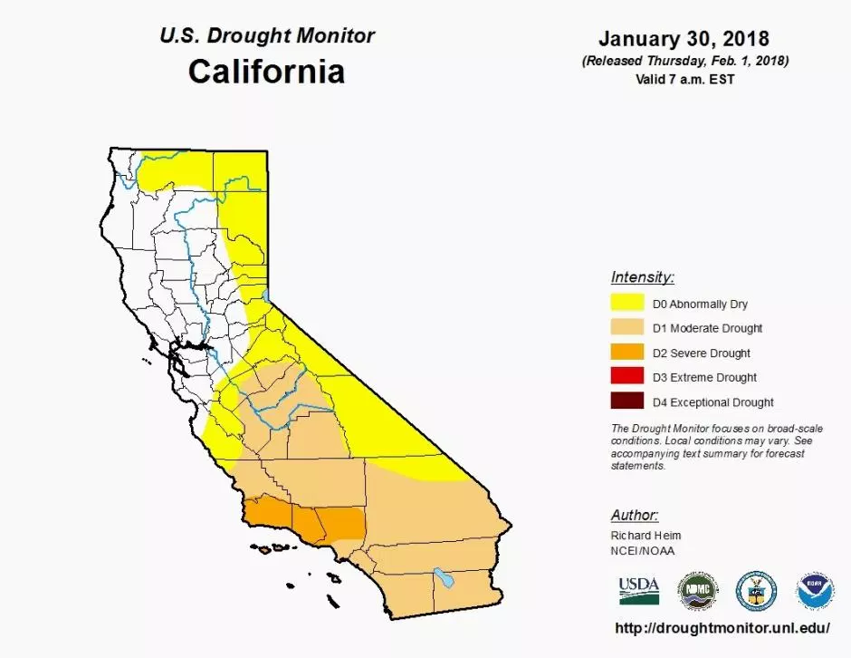
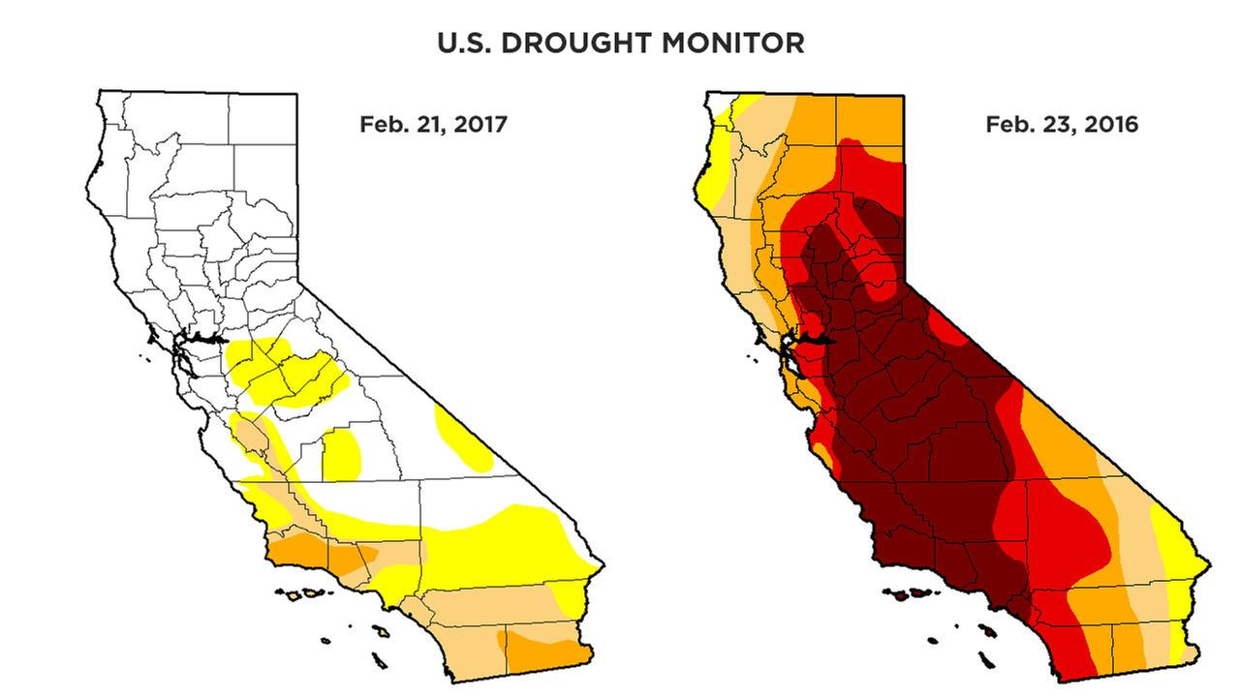
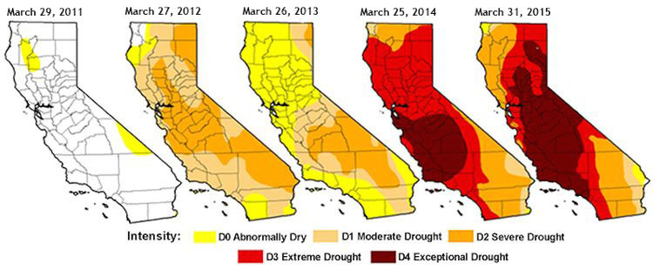
Effects of Climate Change
High Global Temperatures
Lead to
Droughts
California had the worst drought in recorded history a few years ago. This year and last year were better.

Slide 29
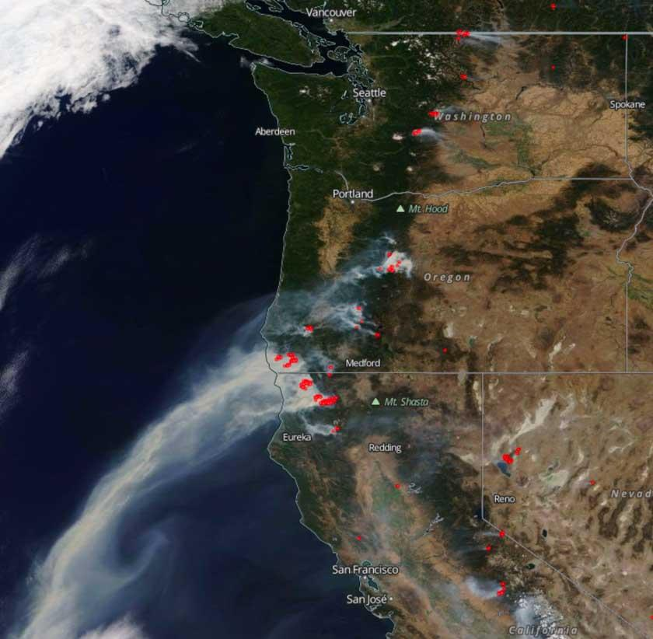
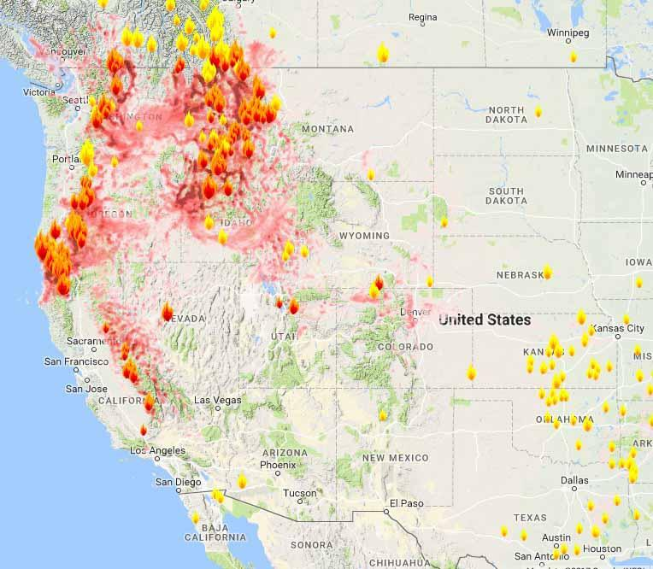
Effects of Climate Change
High Global Temperatures
Lead to
Droughts
Which lead to wildfires
Notes:
Wildfire data from summer of 2017

Slide 30
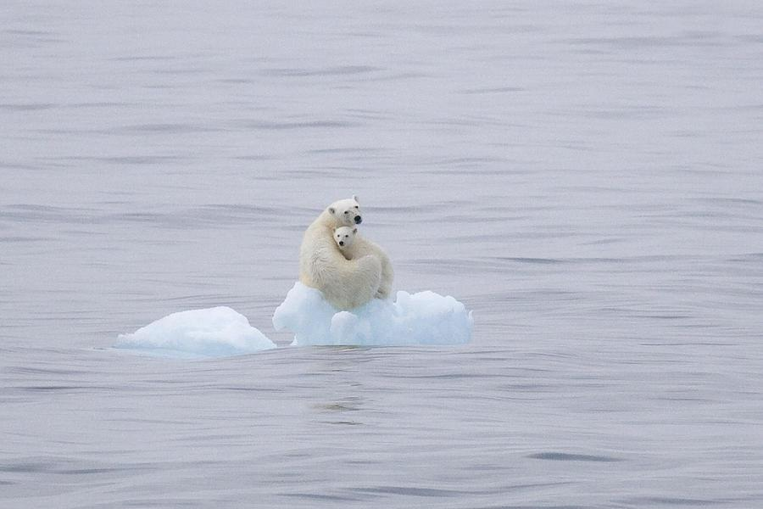
Effects of Climate Change
High Global Temperatures
Also lead to more glacial ice melting.

Slide 31
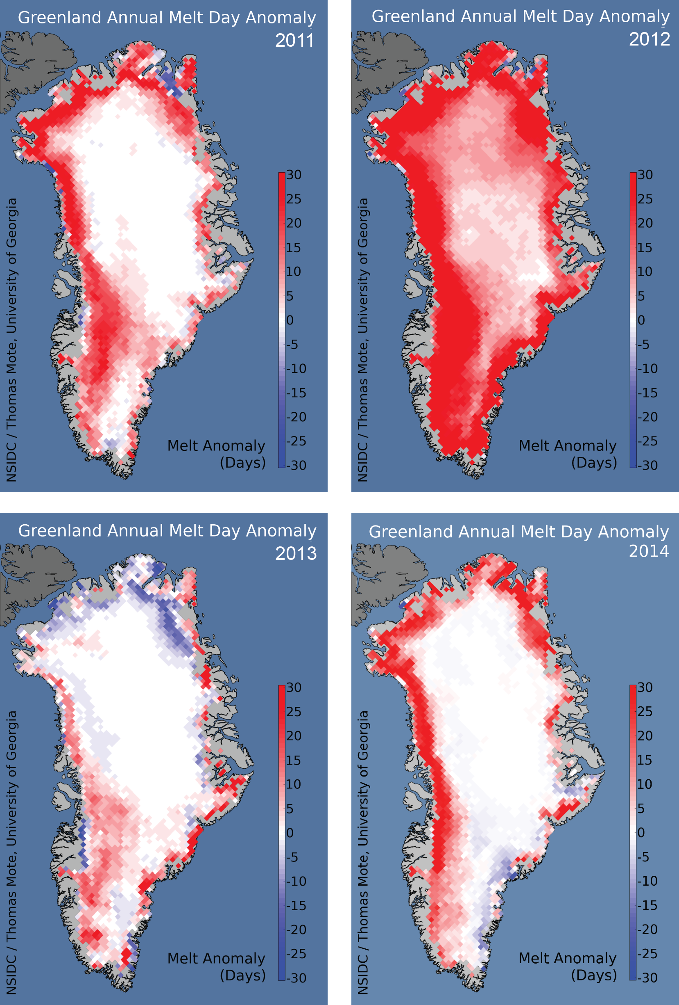
Effects of Climate Change
High Global Temperatures
Lead to more glacial ice melting.
This is especially troubling in Greenland
Notes:
Greenland contains roughly 8% of all ice on Earth.
If the entire Greenland ice sheet were to melt, global sea levels would rise by 20 ft.

Slide 32
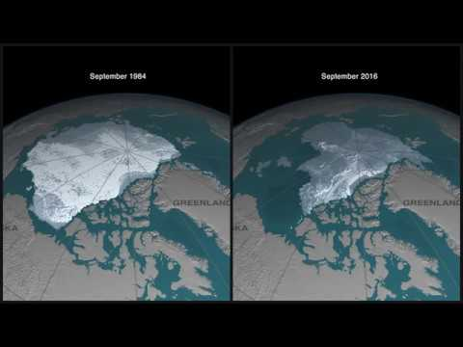
Effects of Climate Change

Slide 33
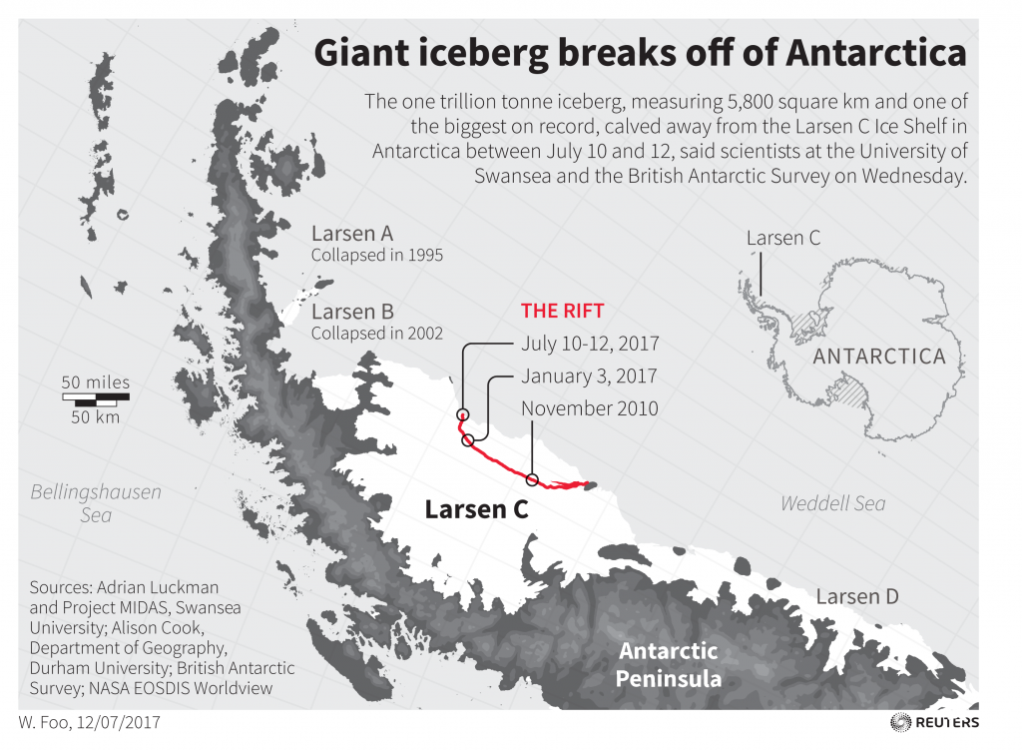
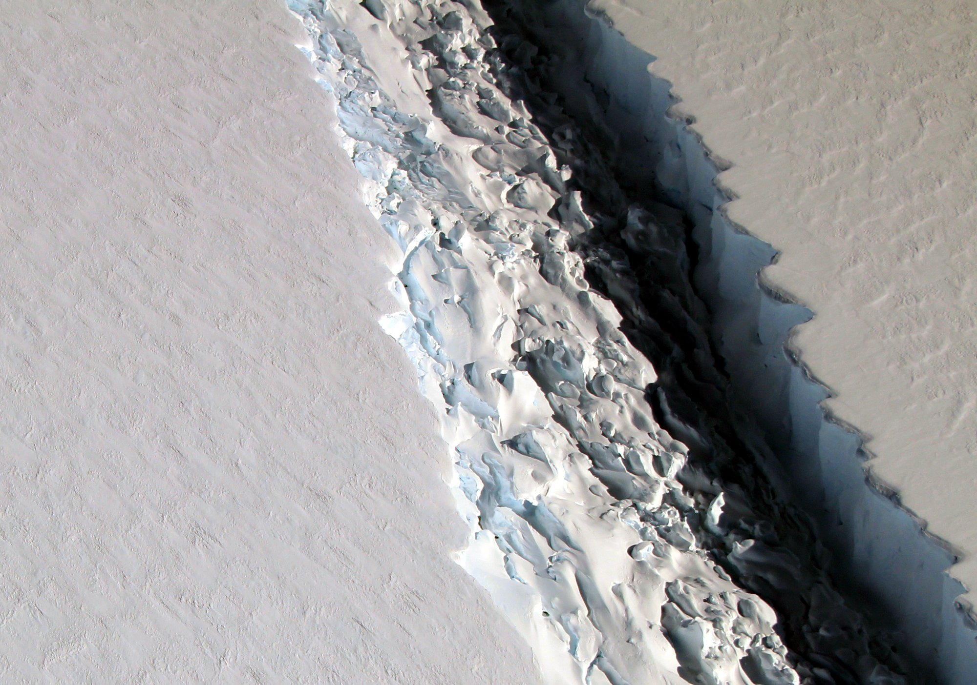

Slide 34
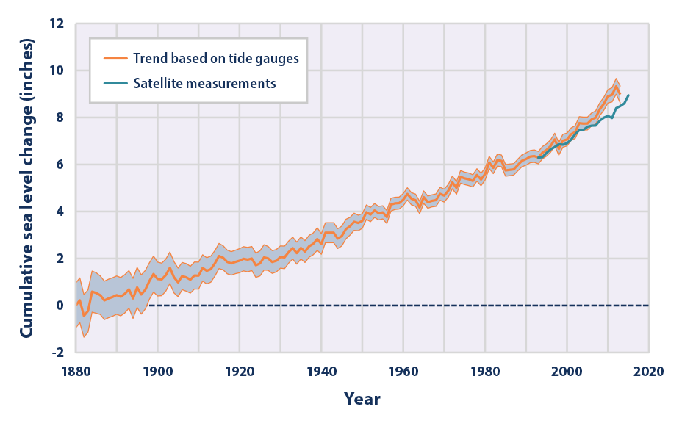
Effects of Climate Change
High Global Temperatures
Lead to more glacial ice melting.
Which will lead to rising oceans.

Slide 35
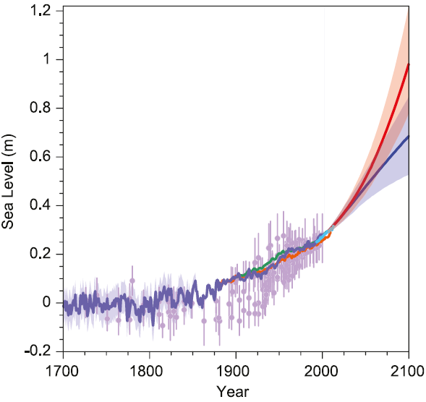
Effects of Climate Change
Just how much will the oceans rise in your lifetime?
Fig. 1. Past and future sea-level rise. For the past, proxy data are shown in light purple and tide gauge data in blue. For the future, the IPCC projections for very high emissions (red, RCP8.5 scenario) and very low emissions (blue, RCP2.6 scenario) are shown. Source: IPCC AR5 Fig. 13.27.

Slide 36
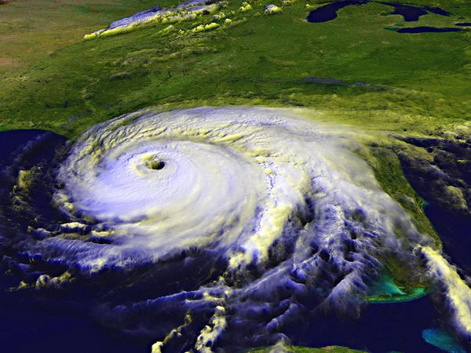
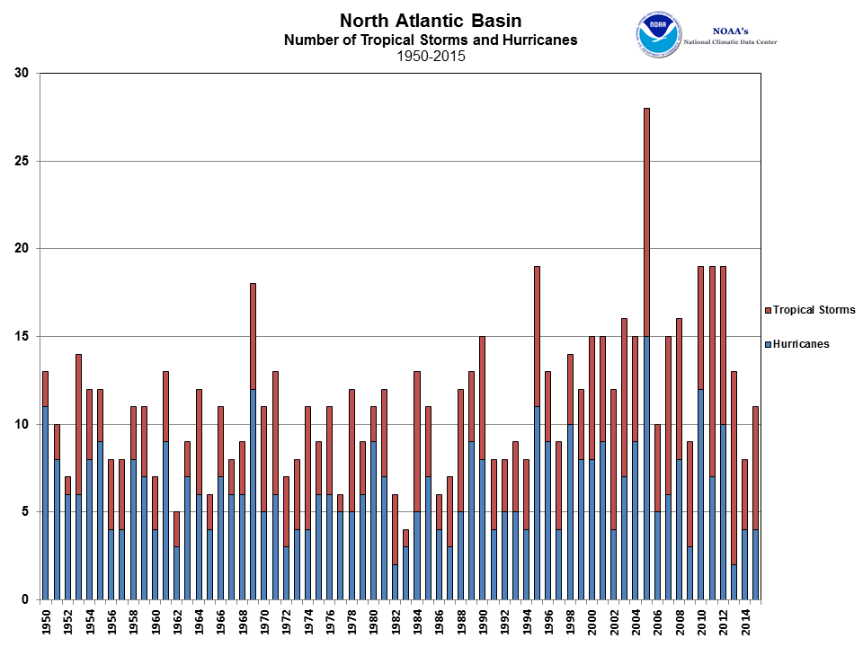
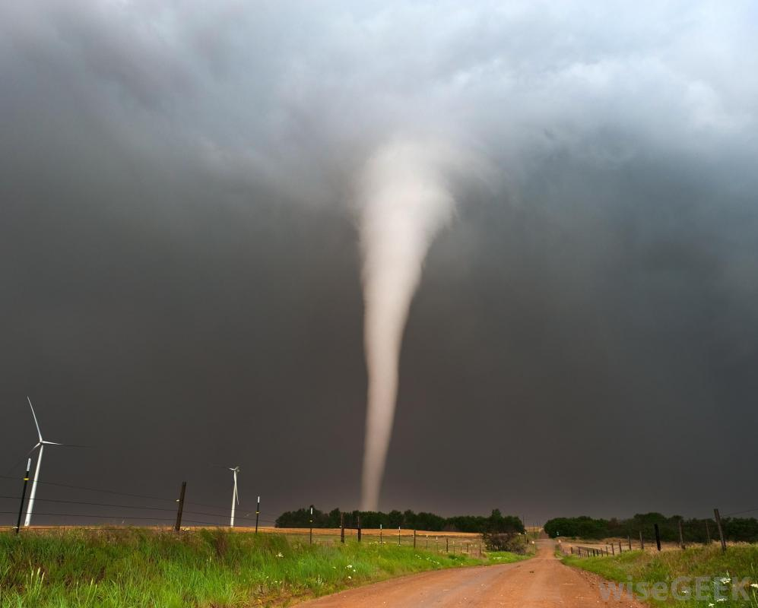
Effects of Climate Change
Rising Sea Levels Leads to more Extreme Weather

Slide 37
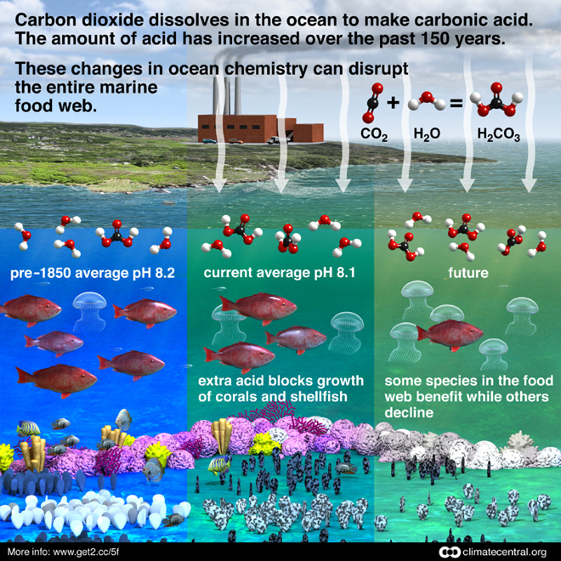
Effects of Climate Change
The ocean absorbs much of the excess carbon dioxide in our atmosphere, leading to ocean acidification.

Slide 38
Effects of Climate Change
Leads to ocean acidification
Which can cause coral bleaching

Slide 39
Feedback Loops
Climate change is being exacerbated by feedback loops.
Remember:
Positive feedback tends to promote instability in systems (think spiraling out of control).
Negative feedback tends to promote stability in systems (think again about homeostasis).

Slide 40
Positive Feedback: Albedo
One example of positive feedback with climate change would be albedo.
Albedo measures how reflective a surface is in a fraction or %.
The higher the albedo:
The more reflective the surface.

Slide 41
Albedo
This is why snow and ice help keep the planet cool. They have a high albedo, and therefore light energy is not converted into heat but reflected back off into space.

Slide 42
Albedo
Albedo measures how reflective a surface is in a fraction or %.

Slide 43
Positive Feedback
We call this a positive feedback loop where:
A produces more of B, which then in turn produces more of A.
Melting sea ice creates a lower albedo, which then in turn causes more ice to melt.

Slide 44
Climate change Vocabulary
Greenhouse Effect
Greenhouse Gas
PPM
Ocean Acidification
Albedo

