Slide 1
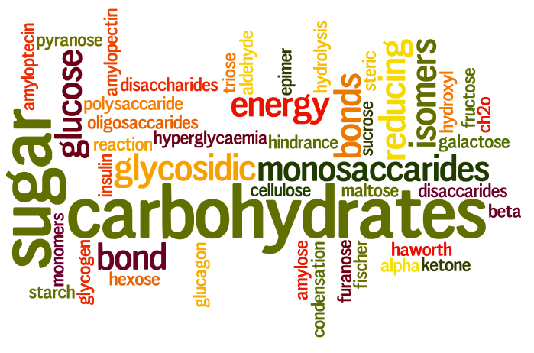
Carbohydrates

Slide 2
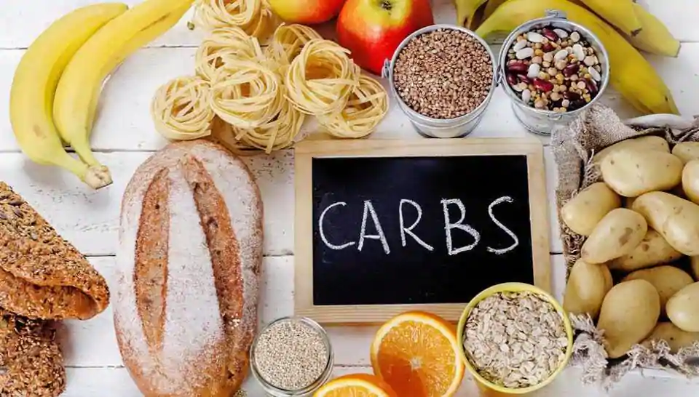
Carbohydrates
Made up of C, H, and O
STOP AND THINK!
Why do you think they call them CARBOhydrates?

Slide 3
Carbohydrates
This group contains simple and complex sugars
Typically end in letters –ose
3 Forms:
Monosaccharides, i.e. glucose
Disaccharides, i.e. sucrose
Polysaccharides, i.e. cellulose
Can be broken down to provide a source of usable chemical energy

Slide 4
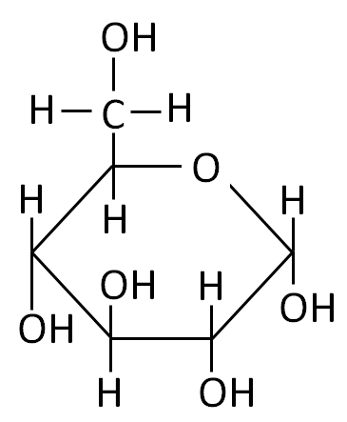
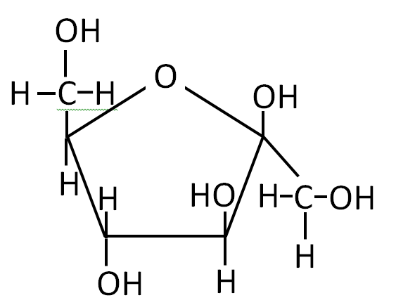
Monosaccharides: “1”
a.k.a. Simple Sugars
E.g. Glucose
VERY, VERY important!
Produced during photosynthesis and the primary form of energy for almost all organisms
E.g. Fructose
Fruit sugar
What atom is at each bend in the ring?
http://cdavies.files.wordpress.com/2009/01/glucose-fructose-sucrose.jpg

Slide 5
NOW DRAW GLUCOSE IN YOUR NOTES

Slide 6
Isomers
– compounds with the same chemical formula but different structure
Choose one monosaccharide below and count up how many C’s, H’s, and O’s it has.
All 3 have the formula C₆H₁₂O_{6.}
http://www.sonefe.org/online-biyoloji-dersleri/grade-10/carbohydrates/

Slide 7
Disaccharides: “2”
Two monosaccharides bonded together
The dash (—) below represents “bonded to”
Examples:
glucose – glucose = maltose
glucose – fructose = sucrose
glucose – galactose = lactose
How do you think these monomers get bonded together??
Dehydration Synthesis!
Notes:
DEHYDRATION SYNTHESIS!!

Slide 8
Example: Building Up (what is this process called??)
Monosaccharide + Monosaccharide →
Disaccharide + H₂O
Glucose + Glucose →
Maltose + H₂O
C₆H₁₂O₆
C₆H₁₂O₆
What is the formula for maltose?
What is the chemical formula for glucose?
H₂O
C₁₂H₂₂O₁₁

Slide 9
Example: Breaking Down (what is this process called??)
Disaccharide + H₂O →
Monosaccharide + Monosaccharide
Sucrose + H₂O →
Glucose + Fructose
C₁₂H₂₂O₁₁
+ H₂O
→
C₆H₁₂O₆
+ C₆H₁₂O₆
What is the formula for sucrose?
What is the chemical formulas for glucose and fructose?

Slide 10
Polysaccharides: “many”
Complex carbohydrates: long chains of monosaccharides (also joined by dehydration synthesis rxn)
Like a string of pearls or a train with many cars
What does each pearl or train car represent?
What can we call the whole molecule?
Found in plants and animals
Two basic purposes:
Structural
Energy storage
Polymer
Monomer
Monomer
Monomer
http://openclipart.org/image/800px/svg_to_png/191529/1393859663.png

Slide 11
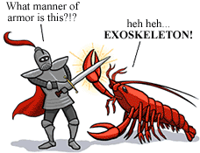
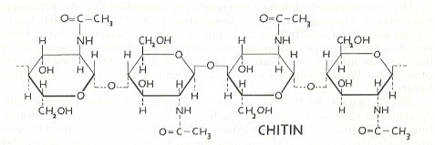
Polysaccharides - Structural
Animals
Plants
Chitin
In arthropod exoskeletons (crustaceans, insects and spiders) and fungal* cell walls
Cellulose
In cell walls
Most organisms lack enzymes to break down to use for energy…but it’s the FIBER that is so important in your diet!
*A fungus is not an animal
http://www.metafysica.nl/wings/chitin.jpg
http://evolution.berkeley.edu/evolibrary/article/arthropods_06

Slide 12
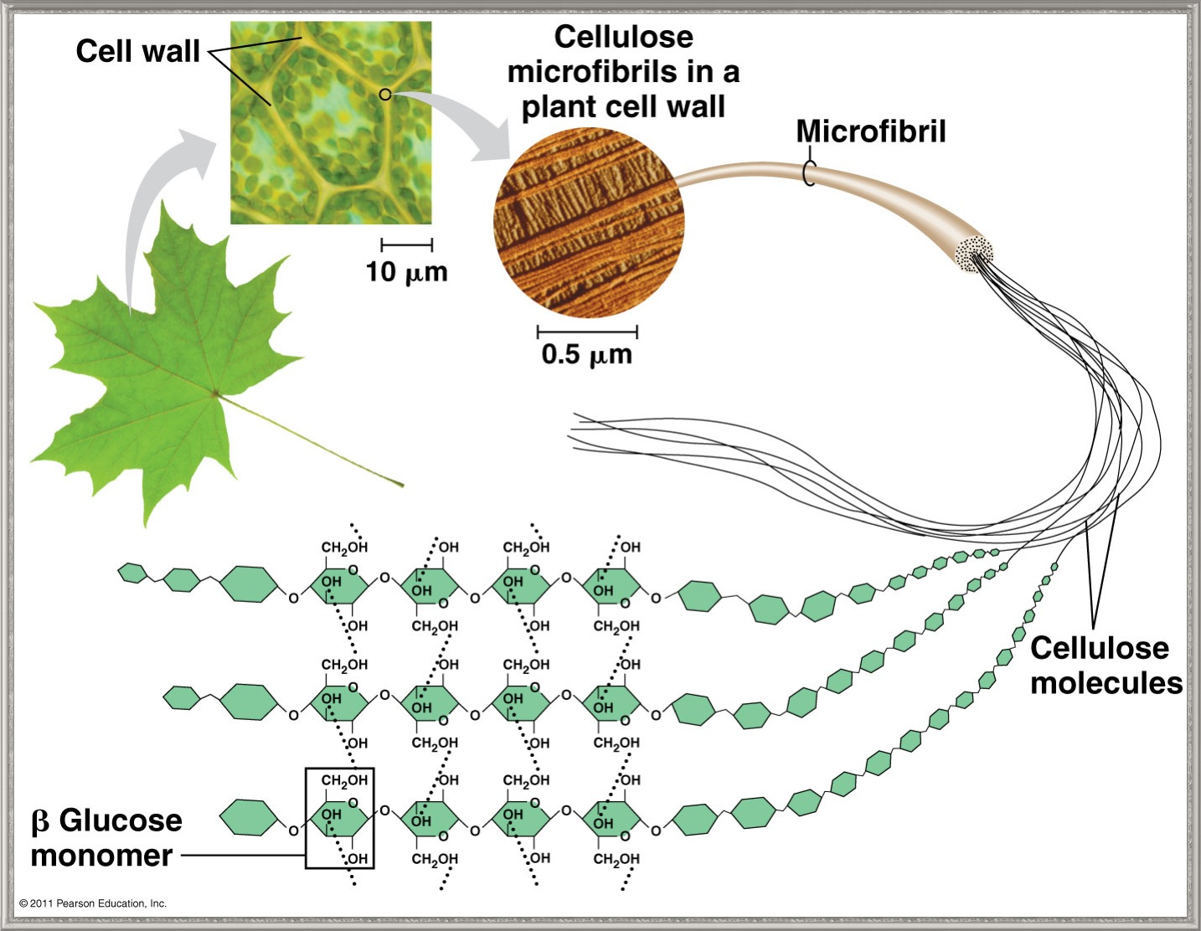
Polysaccharides - Structural
Both chitin and cellulose use modified glucose that form chains like strings of pearls.
http://dennisliu-biology.blogspot.com/2011/02/macromolecules-carbohydrates.html

Slide 13
Polysaccharides - Storage
We are storing Energy in the bonds between monomers.
Animals
Plants
Glycogen
Made and stored in animals
Stored in the liver and muscle tissue
Highly branched chains of glucose monomers
Starch
Made and stored in plants
Stored in seeds or specialized organelles
Branched chains of glucose monomers
Notes:
BONDS BETWEEN ATOMS STORE ENERGY. I know this may be a topic of debate because it’s an oversimplification…but that can come in chemistry right?
Starch - A plant storage polysaccharide . Two forms: amylose and amylopectin. Most starch is 10-30% amylose and 70-90% amylopectin. Branches provide a mechanism for quickly releasing (or storing) glucose units for (or from) metabolism.
Glycogen -The glucose storage device in animals. Glycogen constitutes up to 10% of liver mass and 1-2% of muscle mass. Glycogen is stored energy for the organism . Only difference from starch: number of branches.

Slide 14
We tend to use the words “sugar” and “starch” and “carbohydrate” loosely.
When we say a food is “high in carbohydrates” do we mean the food is high in “sugar” or “starch” or both?
Potatoes and bread “starchy” foods and are “high in carbohydrates” due to the starch they contain.
Fruits are “high in carbohydrates” but we would never say they were “starchy” - they contain almost all simple carbohydrates such as sucrose, fructose.
We tend to say “high in carbohydrates” for foods with a high level of the complex carbohydrates known as starch. And for foods that have high levels of the simplex carbohydrates, we tend to say they are “high in sugar”.
But sugar and starch are really the same thing! They’re both made from glucose.

Slide 15
Let’s Fill in Your Macromolecule Table for Carbohydrates!
(This table was at the end of your last set of notes)
Macromolecule | Carbohydrates
Types of atoms | Carbon, Hydrogen and Oxygen
Monomers made of | Monosaccharides
Function(s) | Energy Storage, or Cell Structure
Examples | Glucose, Lactose, Cellulose
Sketch | (sketch out a monosaccharide)

