Slide 1
Rules for Lab Drawings

Slide 2
Use white, unlined paper.
Always use a pencil and erase all changed work. Never use ink.

Slide 3
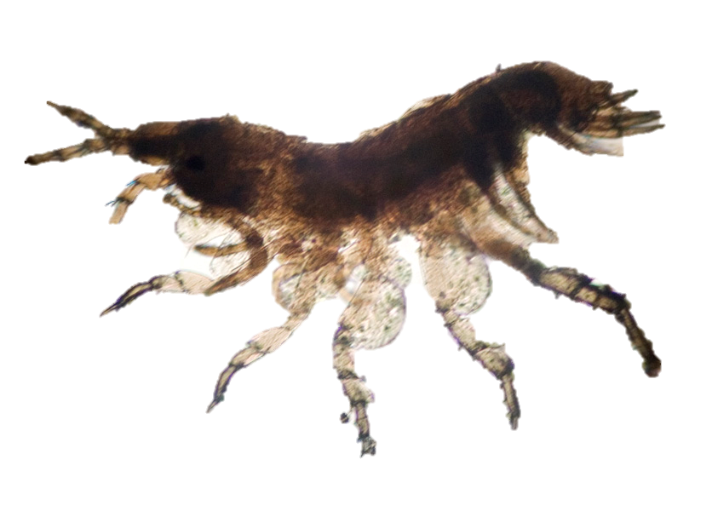
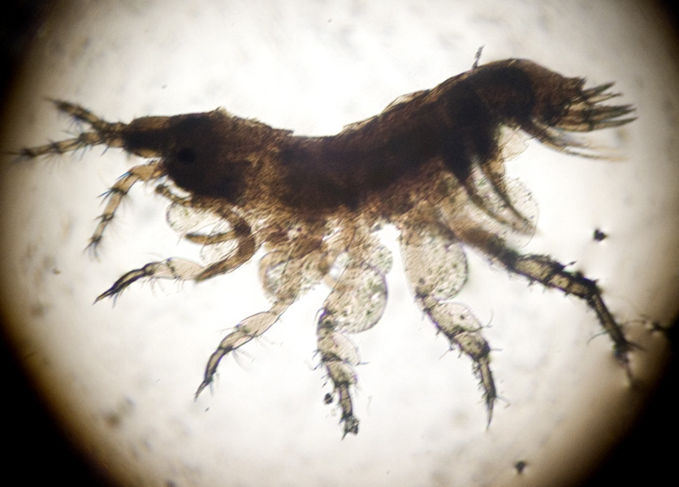
Never draw the circular field of view.
The object being drawn should be relatively large (each at least half a page) and slightly to the left of the page.
Draw what you see, as you see it. You are not necessarily drawing everything that is seen in the field of view. Draw only what is asked for.

Slide 4
Print a title above and to the left of the drawing.
The title should state:
what has been drawn, and
under what power of the microscope (total magnication) .

Slide 5
Pond Creature(40X)

Slide 6
Use a ruler to draw straight, horizontal lines to the right side of the drawing. The labels should form a vertical list.
All labels should be printed.

Slide 7
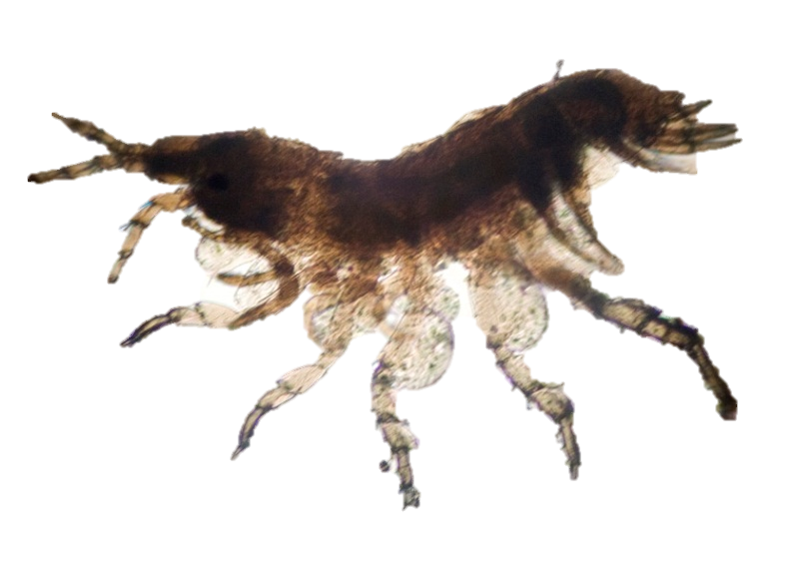
Pond Creature(40X)
Body
Leg

Slide 8
If on a separate piece of paper, print your name, class period, and date the drawing was made, in the top right corner of the page.

Slide 9
Pond Creature(40X) Ms Wieland Period 1-6 10/5/2012
Body
Leg

