Slide 1
Please write your name and you student’s name on the list circulating the room
This let’s me know who’s who!

Slide 2
Welcome to Biology!!!
Ms. Lauren Jean (LJ) Grant

Slide 3
A little about me
Bachelors in Science (Biology) from Western Washington University
Collected data (scat, mostly) for graduate research studies on otters and seals
Designed, tested, analyzed and presented undergraduate research on the Leopard Lizard

Slide 4
A little about me (cont.)
>6 years as a supervisor and manager
Mostly of teenagers and young adults!
Masters in Teaching from Seattle University
Student taught at Lake Washington High School
Fourth year here at Skyline
Absolutely stoked to be back!!!

Slide 5
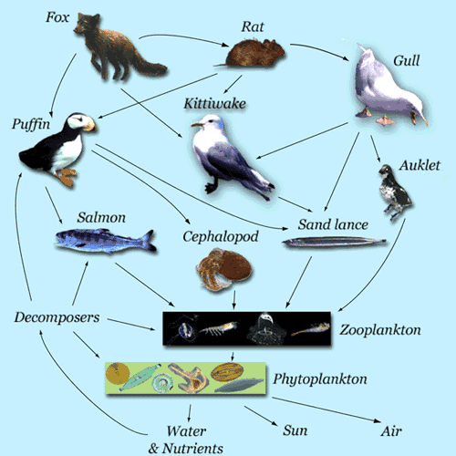
What your student will be doing this year
Macro Biology
Ecology
Ecosystems and Cycles
Classification
Organization of Organisms
Evolution
Darwin and Survival of the Fittest

Slide 6
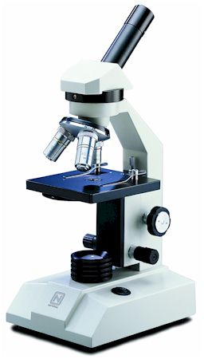
What will your student be doing this year (cont.)
Microbiology
Cells
Plant structure and function
Transport
Reproduction
Microscopy
Use and calculations
Genetics
DNA
Mendalian Genetics
Heredity Predictions
Photosynthesis/Respiration
Plant and Animal Survival and Growth

Slide 7
Biology End of Course Exam (EoC)
In June
Covers both content and lab skills
We will be preparing all year for the test so they should be ready
98% of my students last year passed!

Slide 8
How to keep up with our class
Website: msljgrant.com
Biology Main Page: Course expectations, textbook, and daily calendar.
Calendar: Agenda, Homework & Announcements
Unit Tabs: Notes, activities, and other files organized by topic
Home Page: Contact information for me and Skyline
FAQ: Frequently asked questions from students and parent
Check here when your students is absent!

Slide 9
How to help at home
Study, Review and Talk
Flash cards for vocab
Lab rubrics
Ask about our class!
Help Them Self-Advocate
Troubleshoot grades
Develop plans and solutions they can implement
Help draft emails to me or other adults

Slide 10
Contact
Email
grantl@Issaquah.wednet.edu
Most communication will be by email
I check my email until around 4pm, and periodically on weekends.
Phone
Office phone number: (425) 837-7824

Slide 11
Questions or Comments
Any questions, comments or concerns please write on the note cards at the front of the room
Thank you for coming, it was a pleasure to meet you!

