Slide 1
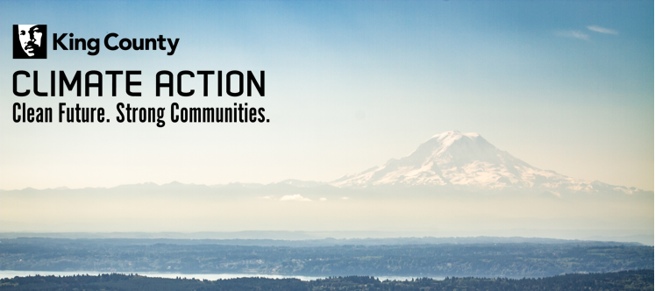
Project Drawdown Solutions that Align with King County Climate Action Plan

Slide 2
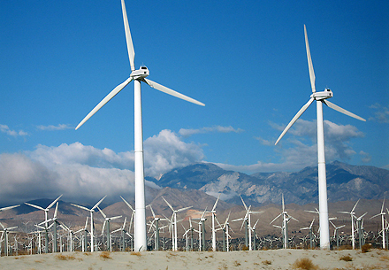
Wind Turbines (On Shore) #2
Wind turbines generate electricity by harnessing the power of moving air; the “on shore” refers to the turbines being located on land.

Slide 3
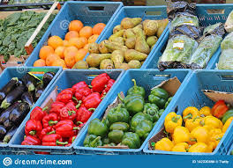
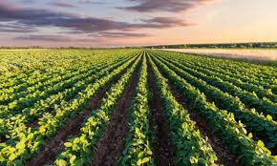
Reduced Food Waste #3
This solution suggests reducing the amount of food that is wasted during production (poor storage/equipment), retail (stores discarding food), and consumption (uneaten/looked over food).

Slide 4
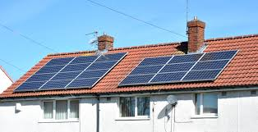
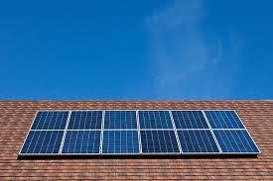
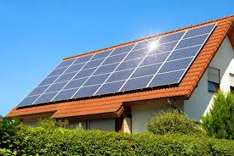
Rooftop Solar #10
Rooftop solar describes the introduction of solar panels mounted on the roofs of commercial or residential buildings to generate their power.

Slide 5
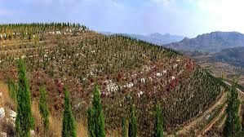
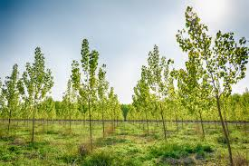
Afforestation #15
Afforestation, or the establishment of new forests, is critical for the sequestering of carbon and the production of oxygen.

Slide 6
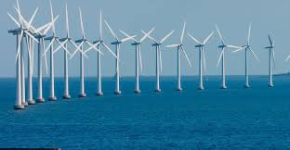
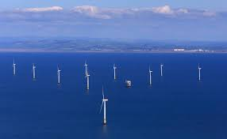
Wind Turbines (Off Shore) #22
Wind turbines generate electricity by harnessing the power of moving air; the “off shore” refers to the turbines being located at sea or other bodies of water.

Slide 7
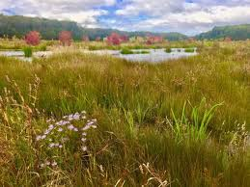
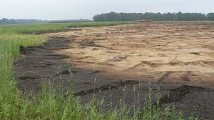
Farmland Restoration #23
A set of processes for restoring degraded, abandoned land to productivity and biosequestration.

Slide 8
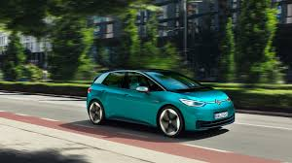
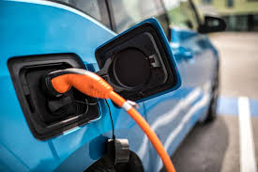
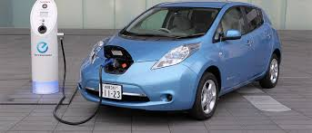
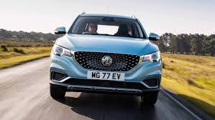
Electric Vehicles #26
The increased use of battery and plug-in hybrid vehicles as opposed to conventional internal combustion engine (ICE) cars.

Slide 9
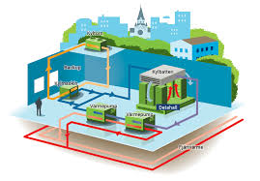
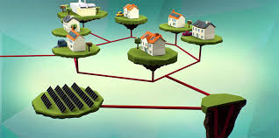
District Heating #27
A centralized heating system and the distribution of generated heat to the buildings of a defined community—through a network of buried pipes—to satisfy the demand for space and water heating.

Slide 10
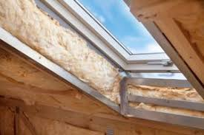
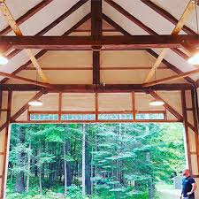
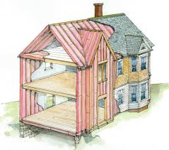
Insulation #31
The use of improved materials in building envelopes that resist heat flow and regulate indoor temperatures in order to minimize heat loss and save energy on heating.

Slide 11
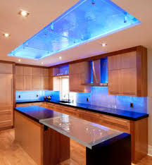
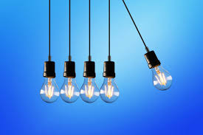
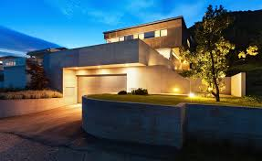
LED Lighting (Residential) #33
The use of efficient light-emitting diodes (LEDs) in residential buildings as opposed to conventional lighting methods.

Slide 12
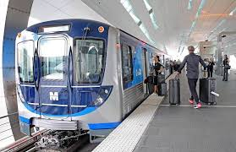
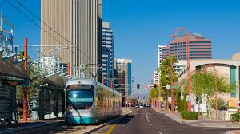
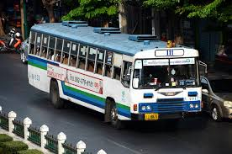
Mass Transit #37
The increased usage of mass transit or public transport to get around cities as opposed to conventional internal combustion engine (ICE) cars.

Slide 13
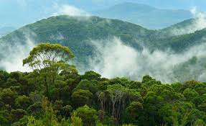
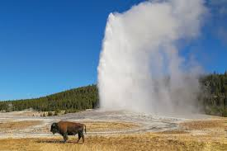
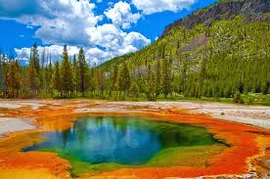
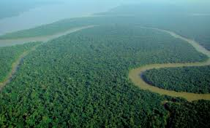
Forest Protection #38
The legal protection of forest lands, leading to reduced deforestation rates and the safeguarding of carbon sinks.

Slide 14
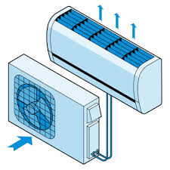
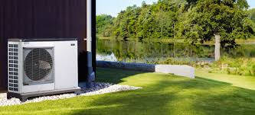
Heat Pumps #42
High-efficiency electrical devices that harvest latent heat from ambient sources such as the ground, air, or water for use in the conditioned space.

Slide 15
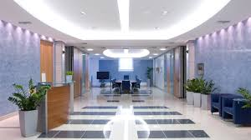
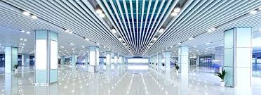
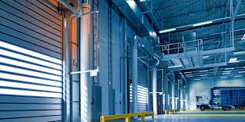
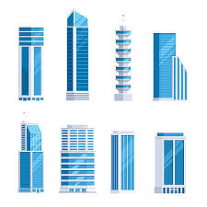
LED Lighting (Commercial) #44
The use of efficient light-emitting diodes (LEDs) in commercial buildings as opposed to conventional commercial lighting solutions (bulbs, ballasts, and systems), such as incandescent or fluorescent lighting.

Slide 16
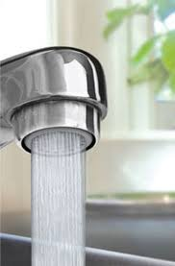
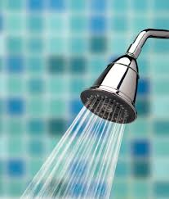
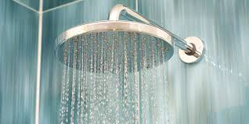
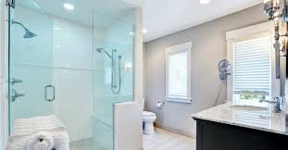
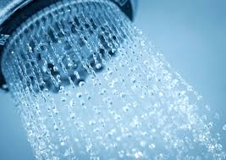
Water Saving Home #46
The use of low-flow fixtures and pressure regulators in the household instead of the use of conventional taps and showerheads.

Slide 17
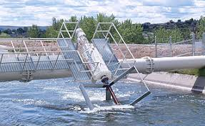
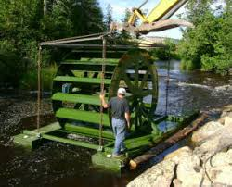
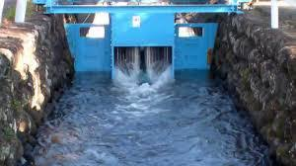
Instream Hydro #48
Using small-scale hydropower technologies to replace conventional electricity-generating technologies such as coal, oil, and natural gas power plants.

Slide 18
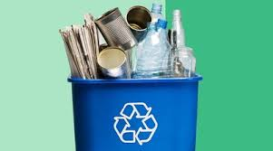
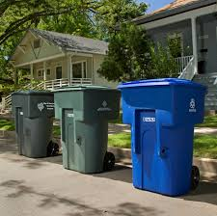
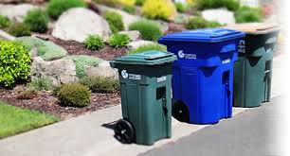
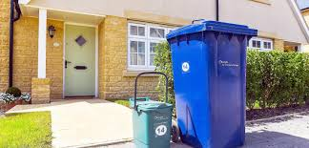
Household Recycling #55
The increased recovery of recyclable materials, not including paper nor organic materials, from the residential sector of the economy.

Slide 19
Industrial Recycling #56
The increased recovery of recyclable materials, not including paper and not including organic materials, from the commercial and industrial sector of the economy.

Slide 20
High Speed Rail #66
Track construction for increased use of high-speed rail for intercity travel replacing other forms of travel, such as by airplane and by internal combustion engine (ICE) car.

Slide 21
Farmland Irrigation #67
A set of energy-efficient irrigation practices that reduce agricultural water consumption while avoiding emissions.

Slide 22
Electric Bikes #69
The increased use of electric bikes for urban travel as opposed to the use of internal combustion engine (ICE) cars.

Slide 23
Recycled Paper #70
The increased recovery and reprocessing of used paper into paper products.

Slide 24
Water Distribution #71
Reducing water leakage or oversupply of regional water, which reduces pumping and pressurization electricity and associated greenhouse gas emissions.

Slide 25
Ride Sharing #75
Increased ridesharing when commuting in North America, which is essentially carpooling: “the sharing of a car trip by the driver with a non-driver.”

Slide 26
Net Zero Buildings #79
New buildings that utilize high-efficiency building solutions and on-site renewable energy systems to consume zero energy from utility-scale sources and produce net zero carbon emissions on an annual basis.

Slide 27
Retrofitting #80
The renovation of building components (including building envelope, appliances, and controls) to include high-efficiency solutions.

