Slide 1
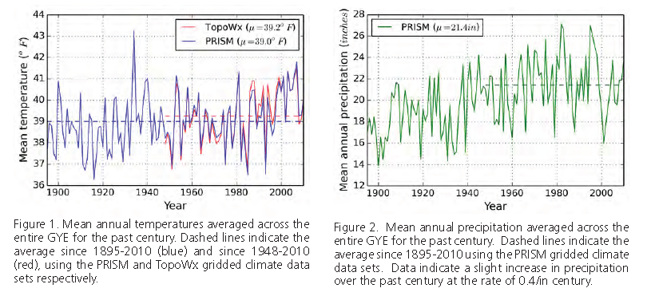
From: Yellowstone Science: Ecological Implications of Climate Change on the Greater Yellowstone Ecosystem. Volume 23, Issue 1. March 2015

Slide 2
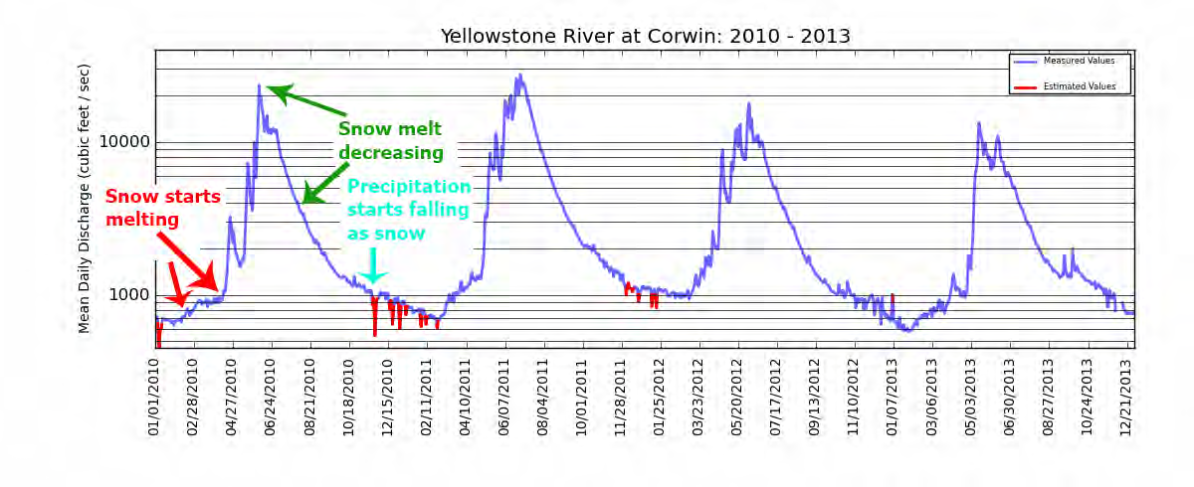
Mean daily stream flow on the Yellowstone River at Corwin Springs, Montana, 2010–2013. The y-axis is logarithmic, meaning each major division is 10 times greater than the previous (e.g., 1,000 vs. 10,000). Data source: U.S. Geological Survey.
From: Yellowstone Science: Ecological Implications of Climate Change on the Greater Yellowstone Ecosystem. Volume 23, Issue 1. March 2015

Slide 3
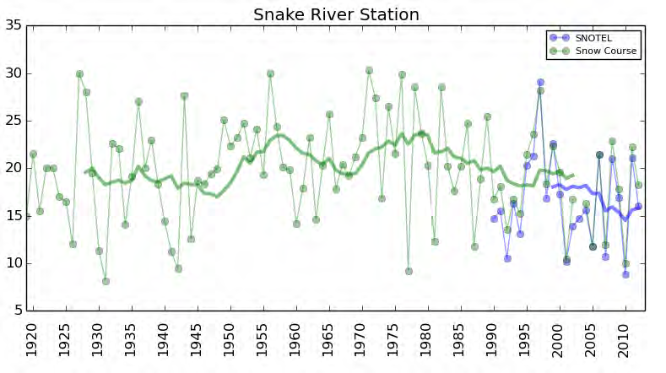
Snow course and SNOTEL data collected at Snake River Station (south gate), Yellowstone National Park. Green circles represent snow course measurements from 1920 to 2012 and blue circles are automated SNOTEL measurements from 1988 to 2012. Ten-year running averages (heavy lines) are calculated as the average of the current year and the previous nine years.
From: Yellowstone Science: Ecological Implications of Climate Change on the Greater Yellowstone Ecosystem. Volume 23, Issue 1. March 2015

Slide 4
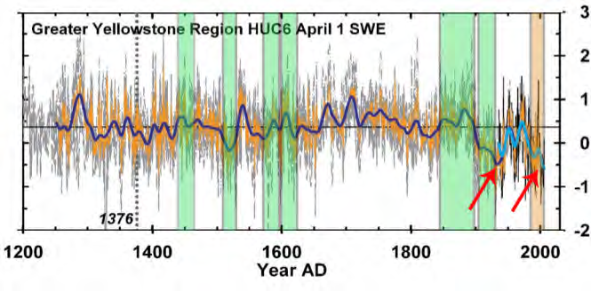
April 1 SWE reconstructed from tree rings, taken from Pederson et al. 2011b. Red arrows (added by authors) point out the 1930s and the 2000s which had the lowest snowpack in 800 years. The y-axis is expressed as z-scores, which are the number of standard deviations that a measurement departs from the long-term average.
From: Yellowstone Science: Ecological Implications of Climate Change on the Greater Yellowstone Ecosystem. Volume 23, Issue 1. March 2015

Slide 5
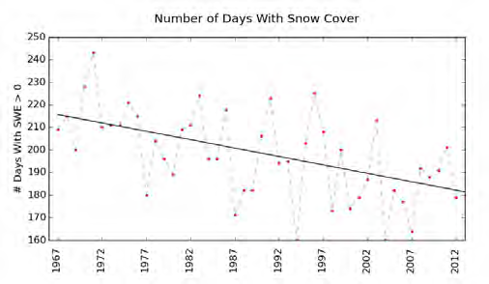
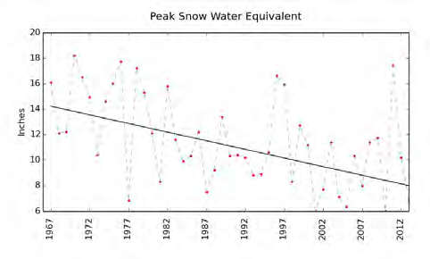
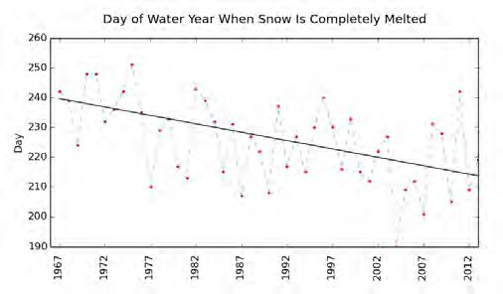
Winter trends at Yellowstone’s Northeast Entrance, 1966 to 2013. The x-axes show water-years, which run from October 1 to September 30 of the next year. The y-axis on the bottom-right graph shows the number of days after the start of each water year (e.g., day 240 in the bottom right graph would be May 29 in a non-leap-year).
From: Yellowstone Science: Ecological Implications of Climate Change on the Greater Yellowstone Ecosystem. Volume 23, Issue 1. March 2015

Slide 6
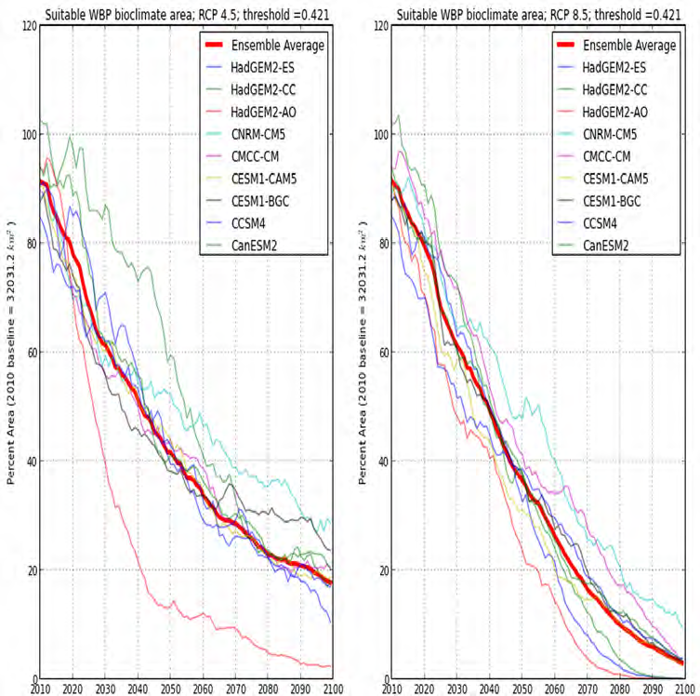
Bioclimate projections for whitebark pine for 2010 to 2099 under 30-year moving averaged climates under nine Global Climate Models for a moderate climate warming scenario (left) and a more extreme scenario (right). From Chang et al. (2014).
From: Yellowstone Science: Ecological Implications of Climate Change on the Greater Yellowstone Ecosystem. Volume 23, Issue 1. March 2015

Slide 7
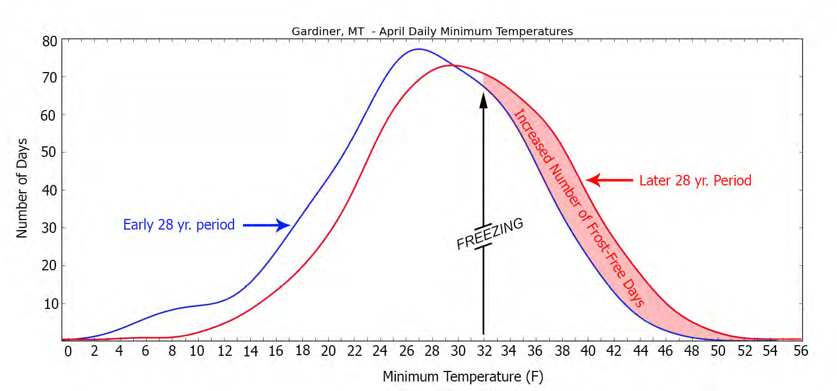
From: Yellowstone Science: Ecological Implications of Climate Change on the Greater Yellowstone Ecosystem. Volume 23, Issue 1. March 2015

Slide 8
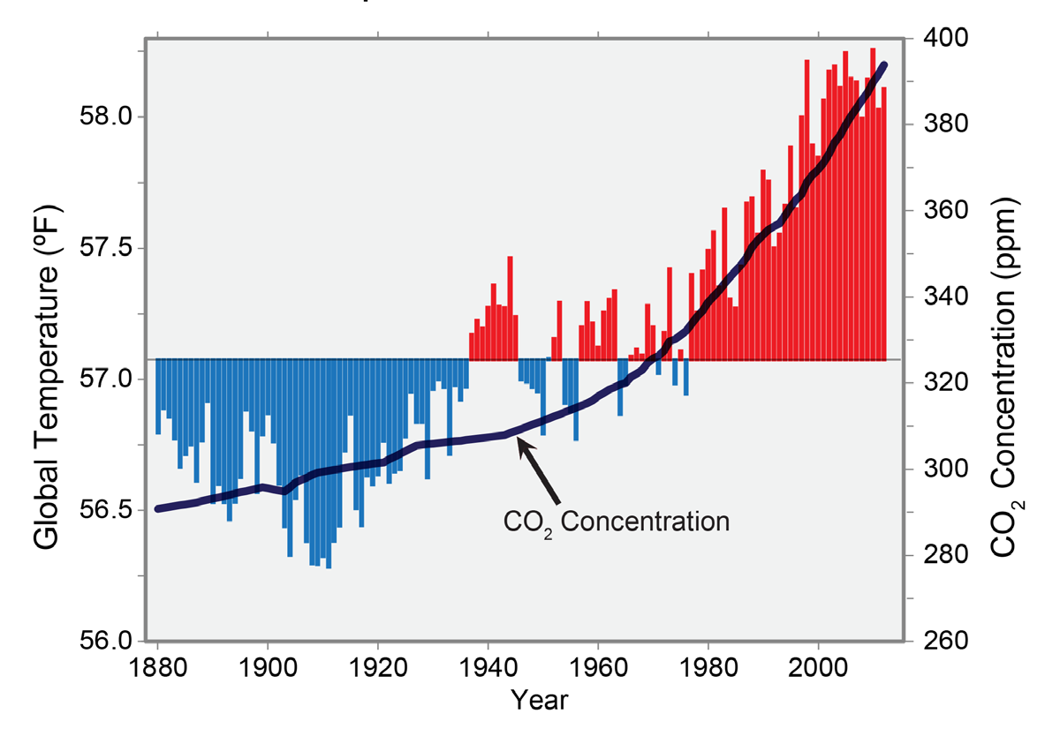
From the U.S. National Climate Assessment: U.S. Global Change Research Program

Slide 9
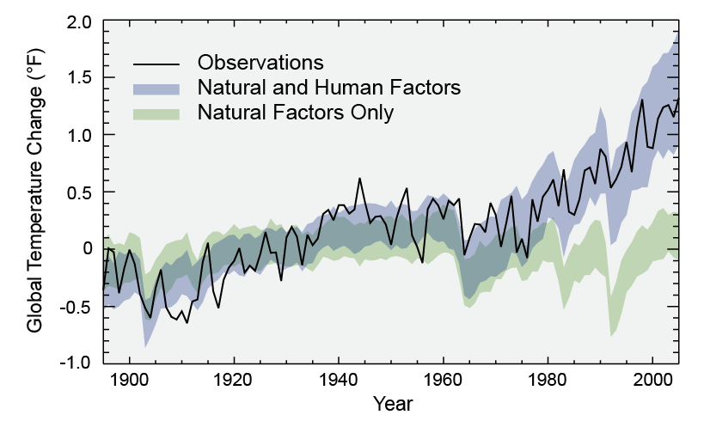
From the U.S. National Climate Assessment: U.S. Global Change Research Program

